Slide 1

2025
Cycle C
CASE REVIEW

Slide 2
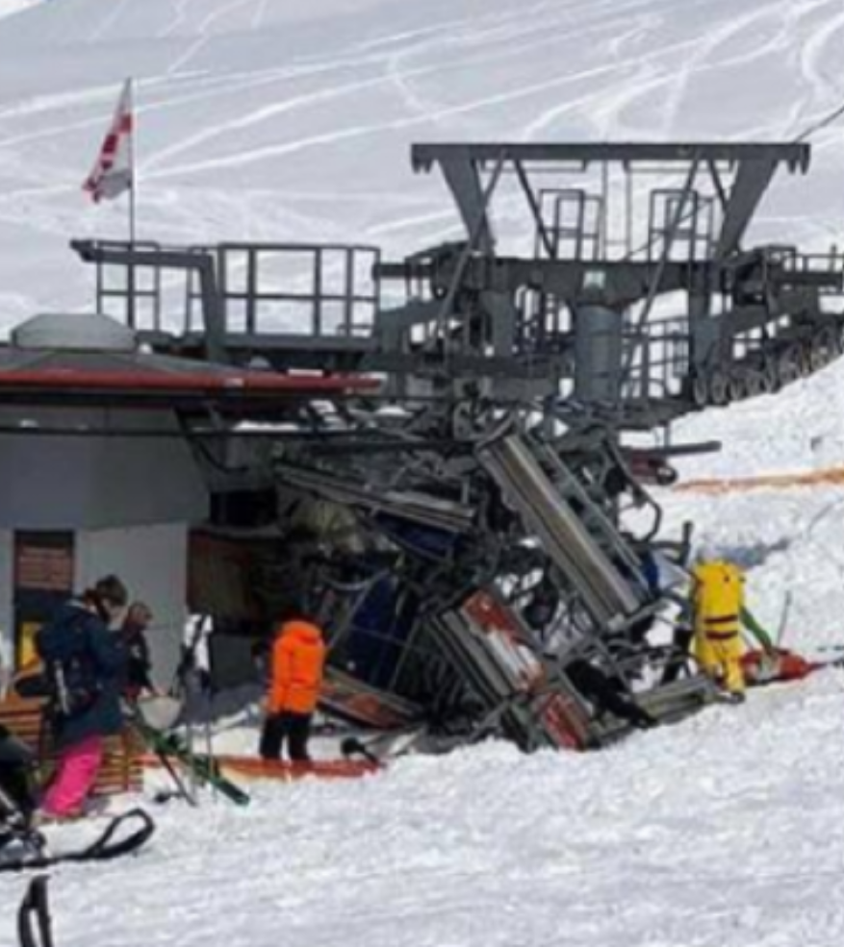
“Please respond to a multi-casualty incident at the base of Black Bear Chairlift…”
The chairlift accident a very short distance from your location.
You are the single primary responder.
You observe 4-5 chairs in a pile at the bottom of the lift.
People are panicked and screaming.
It appears several people have jumped or fallen off the lift just uphill of the loading area.

Slide 3
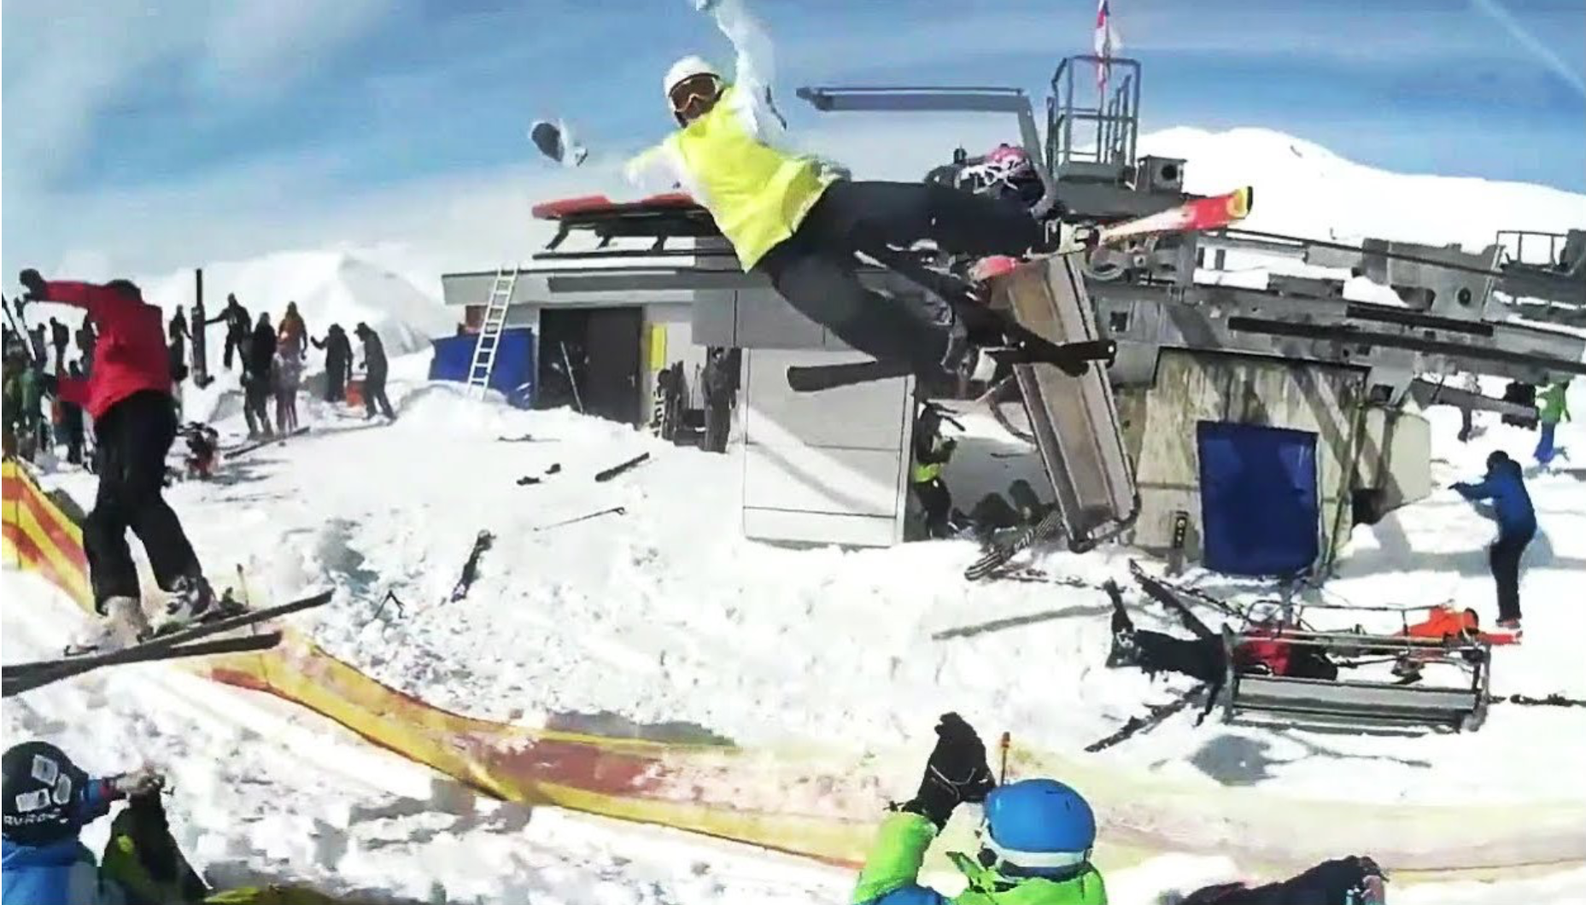
Scene safety. Locked out/tagged out the lift?
Calling for additional help? Who might you call?
How to convey the magnitude of the incident to responding Emergency Services?
Addressing those patrons still on the lift?
From experience, you know that Police, Fire and Ambulances will not arrive for another 15 minutes.
Beyond treating and triaging patients, what additional considerations do you need to consider?

Slide 4
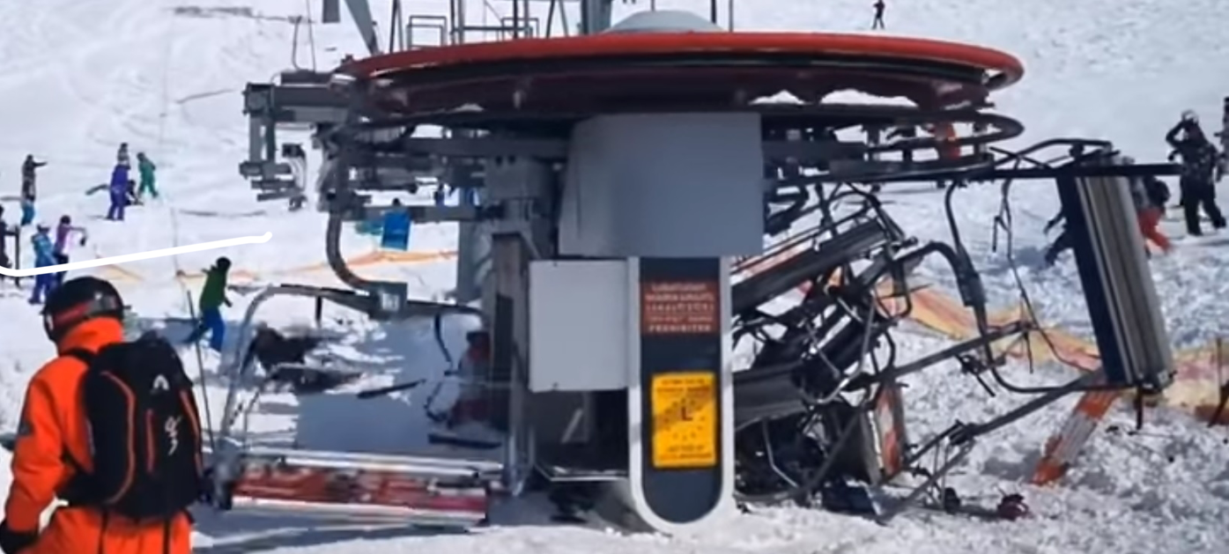
The chair derailment resulted in 12 patients.

Slide 5
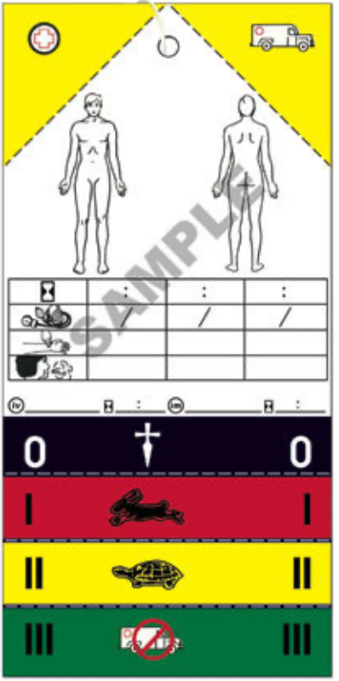
SALT Triage

Slide 6
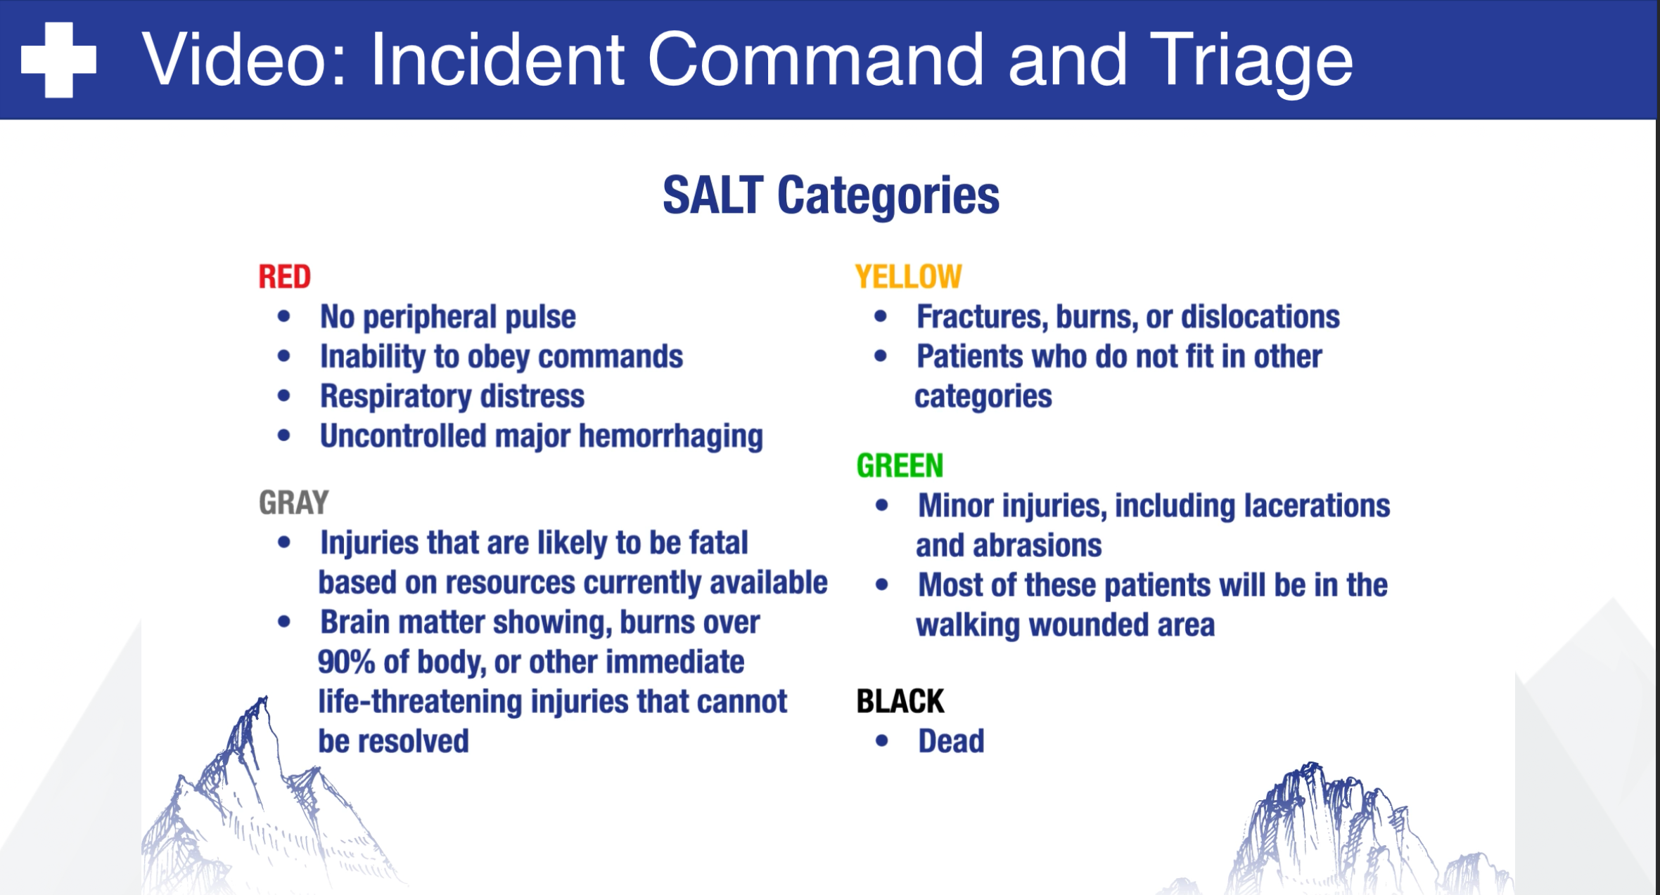

Slide 7
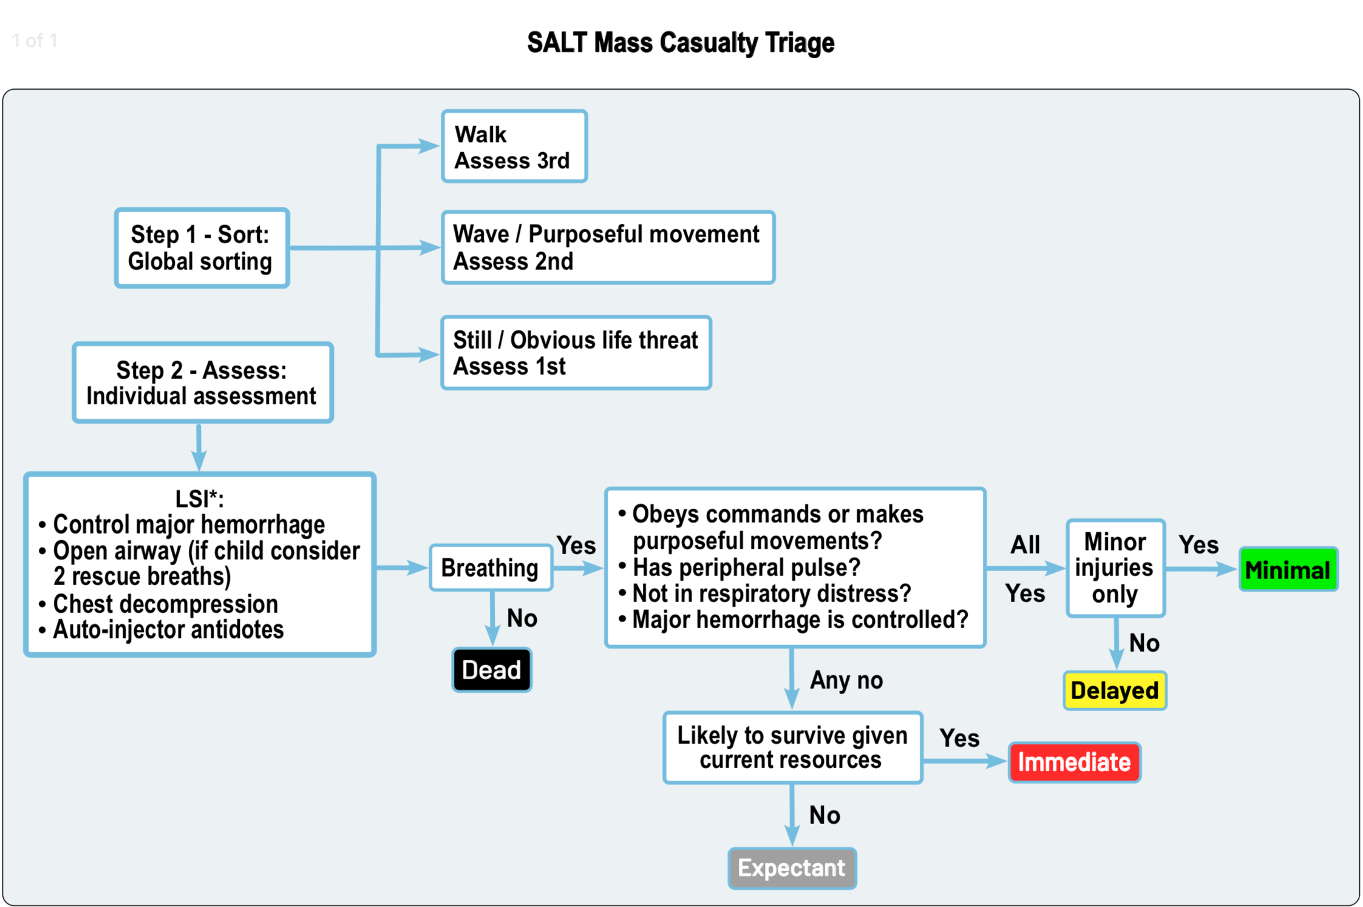

Slide 8
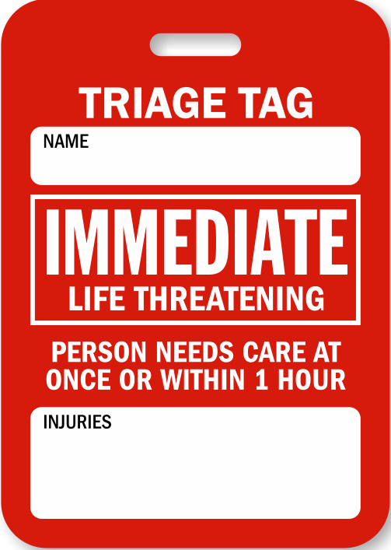
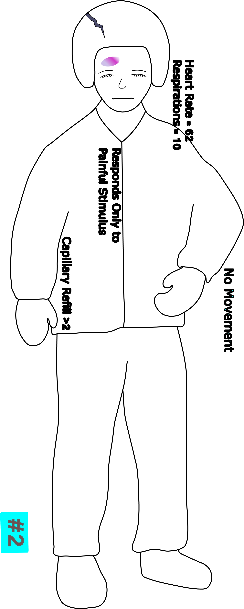
PATIENT # 1:
Responsive to painful stimuli
Helmet cracked, large contusion on forehead
R = shallow,
P = present, CR > 2

Slide 9
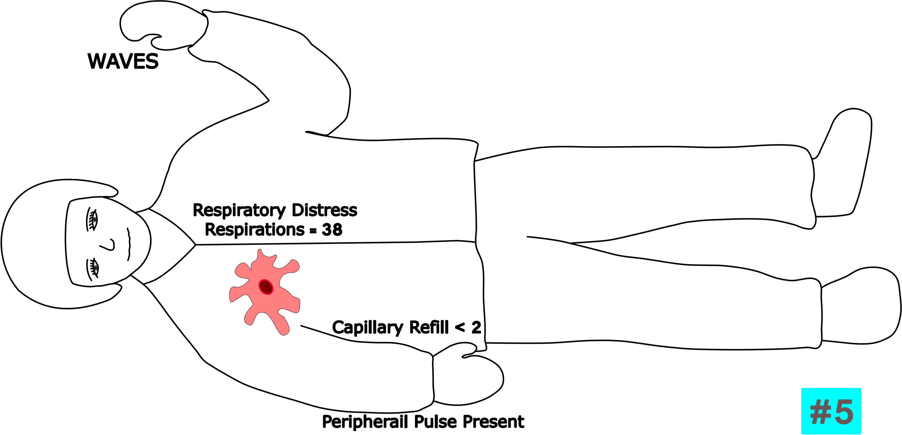
PATIENT # 2:
Sucking chest wound injury
R > 30/minute
P = rapid, CR > 2

Slide 10
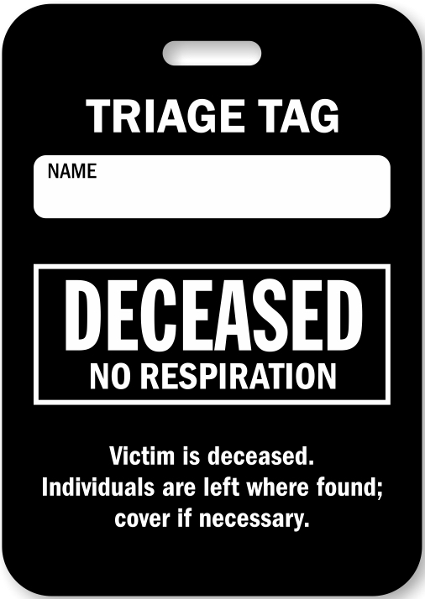
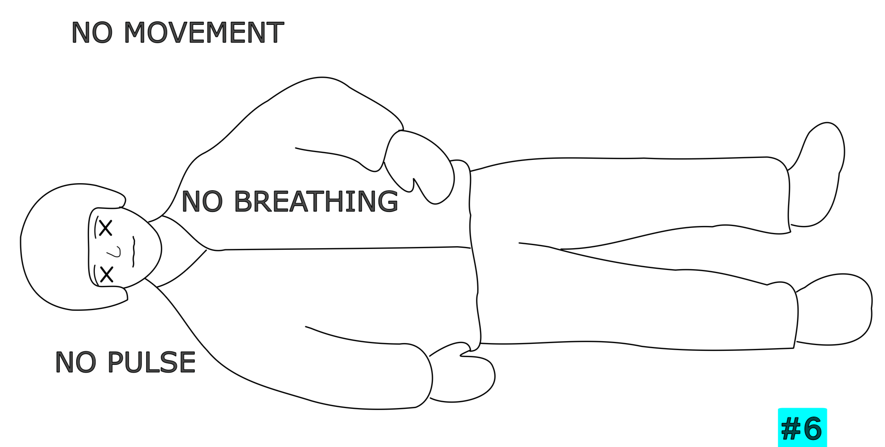
PATIENT # 3:
Unresponsive
R = 0
P = 0

Slide 11
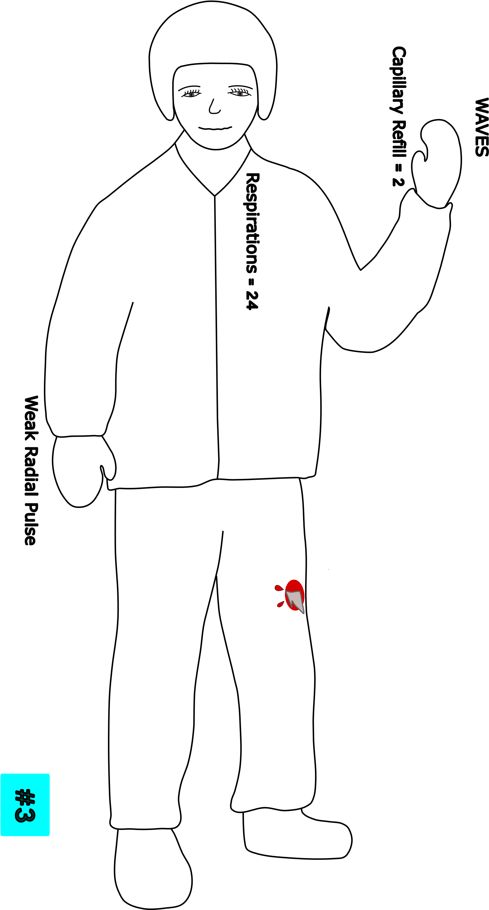
PATIENT # 4:
Fully alert
Pain in mid shaft femur
R < 30
P = rapid, CR > 2

Slide 12
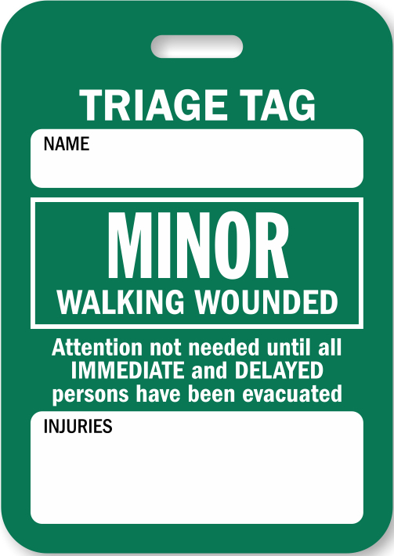
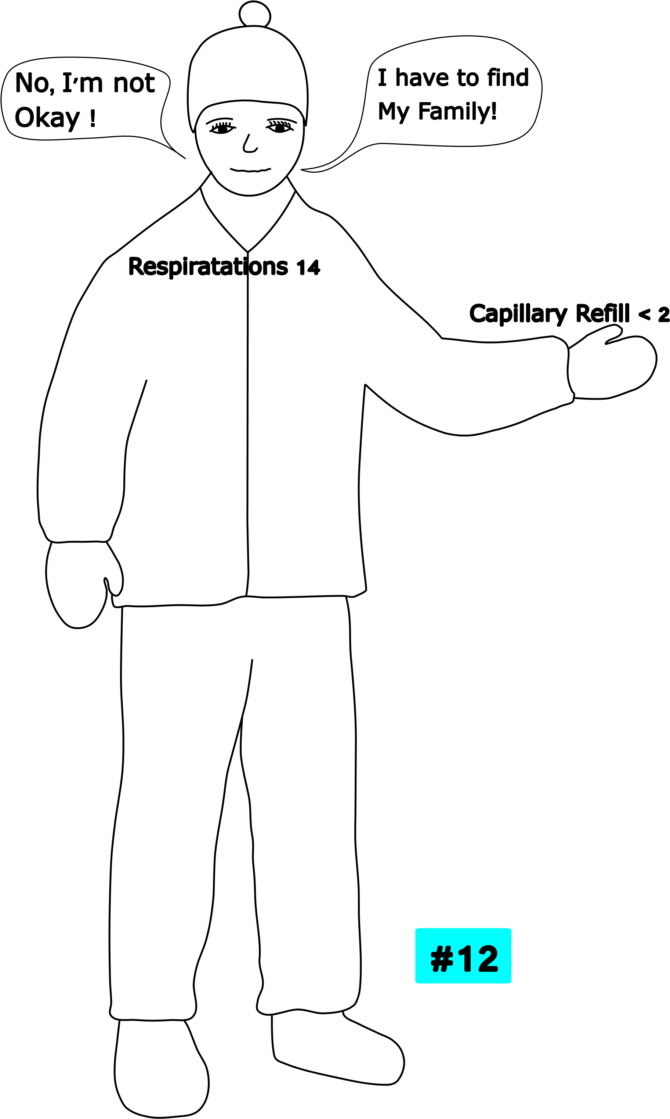
PATIENT # 5:
Alert
No apparent injury
R < 30
P = present, CR < 2

Slide 13

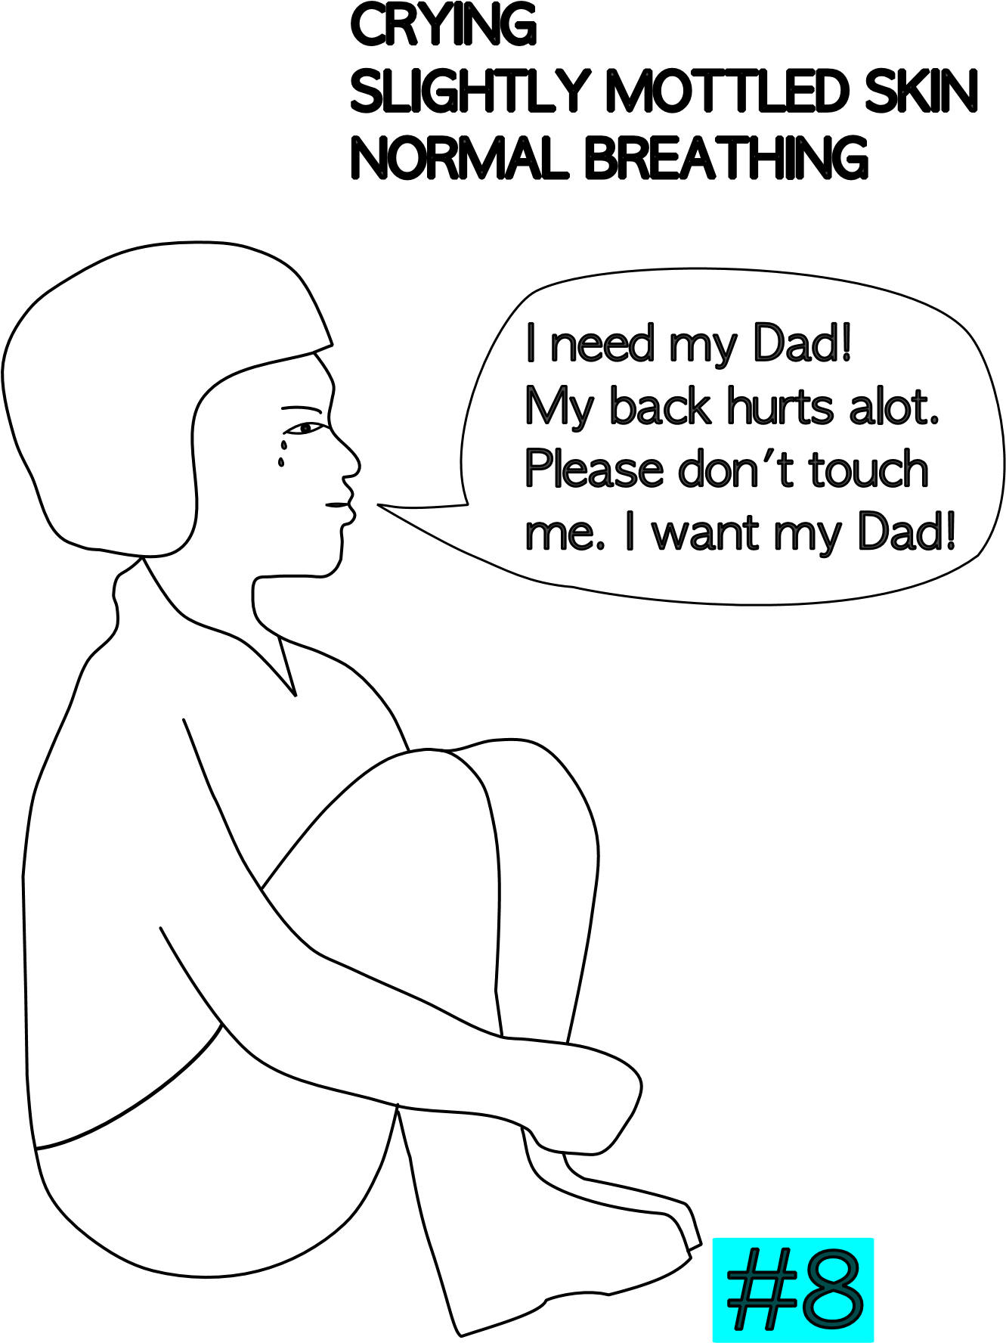
PATIENT # 6:
Pediatric patient
Landed sitting up
C/o severe back pain
R < 30
P= present, CR < 2
Able to follow simple commands

Slide 14
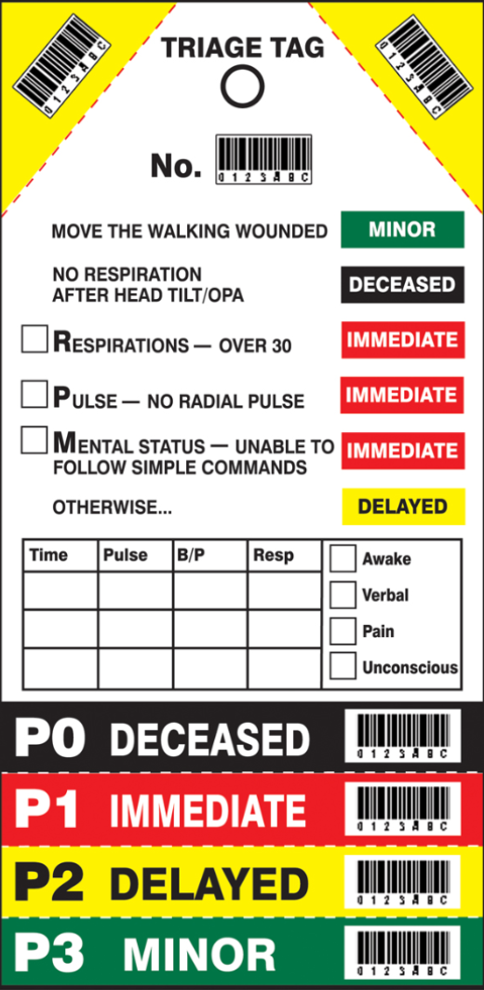
START Triage

Slide 15
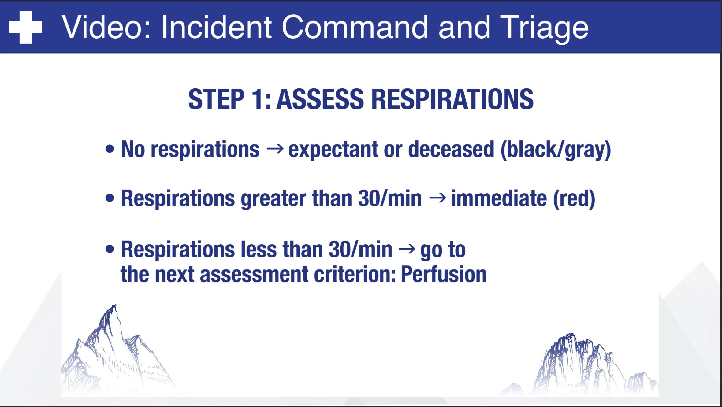

Slide 16
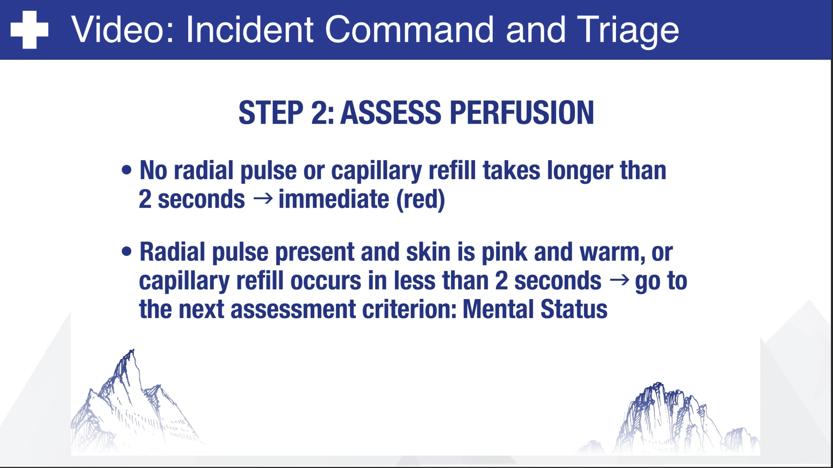

Slide 17
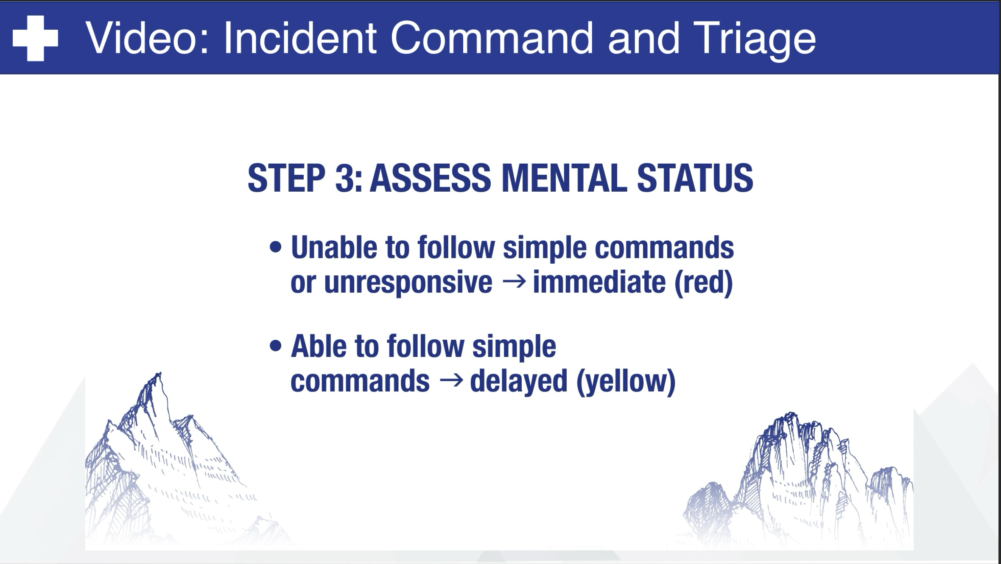

Slide 18
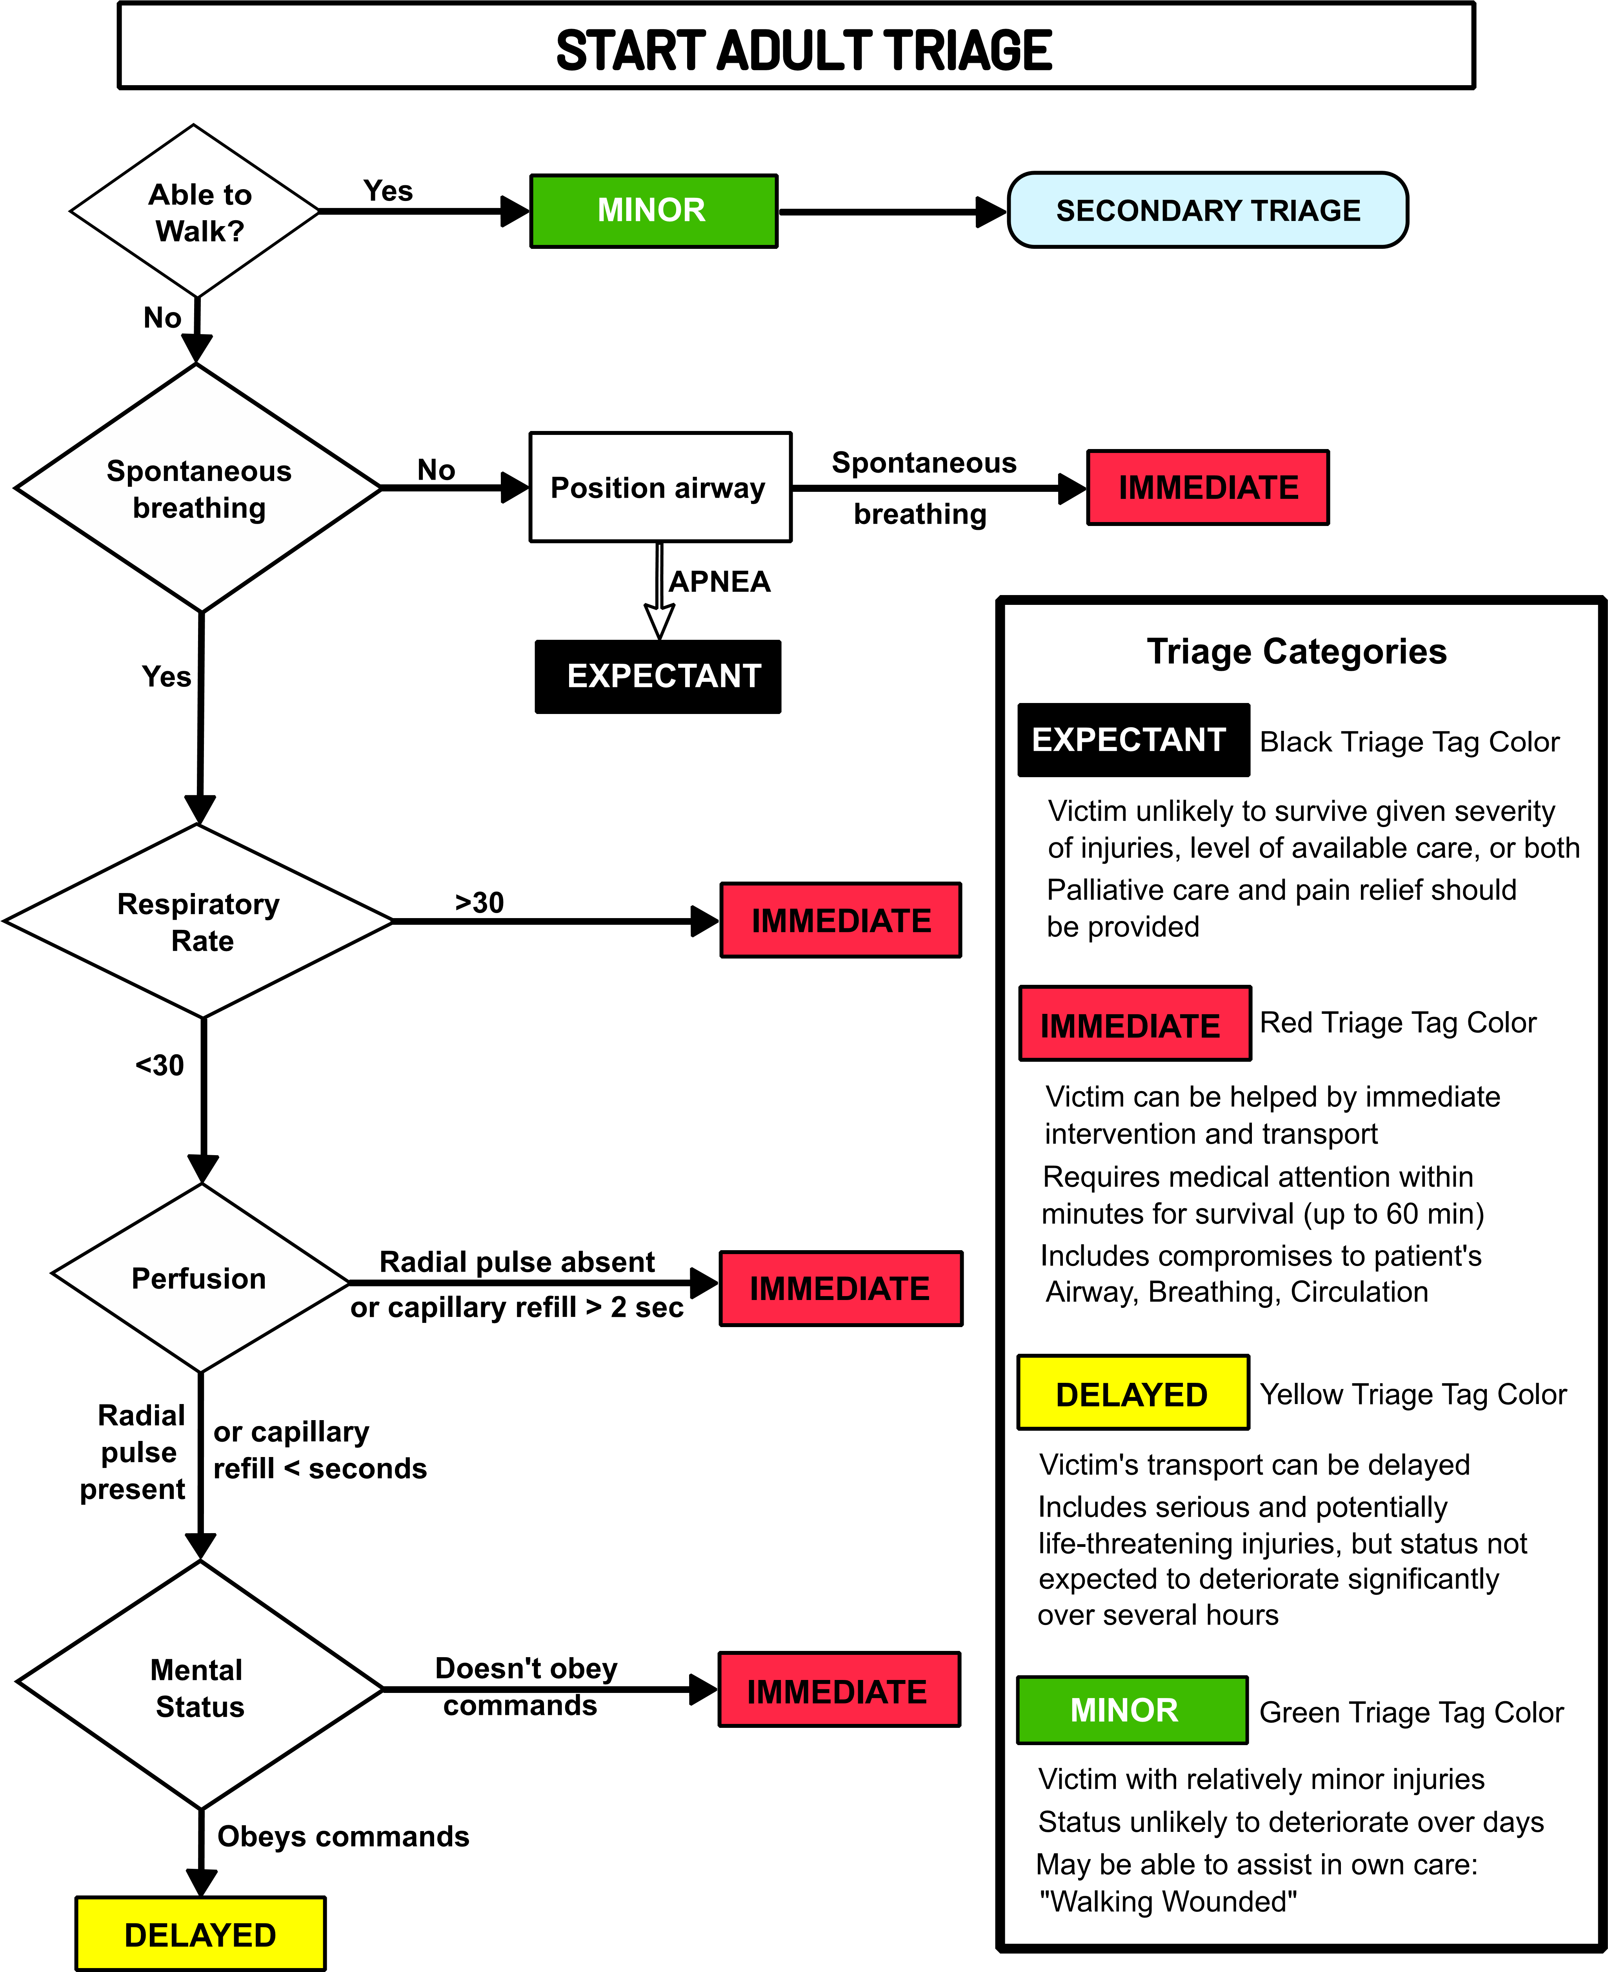

Slide 19
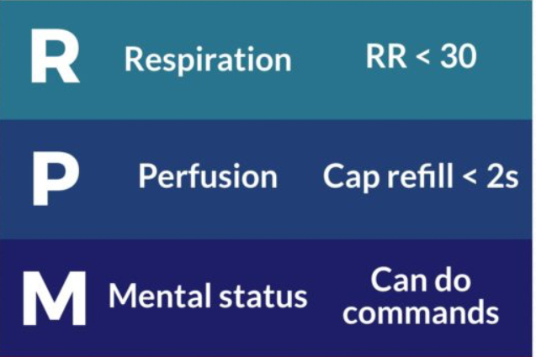

Slide 20
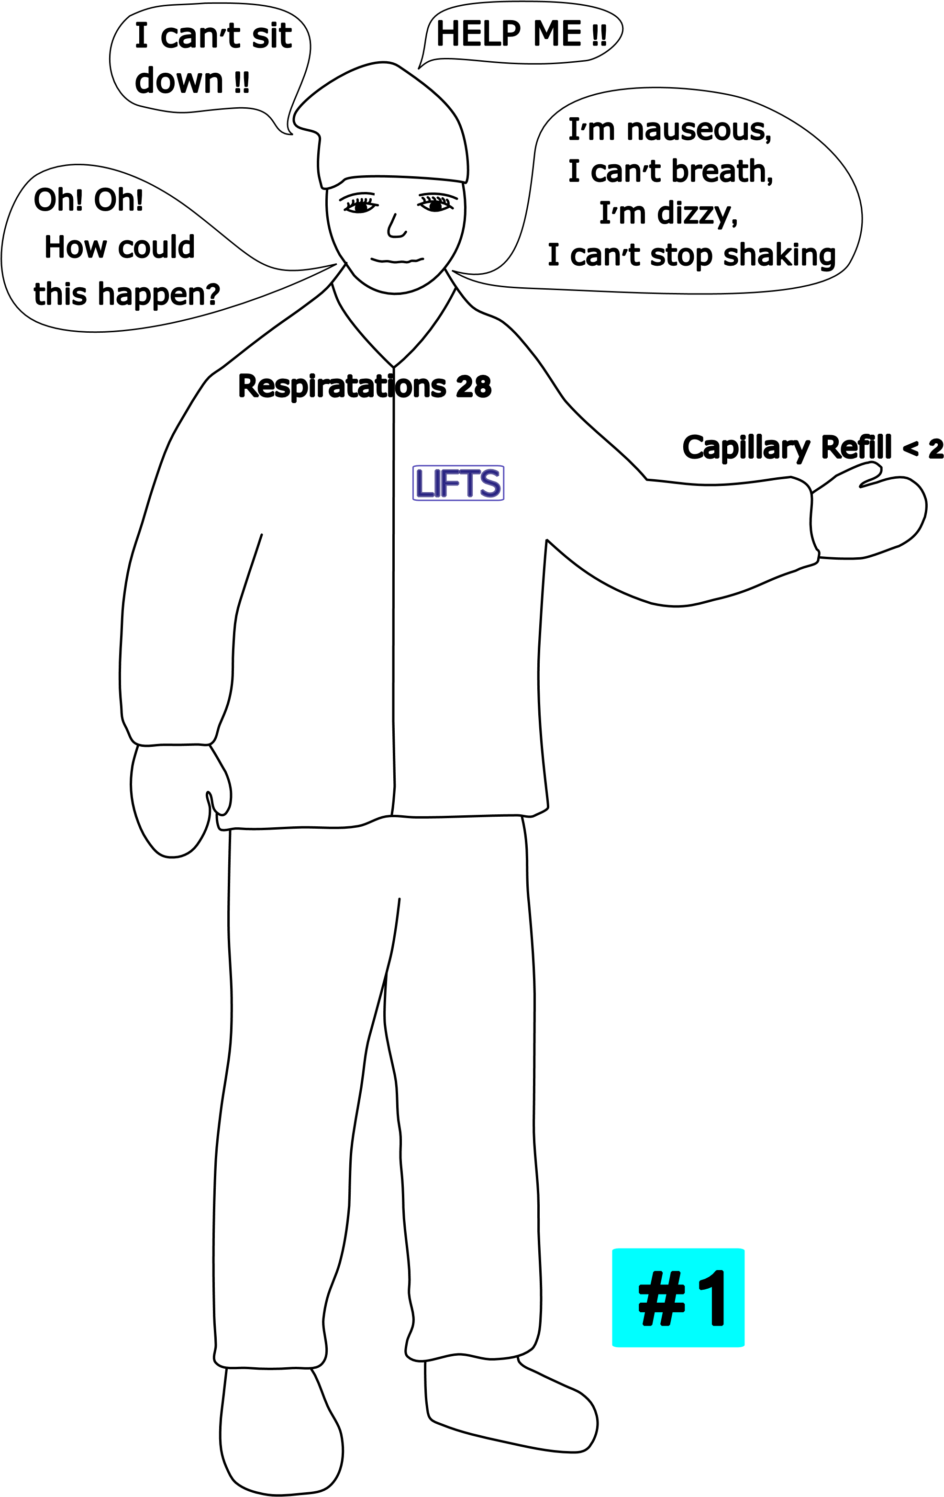
PATIENT # 7:
Lift attendant
Panic attack seeing chairs falling off.
Unable to focus, hysterical
Follows directions

Slide 21
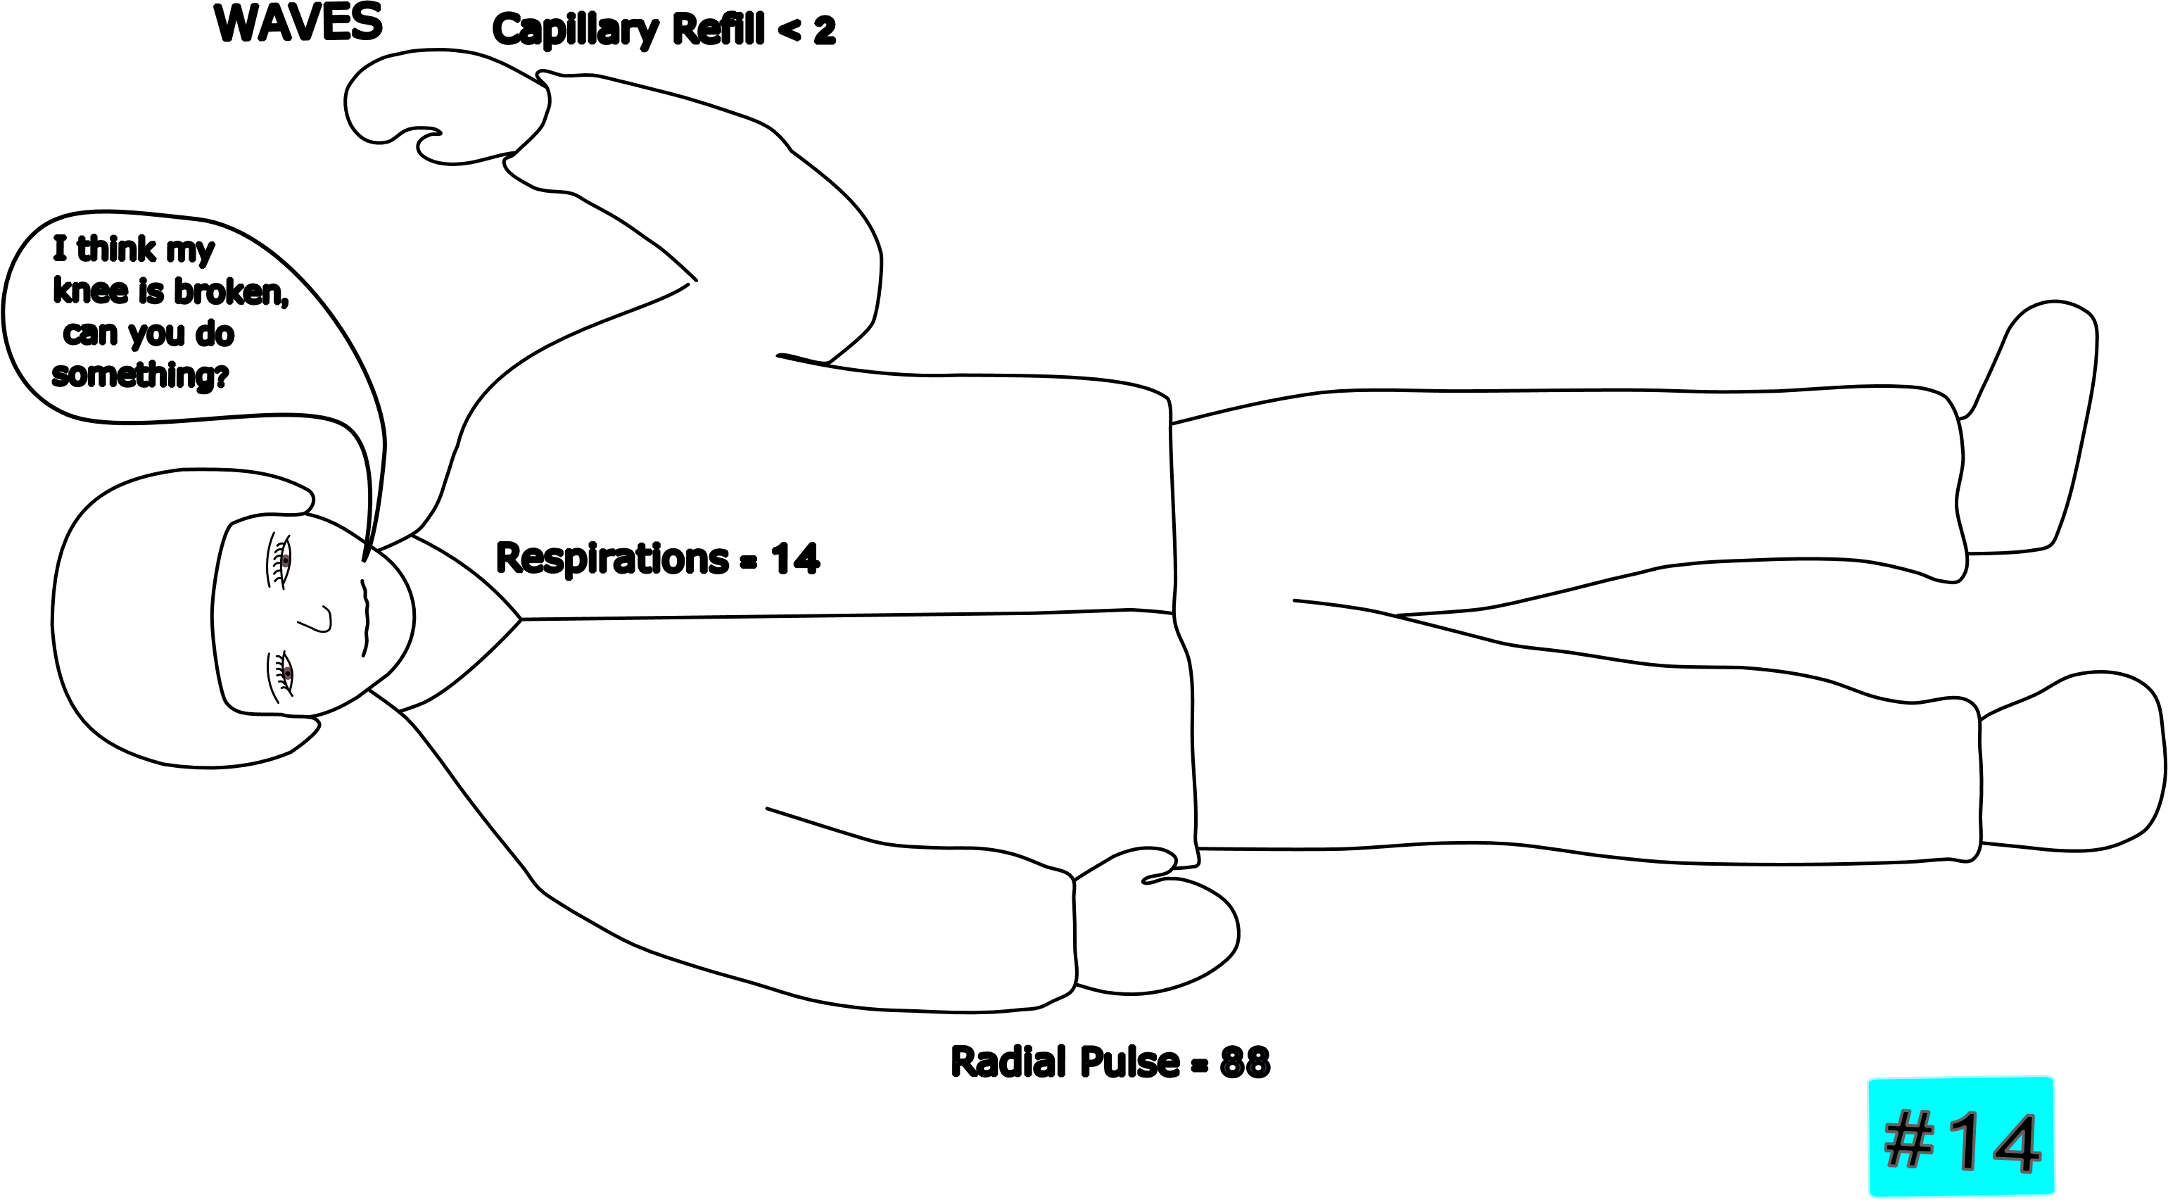
PATIENT # 8:
Fully alert
Knee pain
R < 30
P= present, CR < 2

Slide 22
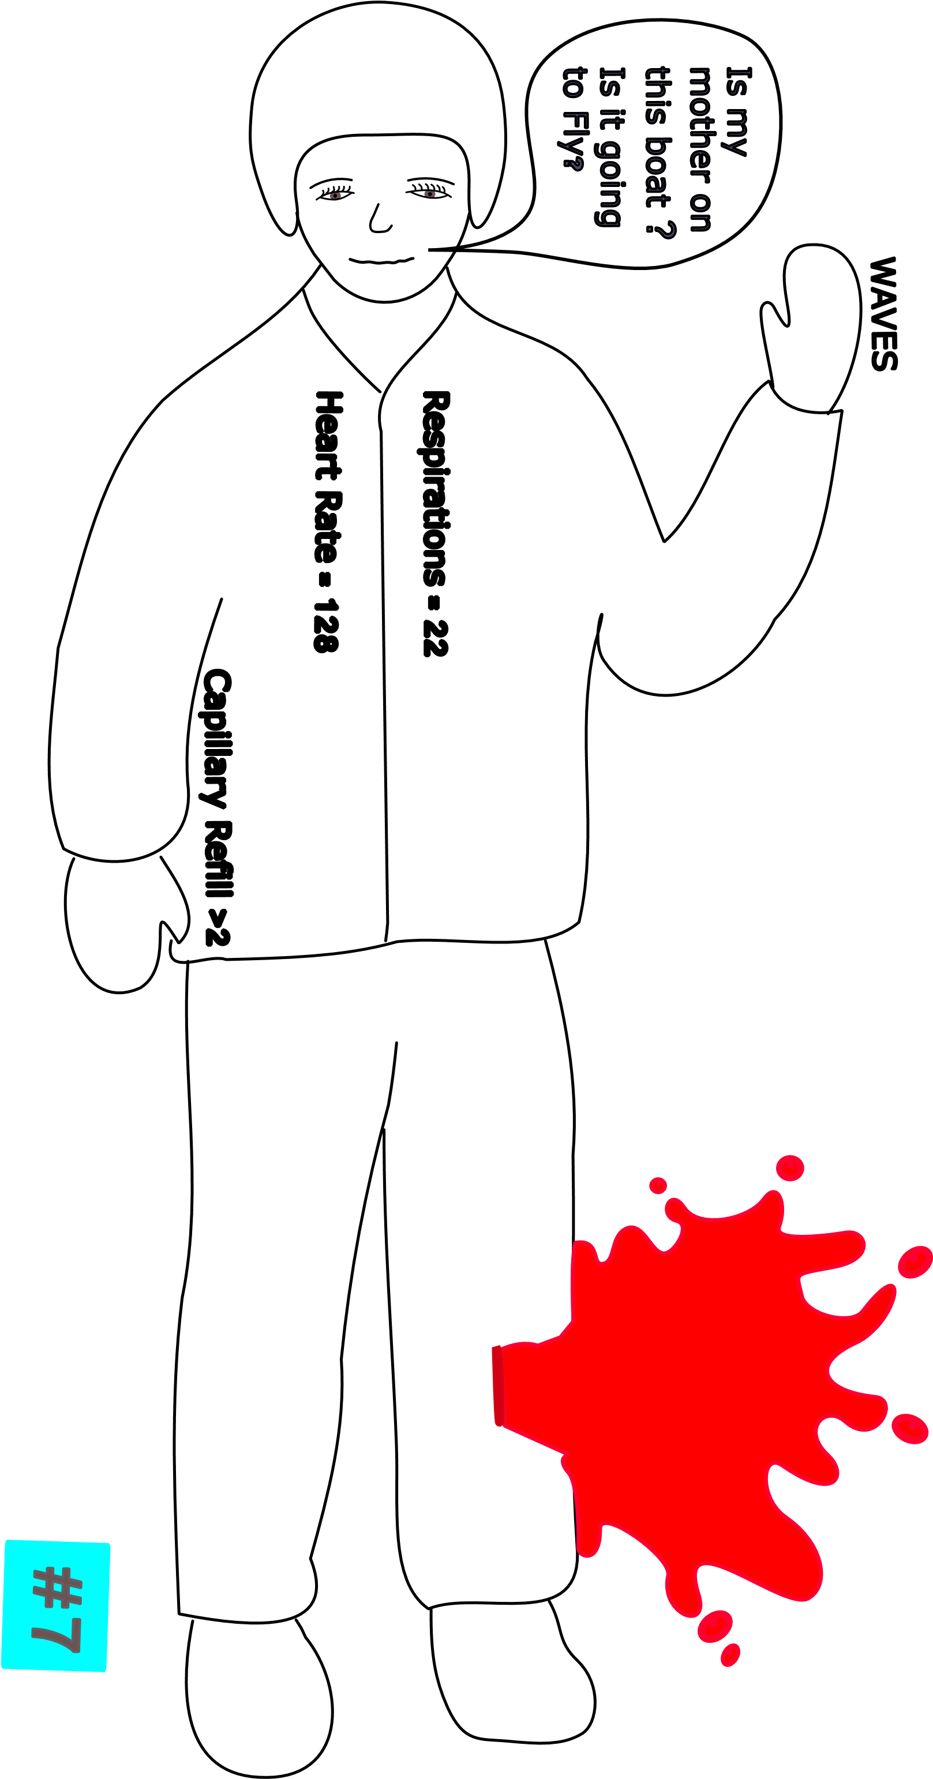
PATIENT # 9:
Severe laceration just below the knee
Profuse bleeding (tourniquet)
R > 30
P = rapid, CR > 2

Slide 23

PATIENT # 10:
Alert
Bruised ribs R < 30
P = present, CR < 2

Slide 24
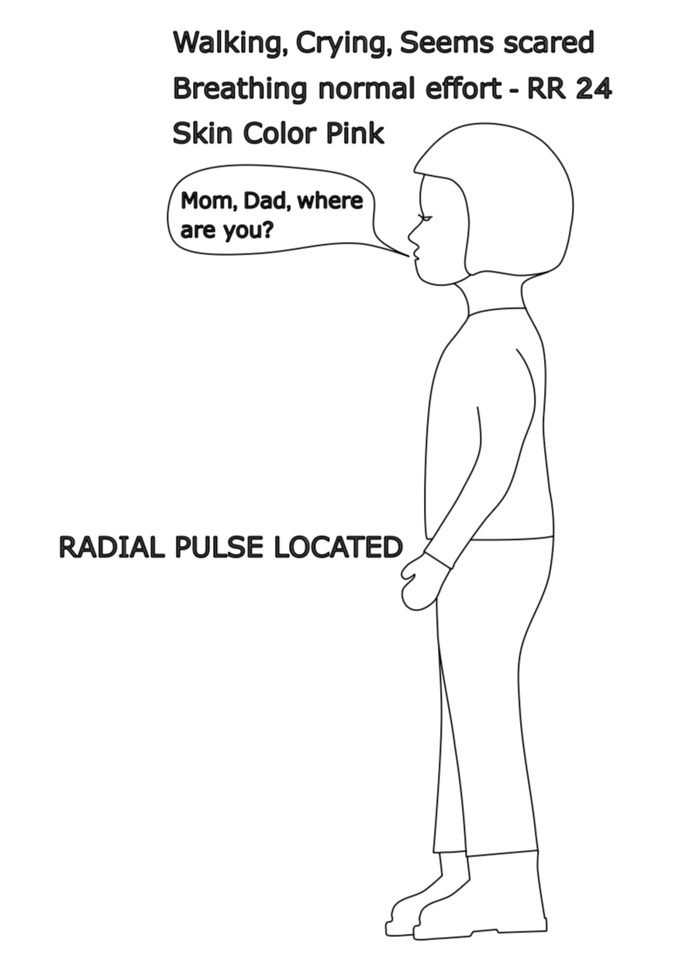
PATIENT # 11:
Pediatric patient
No apparent injury
R < 30
P = present, CR < 2

Slide 25

PATIENT # 12:
Alcohol intoxication
Unable to walk
R < 30
P= present, CR < 2
Able to follow simple commands

