Slide 1
NSP Recognition and Awards 2025

Slide 2
Why recognize members
Silent gratitude isn’t worth much
Recognition is the currency of volunteerism
NSP is over 70% volunteer

Slide 3
Ski Year 2025
Notes:
626 individual recognitions
1 50 year sign
152 Lifetime
778 Total recognitions in 2025
28608 total; Alumni, Patrollers and Hosts 7-1-25
Approximately 3.2% of the membership was recognized at the National level. Many more were recognized at local, region and division levels bringing the total to an estimated 15 to 20%

Slide 4
Southern Division 2025 Recognitions
Notes:
SD 38 individual Awards

Slide 5
Recognition by Percent of Membership
Notes:
SD Tied for 4th.
Members, Division
8123 EASTERN
6312 CENTRAL
4556 PROFESSIONAL
2799 PACIFIC NW
1971 FAR WEST
1351 SOUTHERN
1349 ROCKY MTN
994 INTERMOUNTAIN
610 NORTHERN
272 ALASKA
127 INTERNATIONAL

Slide 6
2025 Outstanding Nominations
 | ADP | AL | APL | APS | ASP | AXP | BH | BHU | BP | BKP | HUR | INS | MH | MHU | NP | NSP | OEC | PPD | PP | PR | YP
Alaska |  |  |  |  | X |  |  |  |  |  |  |  |  |  |  |  |  |  |  |  |  | 1
Central | X | X | X |  | X |  | X |  | X | X | X | X | X | X |  | X | X | X | X | X |  | 16
Eastern | X | X | X |  | X |  |  |  |  |  |  | X | X |  | X | X | X |  | X | X | X | 12
International |  |  |  |  |  |  |  |  |  |  |  |  |  |  |  |  |  |  |  |  |  | 0
Far West | X | X | X | X | X |  | X |  |  |  |  | X | X | X |  | X | X |  | X | X |  | 13
InterMtn | X |  | X |  |  |  |  |  |  |  |  | X |  |  |  |  | X |  |  |  |  | 4
Northern |  |  |  | X | X | X |  |  |  |  |  | X |  |  |  |  | X | X |  | X |  | 7
PacificNW | X | X | X |  | X | X |  |  |  |  | X | X |  | X |  | X | X |  | X | X |  | 12
RockyMtn |  |  |  |  |  |  |  |  |  |  |  | X |  |  |  |  |  |  |  |  |  | 1
Southern |  |  | X |  | X | X |  |  |  |  |  | X | X |  |  |  | X | X | X | X | X | 10
Pro
Total | 5 | 4 | 6 | 2 | 7 | 3 | 2 | 0 | 1 | 1 | 2 | 8 | 4 | 3 | 1 | 4 | 7 | 3 | 5 | 6 | 2 | 76

Slide 7
Changes

Slide 8
What's new?
Name Changed to Awards and Recognition Program
  Recognize members for using NSP Required Training
  Recognize members for Service to the NSP
  We don’t give prizes for achievements or good work
Medical Merit Stars (Purple, Blue, and Green)
  Removed “under the control of others”
  Changed to “training required for their member type.

Slide 9
What’s coming
Changes to the Outstanding Bike Awards.
  NAC and Bike Committees recommend combining OS Bike Patrol and OS Host Unit into Large and Small Bike Unit Awards
Removing specific member types from most recognition and awards.
Remove Chapter 12 from the NSP P&P
Update criteria for Appointments
PDF Forms

Slide 10
Outstanding Hints and Tips

Slide 11
10 Steps to putting together a high-quality Outstanding Patrol/Patroller nomination
Get Started! It’s the hardest step.
Get the correct nomination form.
Recruit a Writer or team of Writers.
Read and follow the Instructions.
Don’t make this harder than it needs to be.
Gather Information.
Fill out the form.
Understand this is a competition.
Review your work.
Turn in your Nomination(s).

Slide 12
Tips from former judges
Avoid the fluff
  Every nominee joined the National Ski Patrol, took classes, etc.
  Patrollers are great people; you don’t need to tell me.
  Give me specifics of what they accomplished in the review period.
  Bullets of accomplishments and the effect on NSP, outdoor recreation, community, etc. are easier to judge than a paragraph of great writing with the key information buried in the prose.
Watch spelling and grammar.
  Not part of the scoring but can make nomination look bad and cost points.

Slide 13
Tips from the NAC
Start early
  Potential nominee(s) could be identified in the spring or summer before nomination. You’re already 3 years into the review period, start documenting and writing then update with the final year.
4 years is 4 years. For Winter Sports this is 4 NSP fiscal (ski) years. For Summer Sports this can be 4 calendar years.
Watch out for identifiable information. If a “Google” search can pin the information to a specific Division or smaller area it will get redacted.

Slide 14
Discussion Samples

Slide 15
Review Nomination - PMS
I am submitting this patroller Jimmy John for a Purple Merit Star.
A 41-year-old snow boarder was participating in the “Slush Cup” pond skimming contest at Big Mountain. Upon transition from the snow to the water, the snowboarder caught his front edge and violently slammed face first into the water.
Jimmy recognized that the snowboarder was floating face down in the water and non-responsive, recognized that the snowboarder’s airway was compromised, and the airway needed to be opened. Jimmy made his way over to the patient in the waist deep 50-degree water, walking carefully not to trip over the plastic lining. Jimmy reached the patient after Moe and participated in assisting by securing his lower body and rolling the patient over so the snowboarder’s airway could be opened. The patient was unresponsive with no gurgling sounds, not purposeful breathing. The patient was drooling blue water, couldn’t cough or breathe at first. The patient was floated to the side of the pond by Jimmy and Moe. Curley and Larry were at the edge of the pond and helped support the patient and C-spine, while Jimmy worked with frozen fingers to remove the snowboard. The patient was extricated from the pond and passed to Lary and Curley. Jimmy crawled out of the pond, to assist in lowering the patient to the backboard. At this time the patient started to regain consciousness with gurgling sounds, not purposeful breathing, not enough to sustain life. Larry rolled the patient onto his side to drain fluids from his airway.
Jimmy’s actions contributed to a successful rescue event, ensuring the patient had an open airway, while removing him from the frigid water saved his life.
The actions of Jimmy John are in the best tradition of the National Ski Patrol and reflect great credit himself, his NSP training and the Big Mountain Ski Patrol.

Slide 16
Outline of Award Recommendations for
Award Proposed | Nominee | At Scene | Transport | Patrol Room
 | Jimmy John | Second to patient, assisted Secured lower body and assisted rolling the patient Floated Pt to side of pond Removed Snowboard Crawled out of pond and helped lower pt to board
 | Moe | First to patient Opened pt airway Floated Pt to side of pond while securing PT head
 | Curley | At edge of pond helped secure PT at edge of pond while snowboard removed Received pt from Jimmie & Mo
 | Larry | At edge of pond helped secure PT at edge of pond while snowboard removed Received pt from Jimmie & Mo Rolled pt onto side to drain fluids

Slide 17
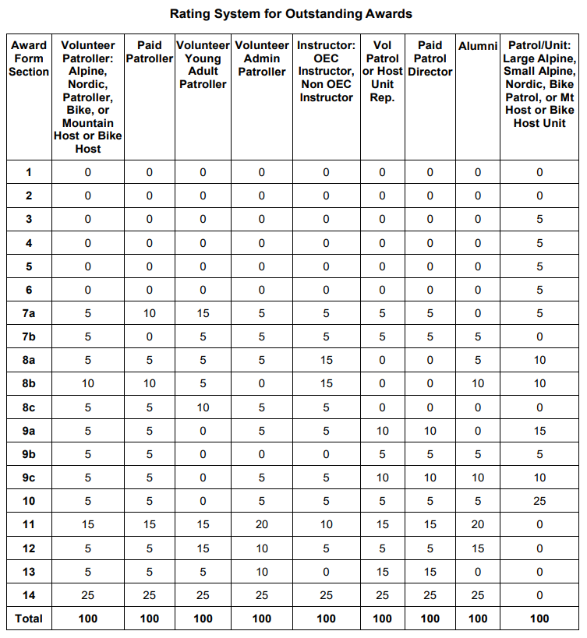
Judging Matrix

Slide 18
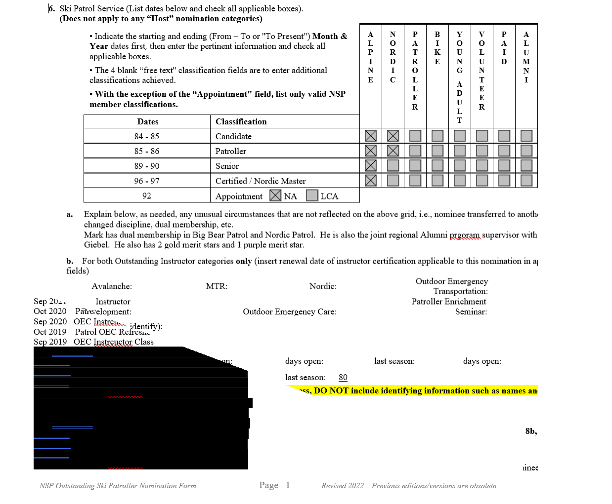
Sample OS Nomination

Slide 19
Sample 1
12. Sponsor’s Recommendation (750 words or less). Why induct this nominee? Indicate DETAILED IMPACT / HISTORICAL SIGNIFICANCE to the NSP organization. Emphasize specific details of nominee’s accomplishments.
Hall of Fame inductions are important as they not only recognize the best of the best, but they memorialize the historical contribution made by connecting our past to the present. This blueprint laid for success is easily experienced when viewing the 50-year career of Jimmy John in providing safety and education in the ski industry across the nation.
This Hall of Famer Nominee's career in the ski industry began in 1972 and within five years did more than many do in a lifetime. Initially, he became a National Ski Patrol, Far West Pro Ski Patrol Association (FWPSPA - now Association of Professional Patrollers) and National Ski Area Association member. His early training with NSP gave him an advantage to be hired as a Pro Ski Patroller at Sierra Summit and Sugar Bowl Resorts. He then earned his NSP Level 1 and Level 2 Avalanche Certification, NSP Alpine Senior and NSP Toboggan Instructorship. Concurrently, he was elected as a BOD for the FWPSPA, graduated from the United States Department of Agriculture Forest Service Avalanche School and California Polytechnic State University with a Bachelor's degree in Natural Resources Management (1977), earned a State of California Blasters License (1975), EMT license (1974), then FWPSPA Full Certification (which is now the NSP Certified Program) (1975). To finish out this five-year stint, he was then promoted to Assistant Patrol Director at Sugar Bowl (1976-1978).
Jimmy John concluded the 70's and welcomed in the 80's as the Pro Ski Patrol Director at Sugar Bowl (1978-1982) then moved to China Peak (then Sierra Summit) as Pro Ski Patrol Director. Through the next 40 years, this HOF Nominee avidly integrated volunteer and pro staff service and training to operate as a unified Patrol community. He continued his investment into NSP by becoming a NSP Avalanche and OEC Instructor (1976-present), NSP Avalanche IT (1976-present), NSP Level 1 Mountain Travel Rescue (1975-present), Far West Division BOD as Pro Ski Patrol Advisor (1985-2018) and Avalanche Advisor (2012-2014), and invited by National to represent NSP as their Expert Rebuttal Defense Witness for the Kane v. NSP case in 2001. His testimony was pivotal in the case ending in NSP's favor. During this same time, for the Far West Professional Ski Patrol Association (now Association of Professional Patrollers) he became a Head Judge over Toboggans, Explosives, First Aid, Hill Safety, Risk Management plus Avalanche Rescue (1975-2018), elected FWPSPA (now APP) President (1987-1990 and again in 2015-2018), FWPSPA BOD (1985-2017), and FWPSPA International Snow Survival Workshop Instructor (1994-1998). As a result of his extensive service and leadership within FWPSPA (APP) and NSP, Rich Bailey was instrumental in establishing the NSP Certified Level Program. The curriculum for the Certified Level Program was derived from the advanced training modules in the Association of Professional Patrollers (formerly FWPSPA).
This HOF Nominee not only used his knowledge and leadership roles with NSP and FWPSPA (now APP) to benefit the Patrol community but also the community at large. He became and elected member of the Society of American Foresters and the American Society of Safety Engineers in the late 80's. Beginning in the early 90's he became a consultant for the California Ski Industries Technical Board for Snow Making and Grooming (1994-1998), Avalanche Consultant for PG&E and Southern Pacific Railroad, Safety Consultant for the Forest Service plus the County Sheriff's Department and Lemoore Naval Search and Rescue, and American Red Cross CPR Instructor (1982 - present).
In the midst of these substatial accomplishments and long lasting investments into the ski industry, this HOF Nominee earned awards from NSP including Distinguished Service Award (2012), Far West Division Director's Award (2010 & 1997), Far West Division Most Outstanding Pro Patroller (1985-1986), National Appointment #6551 (1985), Purple Star (1981), and National Ski Areas Association Safety Champion (2021) plus their NSAA Award of Excllence (1999).
Jimmy has demonstrated over these last 50 years great aptitude through these achievements and certifications, but has also sought opportunities to share his knowledge with NSP and its associated organizations. He held countless leadership, advisory, director, consultant and instructor positions as a venue to share his passion for the ski industry with an accute eye for avalanche and public safety. Currently, he is serving as the Pro Ski Patrol Director and Risk Management Director at China Peak. Day to day staff would describe Rich as positive, consistent, knowledgeable, team player and a man of integrity. Routinely, he has been the leading advocate for NSP and its volunteers within the local resort operations endorsing a symbiotic relationship between paid and volunteer staff. He shows a positive regard for all his staff and is eager to promote programs within NSP such as YAP, Women, Senior, Avalanche, OET and OEC. Anyone would say their life has been positively touched by this HOF Nominee.
It is clear Jimmy John far surpasses the requirements for an induction into the HOF evidenced by his time, service, and contribution. He is well deserving of this recognition. It is my pleasure to present Rich Bailey for induction into the NSP Hall of Fame.

Slide 20
Sample 2
Chair Patroller Committee that fought to retain members rights including electing National Board Members by a majority of members voting and requiring bylaw changes to be approved by the membership. The National board instituted a procedure of allowing the membership to vote on a slate of officers proposed by the board. As enacted the vote would require a majority of the total membership to reject the slate making it virtually impossible for the membership to reject the slate.
Co-authored the Adaptive Chapter of the OEC 6th Edition. John became an informal subject matter expert in working and caring for physically challenged athletes from firsthand experience. His son was such an athlete who enjoyed the outdoor environment, especially snow sports. John’s experience enabling his son to enjoy skiing combined with his Ski Patrol training led John to develop procedures and standards for up-hill transportation, lift evacuation, treatment of injured adaptive athletes. He was a frequent guest lecturer in OEC classes and refreshers, Region, Division and Trade Association Meetings advocating for and teaching other to embrace all participants in our sport.

Slide 21
Contact Info

Slide 22
Contact Info:
  Dick Jacques
  National Awards Advisor
  Awards@nspserves.org

