Slide 1

AWARDS AND RECOGNITIONS – DEMYSTIFIED AND SIMPLIFIED

Slide 2
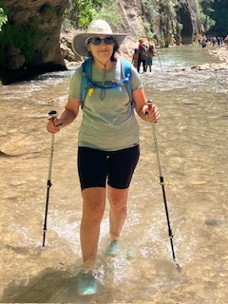
DIANE WILKEY – SOUTHERN DIVISION AWARDS ADVISOR

Slide 3
WHY RECOGNIZE MEMBERS?
  Former NSP Board member John Kane “Awards is the currency of volunteerism”.
  Recognizing members for exceptional service encourages others to excel and improves member satisfaction, retention and recruitment.
  NSP Membership is 70% volunteer, and many paid members volunteer in leadership and instructional roles.

Slide 4
THE BASICS
Where to find Awards information:
Log into the NSP website
Go to the Resources dropdown menu and choose Document Library
Then choose Governance
Under the heading Policies
You’ll find NSP Policies and Procedures
Chapter 12 covers the Awards Program

Slide 5
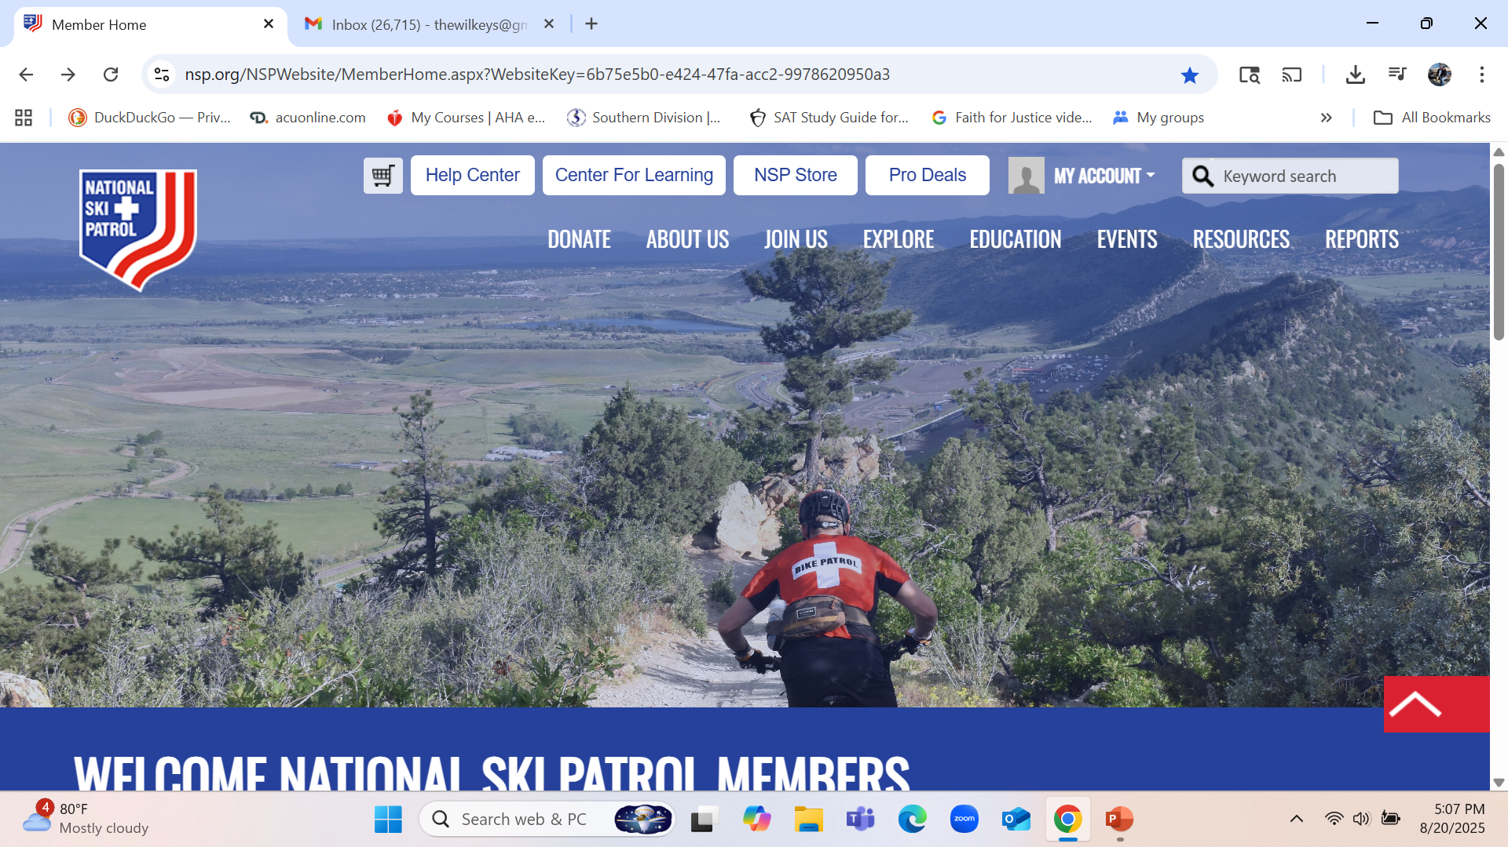
RESOURCES

Slide 6
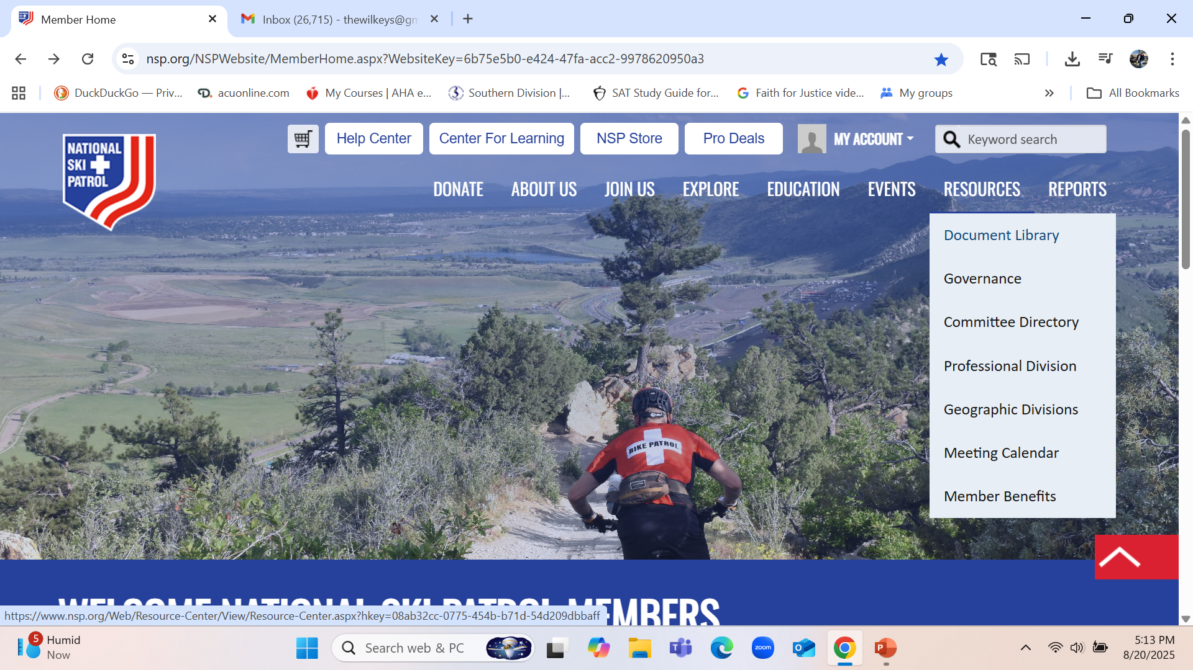
DOCUMENT LIBRARY

Slide 7
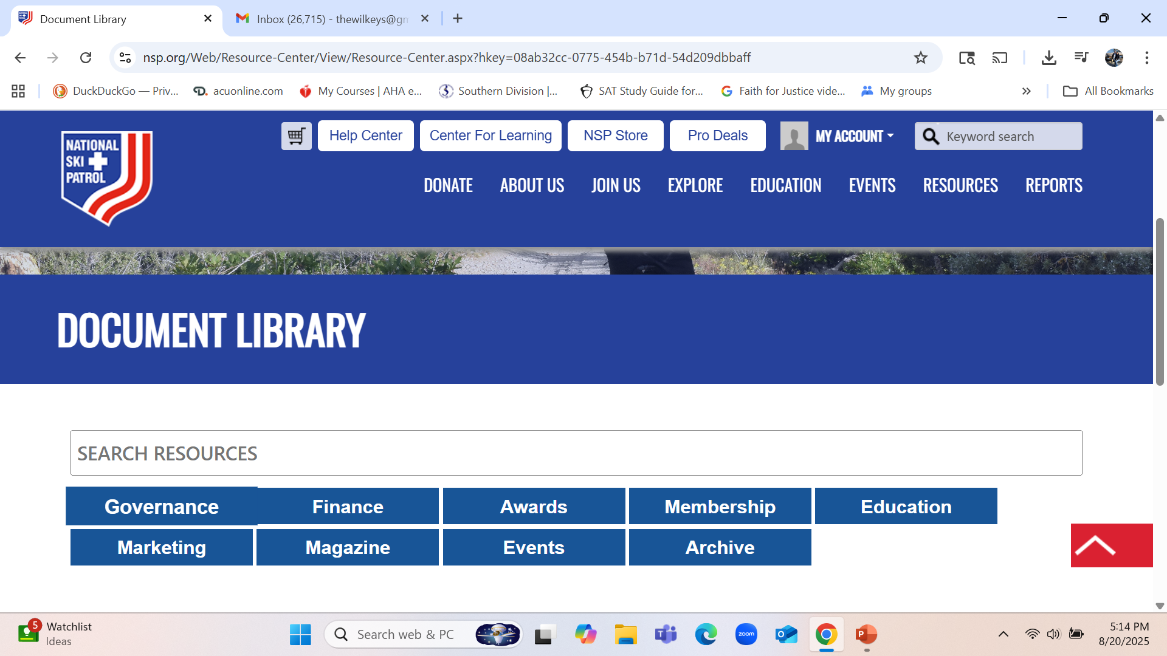
GOVERNANCE

Slide 8
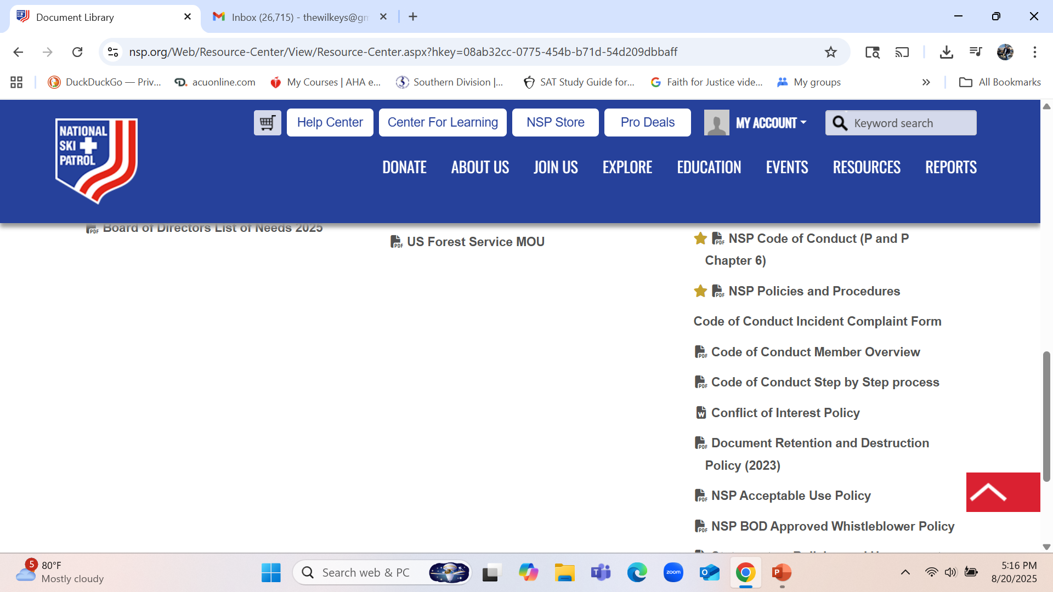
NSP POLICIES AND PROCEDURES

Slide 9
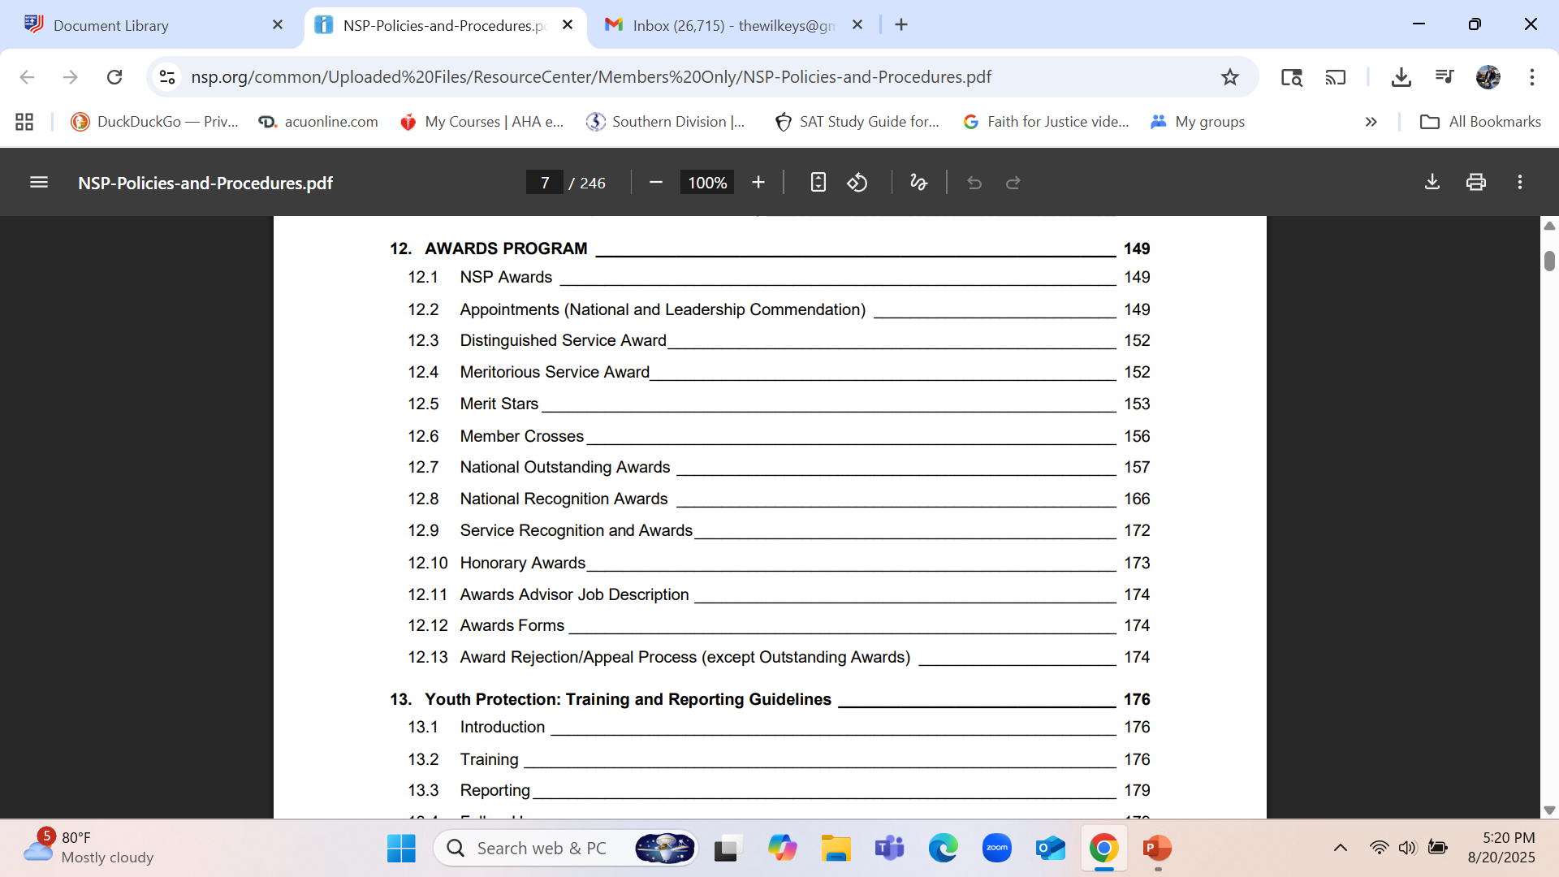
CHAPTER 12

Slide 10
THE BASICS CONTINUED
Where to find Awards forms:
Resources
Then Document Library
Then Awards

Slide 11
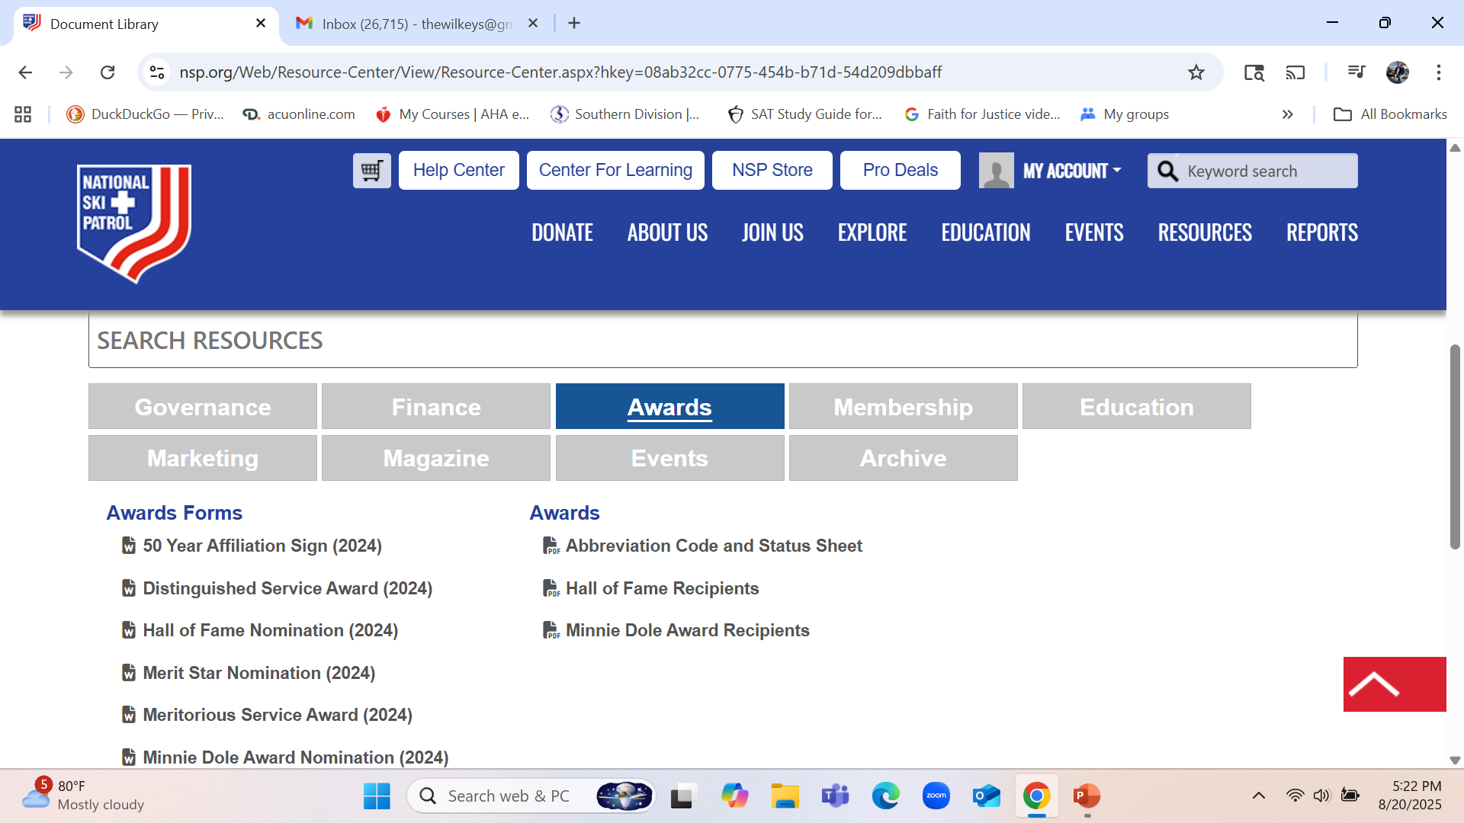
AWARDS FORMS AND AWARDS

Slide 12
AWARDS FORMS – UPDATED IN 2024
Awards Forms
50 Year Affiliation Sign (2024)
Distinguished Service Award (2024)
Hall of Fame Nomination (2024)
Merit Star Nomination (2024)
Meritorious Service Award (2024)
Minnie Dole Award Nomination (2024)
National Appointment Nomination (2024)
National Appointment or LCA Acknowledgement
NSP Memorial Nomination (2024)
Outstanding Awards Scoring MatrixScoring Matrix for Outstanding Awards
Outstanding Instructor Patroller or Host Nomination (2024)
Outstanding Patrol or Host Unit (2024)
Patroller's Cross Nomination (2024)

Slide 13
RECOGNITIONS
Certificate of Appreciation (Local, Region, Division, National).
Merit Stars:
  Yellow – Single act of service to the NSP
    Service above the patrol
    Assisting with lifesaving event
    National Outstanding Nominees (Automatic)
  Green – Difficult and/or hazardous rescue
  Blue – Assisting in or attempting to save a human life
  Purple – Saving a life
  Silver – National Outstanding first runner-up
  Gold – National Outstanding winner
Appointments NA/LCA
Distinguished Service Awards (member and non-member)
Meritorious Awards
Hall of Fame
Minnie Dole
Crosses Patroller/Host/Alumni
National Ski Patrol Memorials Patroller/Host/Alumni
Service Recognition and Awards Patroller/Host/Alumni
Service Recognition and Awards Instructors
Honorary Awards
  Honorary National Appointment
Angel Pin
Patrol - National Ski Patrol 50 Year Membership Recognition Sign
50 years of membership
National Service Excellence Award
Unit Recognition
  Unit Citation

Slide 14
WHAT IS DUE WHEN?
Most awards can be submitted any time during the year.
Exceptions:
  NA/LCA – we like to award these at the Southern Division Awards Banquet, so these should be submitted by the end of April to allow time for approvals and processing.
  Medical are accepted year-round. Be sure to keep good notes following any qualifying incidents and write them up as soon as possible. These require a time-line if more than one patroller is involved.
  Outstanding Awards – 21 different categories, due to me by May 1st to allow time for processing.

Slide 15
WHO’S RESPONSIBLE FOR THE AWARDS; WHO SHOULD WRITE THEM?
Service Awards
  Patroller – me (2026 and on, only 20 years will be framed)
  Instructor – PR’s or PD’s
NA/LCA – sponsor must have an appointment
Medical Merit Star – someone with first-hand knowledge of the incident
Honoring – the sponsor should write it (sometimes with input from a family member)
Outstanding – the patrol awards advisor and/or the PR/PD. An important consideration is that neither the person nor the patrol (nor the division for that matter) can be recognizable. Do not use names of people, places, or events!

Slide 16
THANK YOU FOR JOINING US!
You can contact me at:
      thewilkeys@gmail.com

Slide 17

DICK JACQUES – NATIONAL AWARDS ADVISOR

