Slide 1

Case Review
2026

Slide 2

Early in the season, Herb took his 10 year old grandson, Tim, skiing.
He had breakfast, took his daily medications and grabbed Nitroglycerin to carry.
Herb had a “minor cardiac event” three months earlier.

Slide 3

Tim skis ahead of his grandfather.
When he turns around, he realizes his grandfather is sitting on the ground holding his chest.
His grandfather asks him to get Ski Patrol.

Slide 4
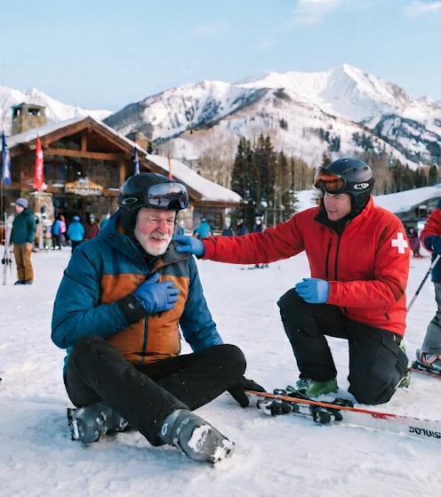
72 year old
Hard of hearing
Signs/Symptoms:
Sitting, clutching chest
Difficulty breathing
Numbness in left arm
Tightness in his chest, “like an elephant sitting on it”
Nauseous and lightheaded

Slide 5
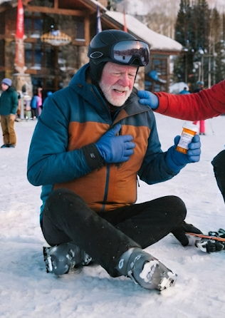
During SAMPLE, Herb’s medications are:
Warfarin (Coumadin)
Low dose Aspirin
Atenolol
Viagra (Sildenafil)
Nitroglycerin

Slide 6
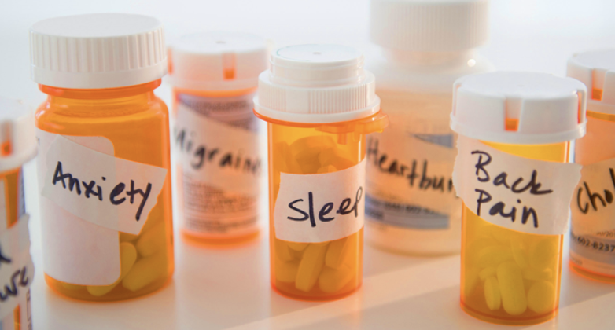
Polypharmacy
The simultaneous use of several medications in combination
Common among older patients
Can be dangerous because the effects of the combination can be unpredictable
Many different providers prescribing medications without communication amongst each other

Slide 7
Do you know what the purpose is of each medication?
Do you know how it works in the body?
How could you find out this information?
What resources are available to gain knowledge about medications if you are unfamiliar?

Slide 8
Warfarin (Coumadin)
Low dose Aspirin
Atenolol
Viagra (Sildenafil)
Nitroglycerin (as needed)
Blood thinner
(81 mg) OTC Blood thinner
A beta-blocker for high blood pressure
Erectile Dysfunction. Interaction with Nitro.
*Last taken 15 hours ago.
Relaxes and widens blood vessels improving blood/oxygen to the heart

Slide 9
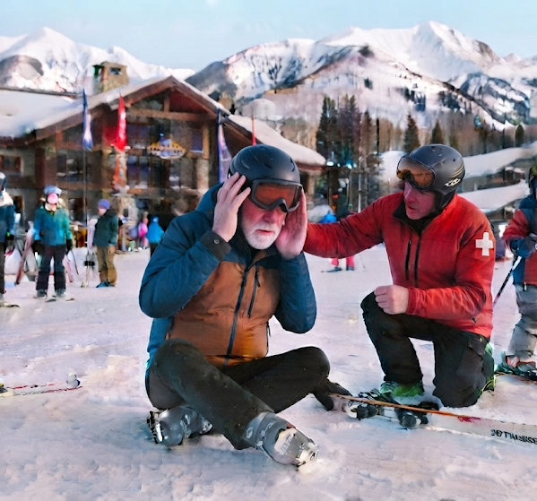
How could you communicate better with someone who is hard of hearing?

Slide 10
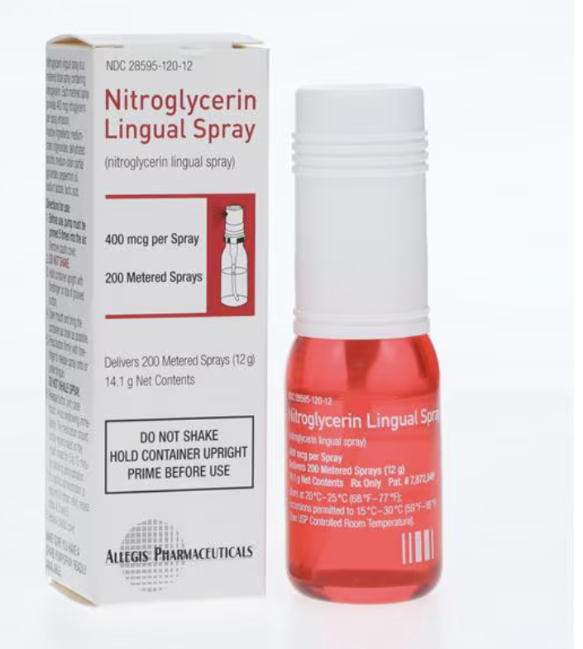
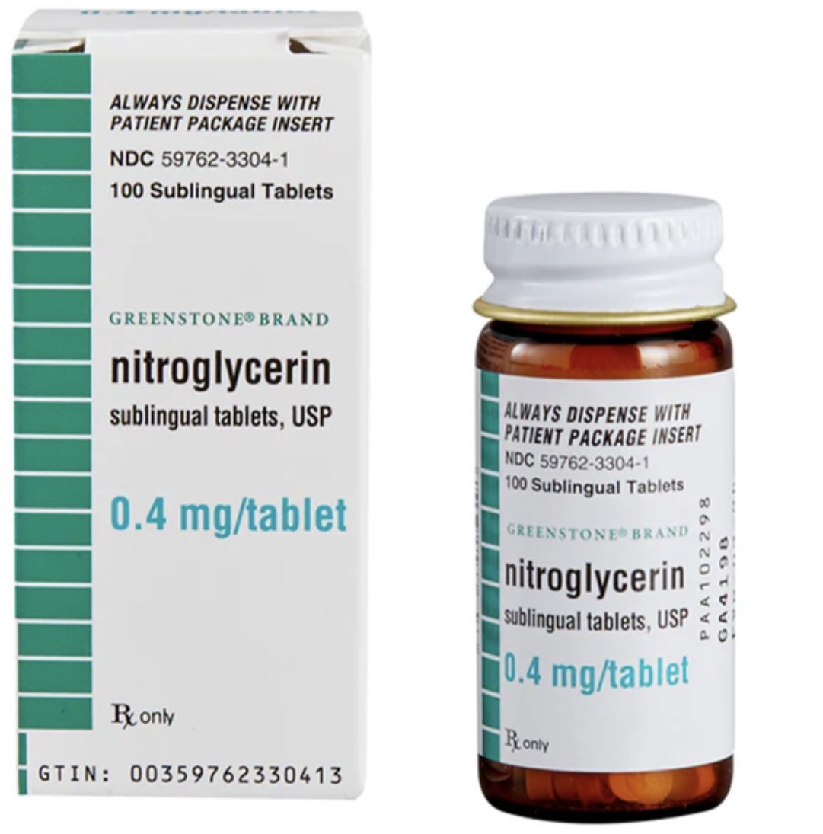
Would you recommend assisting with the nitroglycerin?

Slide 11
Nitroglycerin
Indicated for patients with angina
Can only be taken by:
  Whom it is prescribed / not expired
  Patients that are awake and responsive
  Systolic blood pressure that is greater than 100 mmHg
  Patients who have NOT already taken three doses of Nitroglycerin
  Patients who have NOT taken erectile dysfunction meds in last 24 hours
  Patients whose chest pain is NOT trauma in origin

Slide 12
To Assist with Nitroglycerin Administration:
Check systolic blood pressure (to be greater 100 mmHg)
Check to make sure medication is prescribed to the patient and is not expired
Assist with administering one tablet to the patient
Patient places below tongue and allowed to dissolve
If chest pain persists, can administer two additional doses at 5 minute intervals
Document time and dosage of administration for EMS
Recheck vitals at regular 5 minute intervals
Minimize patient’s physical exertion

Slide 13

What other action would you recommend to immediately help this patient?

Slide 14
To Assist with Aspirin Administration:
Confirm the patient is not allergic to aspirin
Confirm the patient is not experiencing GI bleeds
Aspirin:
  Adult buffered aspirin (325 mg)
  4 x baby aspirin (81 mg each = 324 mg total)
Instruct patient to chew the aspirin before swallowing
OK to provide water after chewing
Document the time and dosage
Recheck vitals on a regular 5 minute interval
Minimize patient’s physical exertion

Slide 15
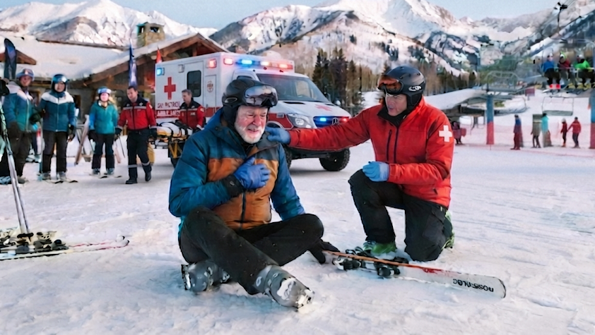
What choices regarding transportation are appropriate for Herb?

Slide 16

What policies does your mountain have for dealing with a 10 year old dependent? Or is he capable of being on his own?

