Slide 1
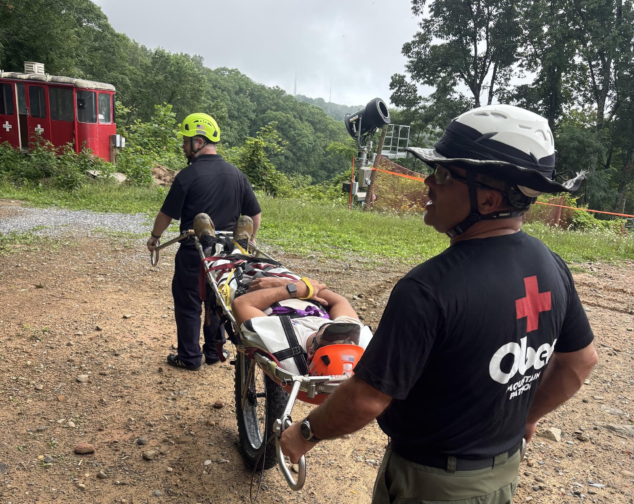
TERRA-TAMER TRAINING
EVACUATION PROCEDURES FOR OFF-ROAD AND DOWNHILL RESCUE

Slide 2
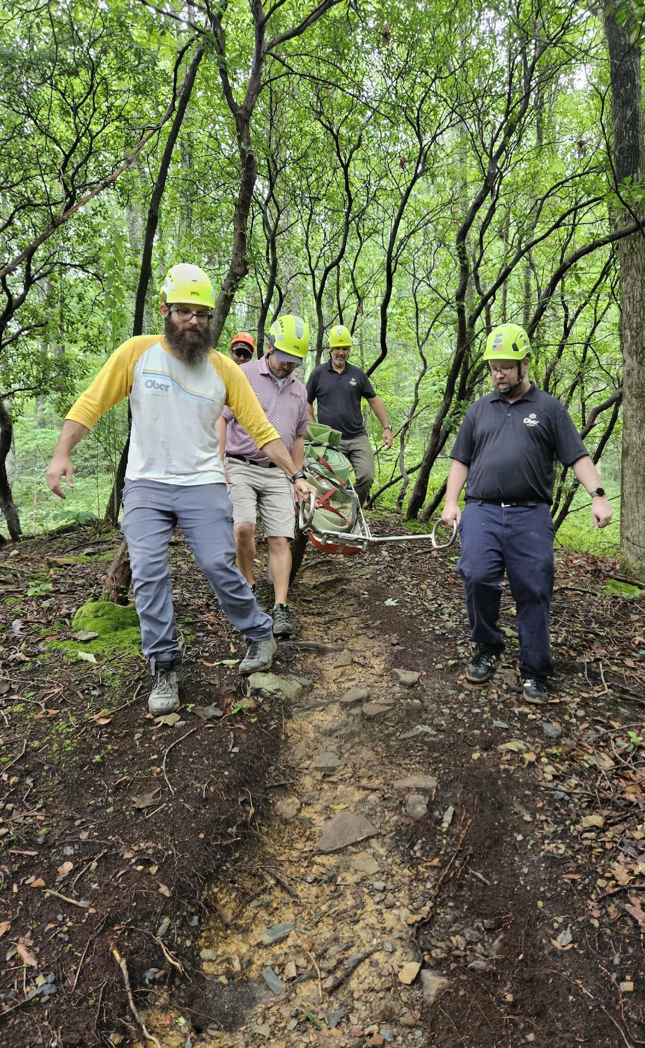
PURPOSE
Equip patrol, bike park staff Mountain rescue teams with the knowledge and confidence to operate the Terra-Tamer safely
Enable safe evacuation of patients from technical and off-road environments

Slide 3
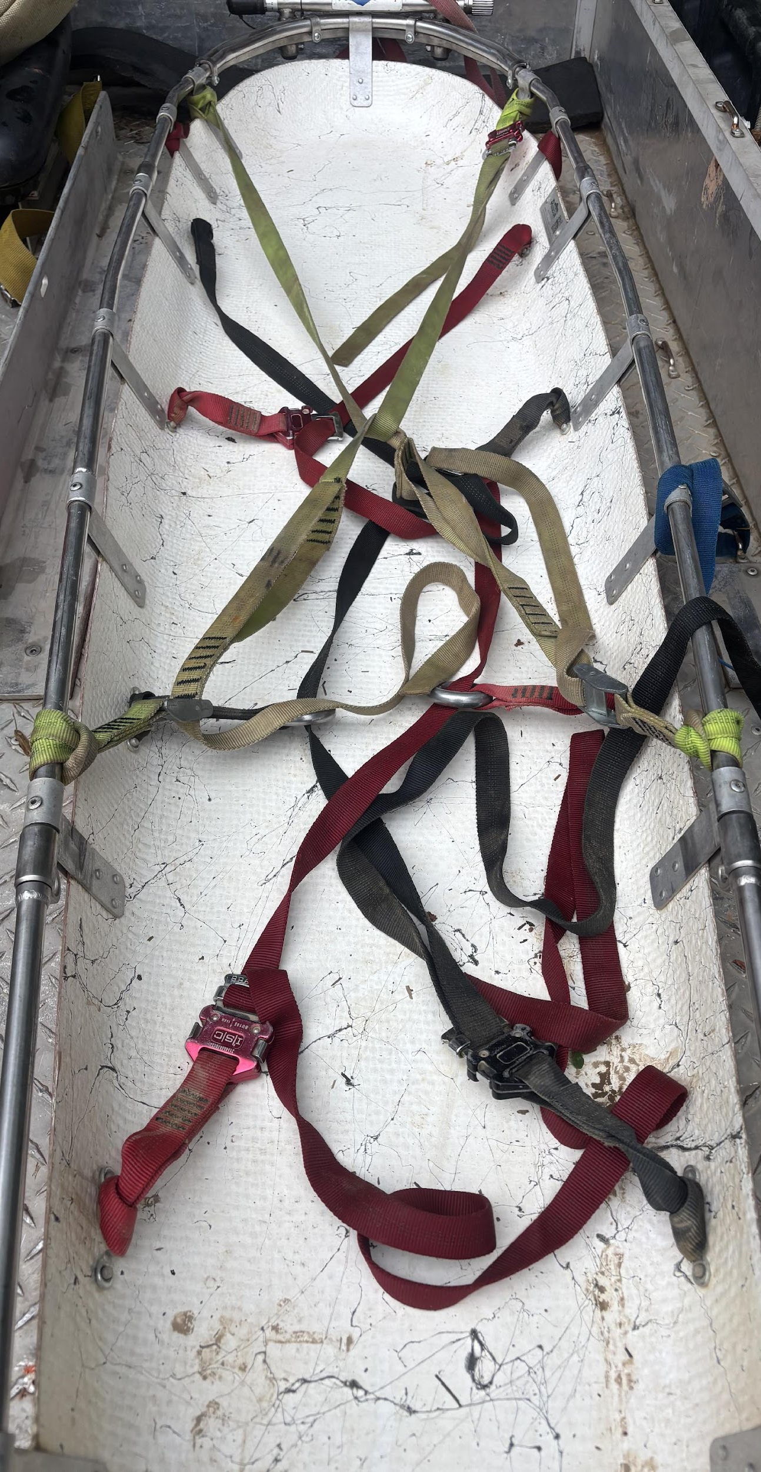
COURSE OBJECTIVES
Assemble and attach the Terra Tamer and Equalizer Handles to a rescue litter
Secure a patient for transport
Navigate rough or technical terrain with a loaded litter
Loading and securing of litter onto Medical UTV
Apply proper safety protocols

Slide 4
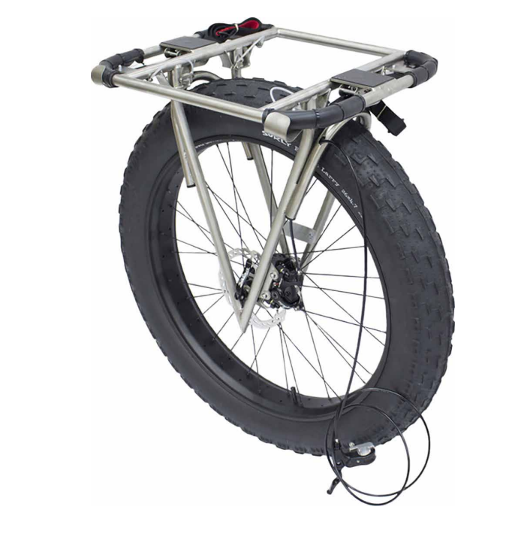
  Cascade Rescue
  Terra-Tamer
  Lightweight, shock-absorbing single wheel system
  Compatible with most rescue litters (Ferno, Cascade, etc.)
  Adjustable ergonomic handles
  Suspension system for reduced patient jostling

Slide 5
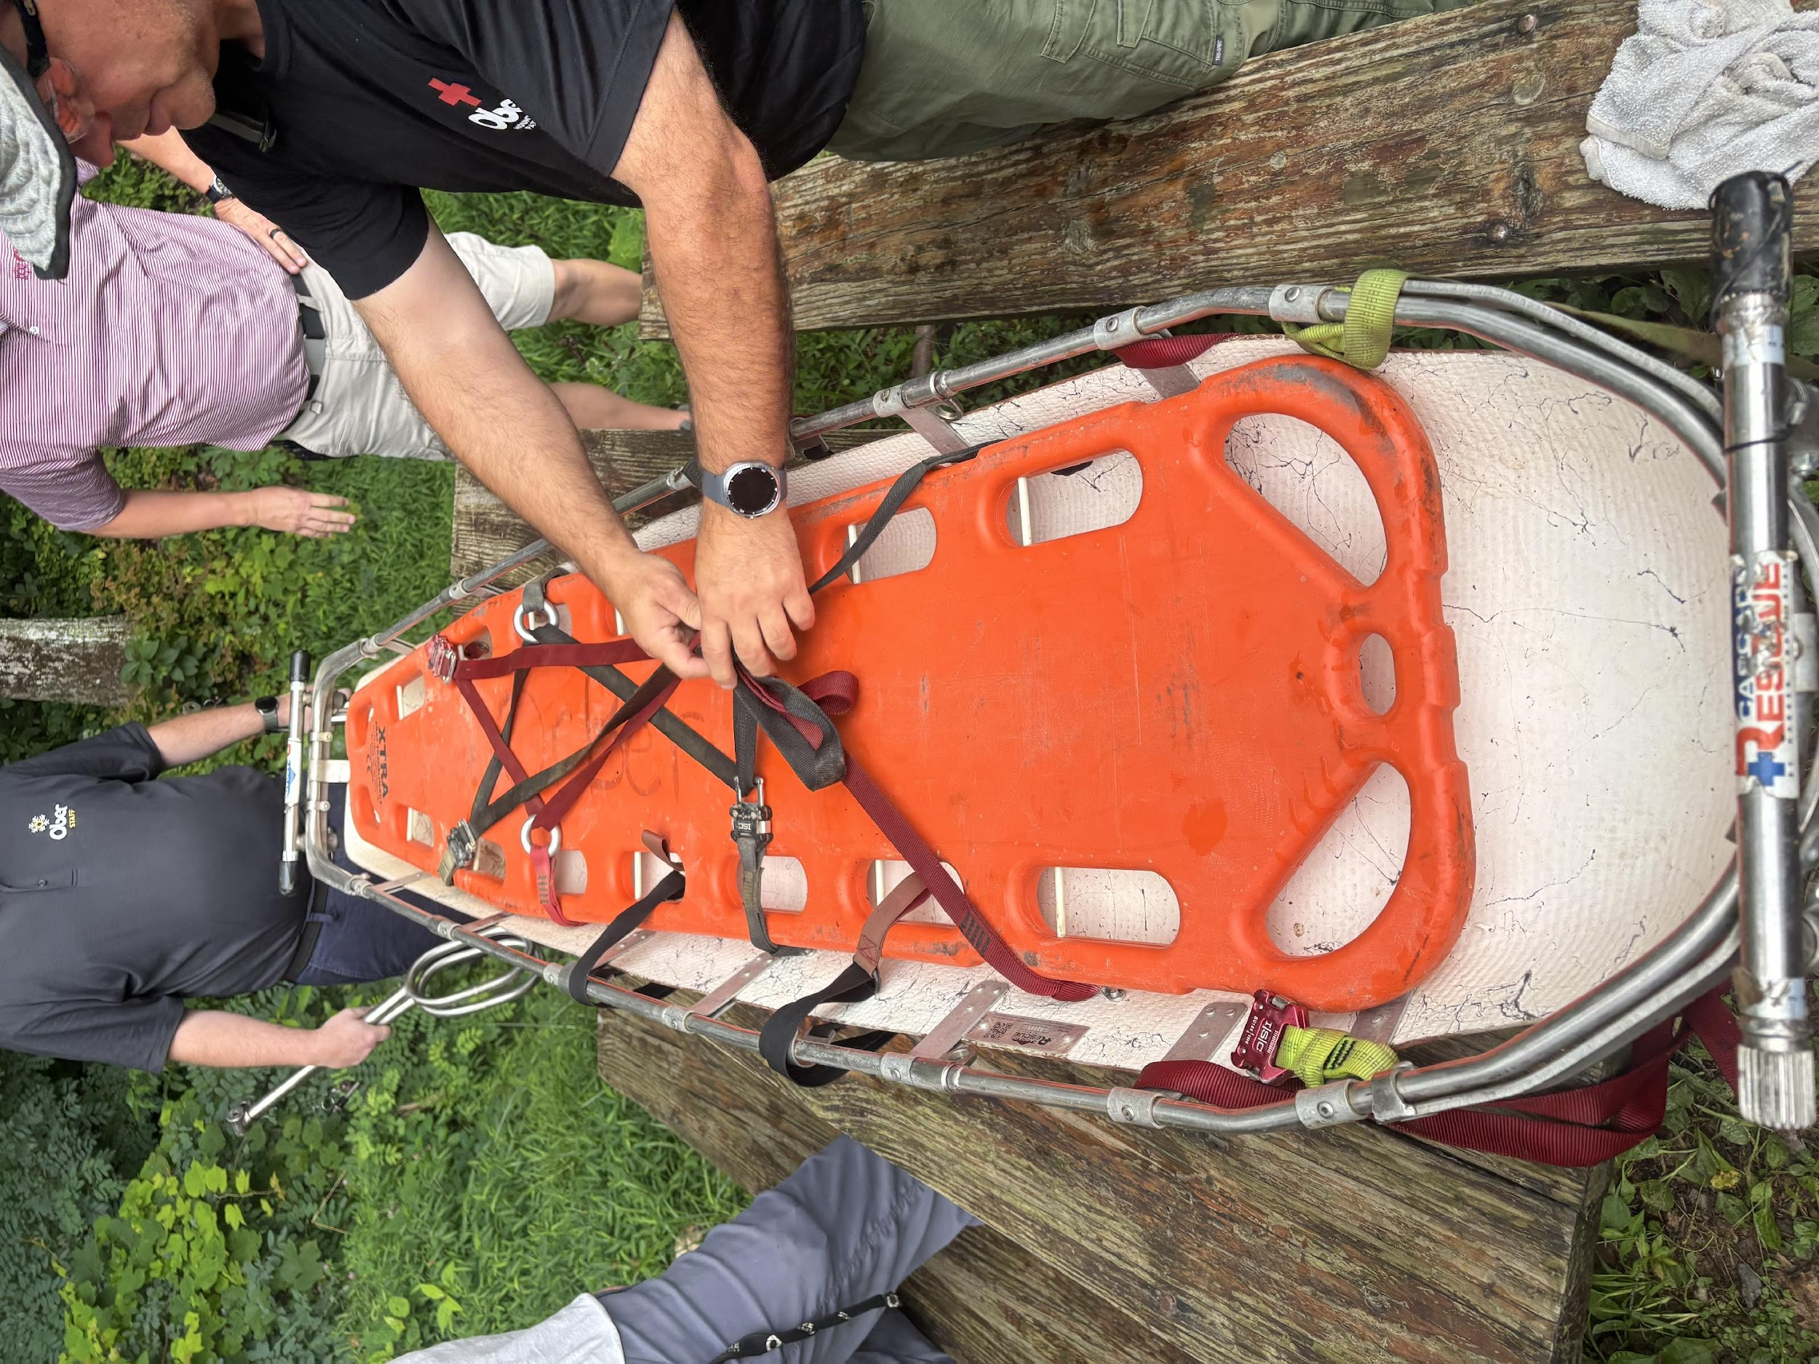
ASSOCIATED GEAR
Rescue litter ( e.g., Cascade Toboggan)
Equalizer Handles
Patient Packing tools ( vacuum mattress, spine board, straps, etc.)
PPE: helmet, gloves, eye protection, sturdy footwear
Webbing or haul lines for brake assist or belay

Slide 6
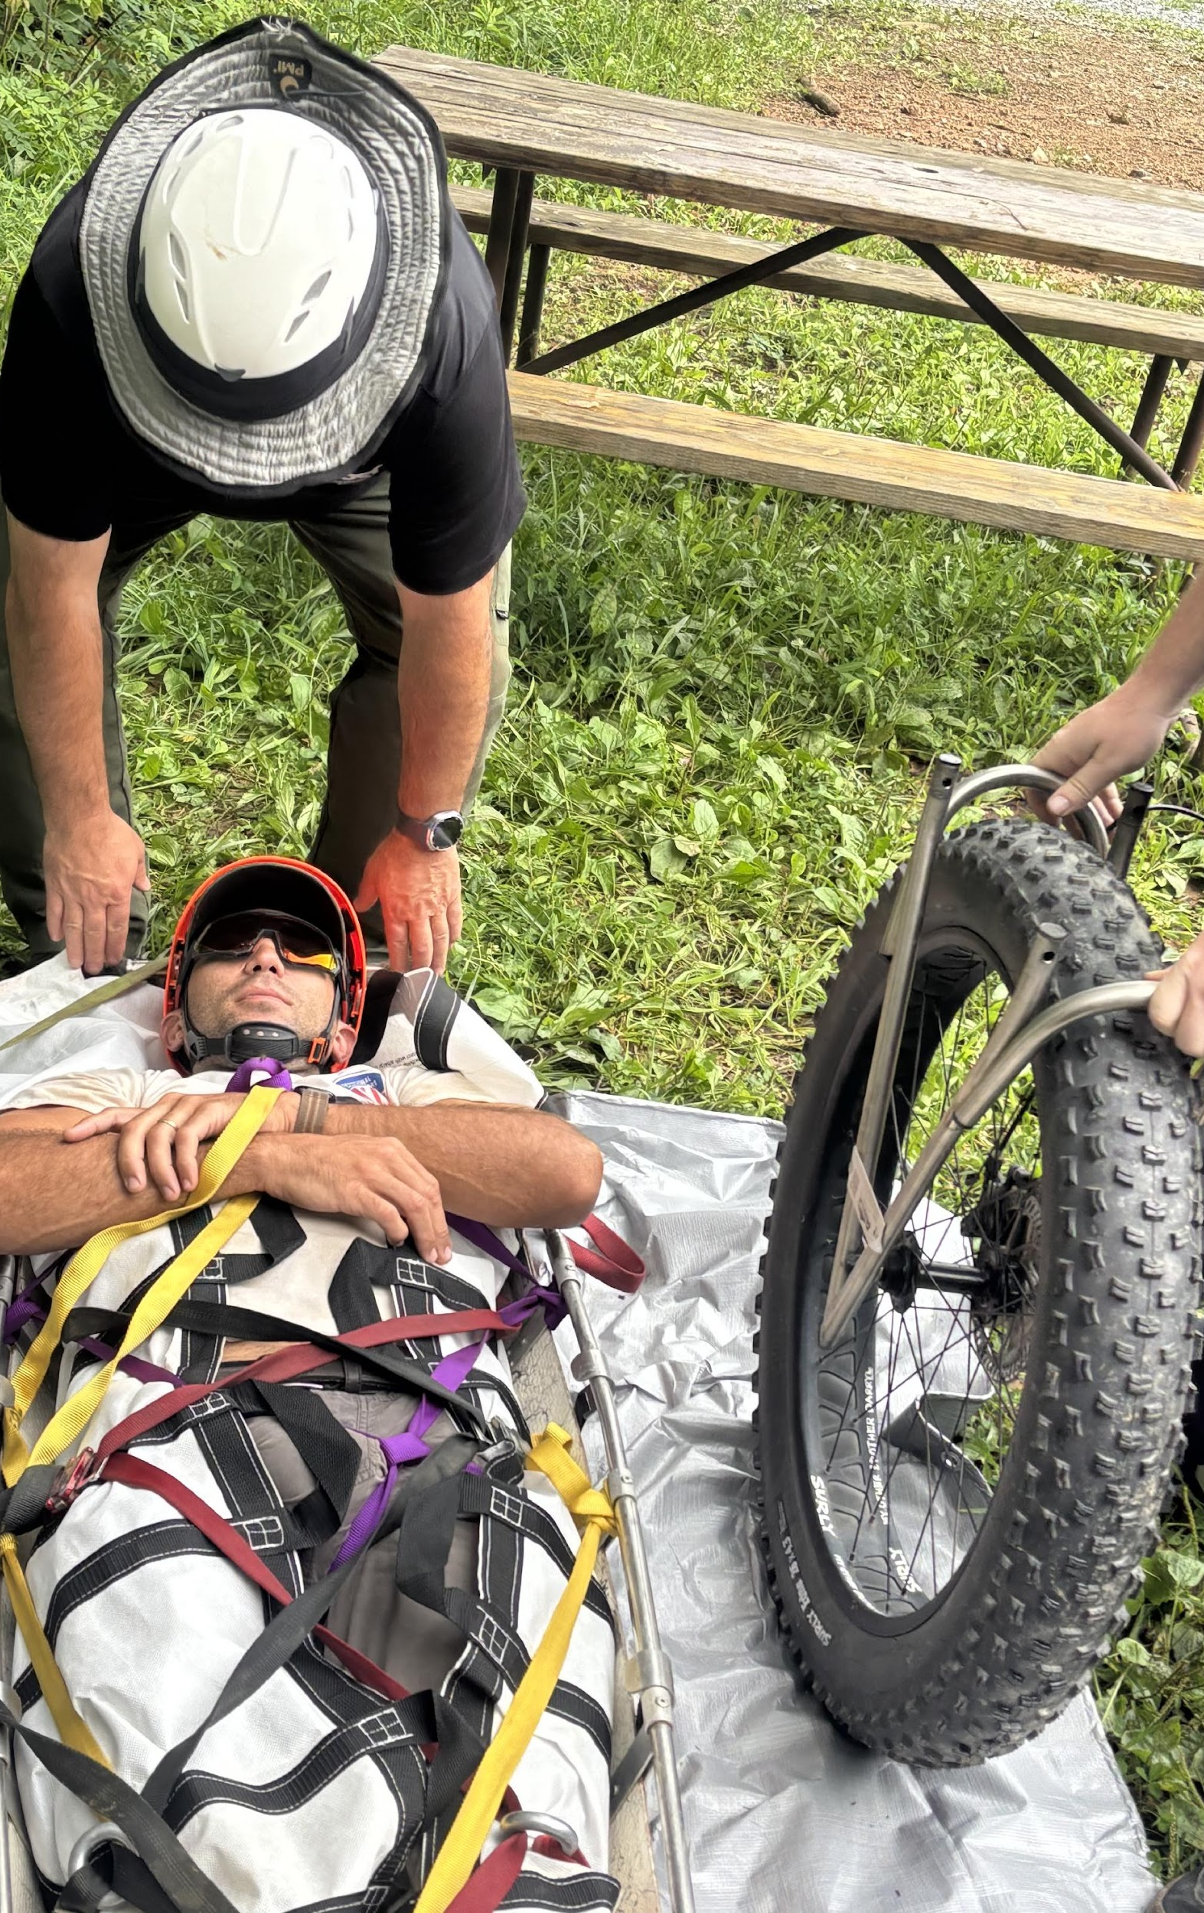
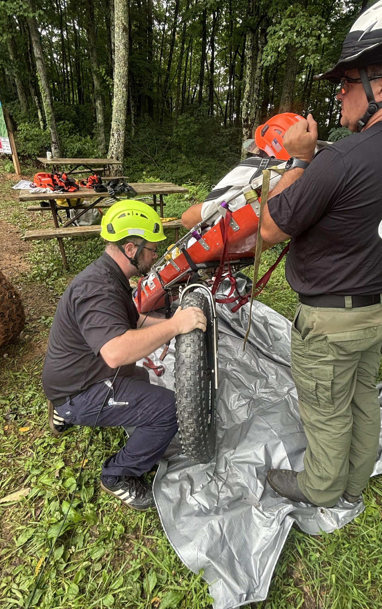
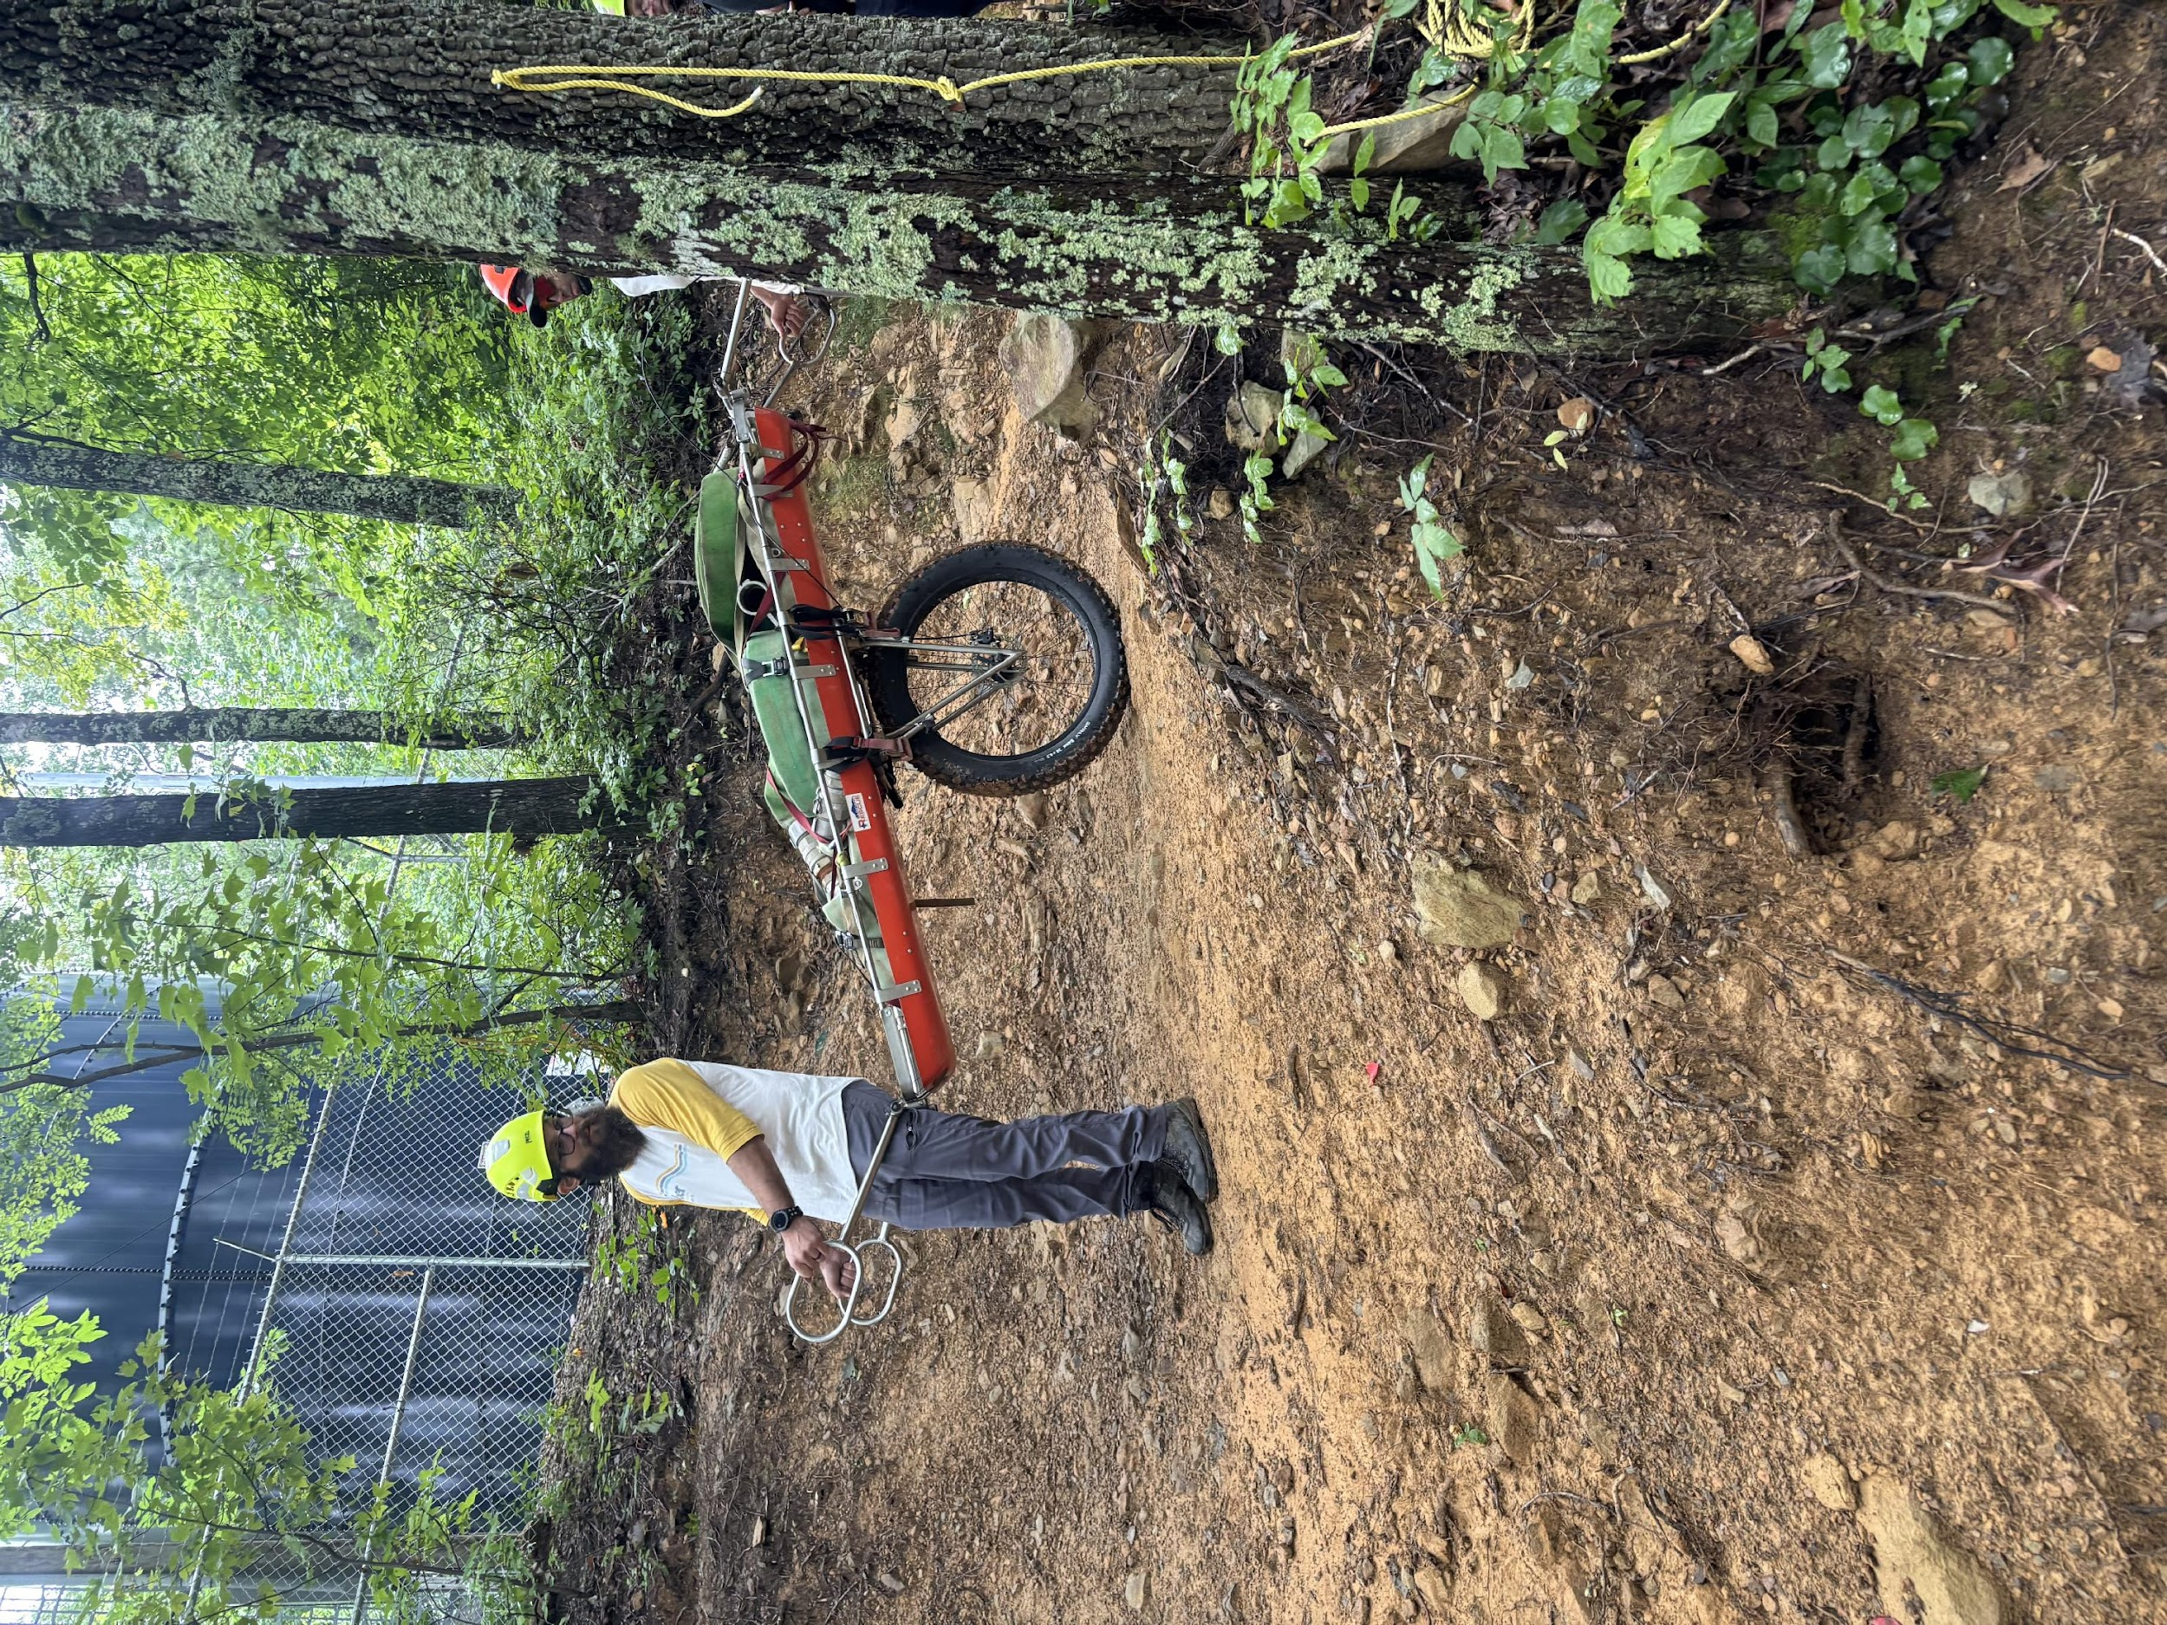
ASSEMBLY AND SETUP

Slide 7
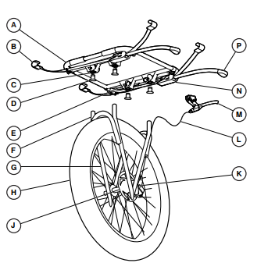
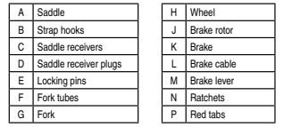
TERRA-TAMER PARTS

Slide 8
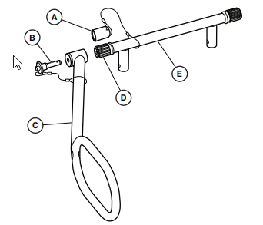

EQUALIZER HANDLES PARTS

Slide 9
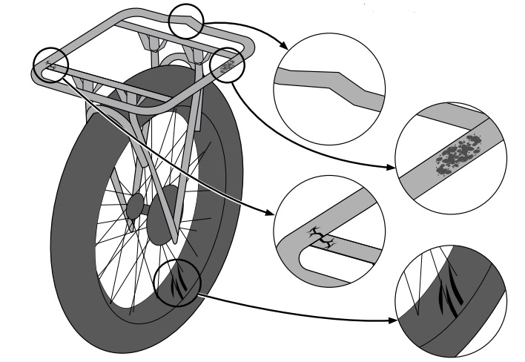
INSTRUCTIONS FOR USE
TERRA-TAMER
Before each use:
Inspect for cracks, distortions, corrosion, scratches, or gouges.
Verify the wheel spins freely
Verify tire pressure matches the recommendation on the sidewall of the tire
Verify the brake functions properly
Do not use the Terra-Tamer and immediately remove from service:
If exposed to caustic or acidic chemical agents
After any impact that results in visible damage or loss of function

Slide 10
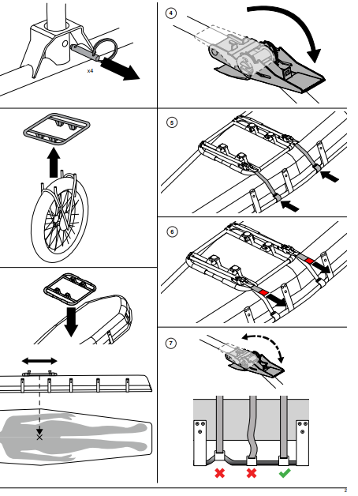
ATTACHING THE TERRA-TAMER TO RESCUE LITTER
Remove the pins securing the forks to the saddle
Remove the wheel from the saddle, place the protective covers into the frame, and reinsert pins
Place the saddle on the bottom of the Litter. Ensure that the saddle is centered for even weight distribution
Open the ratchets and slack the straps
Secure the hooks on the top rail of the litter and then pull the red tabs to remove the slack
Tighten the straps using the ratchet. Ensure that you tighten the ratchets simultaneously to prevent torquing of the Terra-Tamer system.

Slide 11
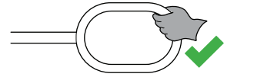
EQUALIZER HANDLES
Before each use:
Inspect for cracks, distortions, corrosion, scratches, or gouges.
Do not use the Equalizer Handles and immediately remove it from service:
If exposed to caustic or acidic chemical agents
After any impact that results in visible damage or loss of function
Do not use the handles to lift the full weight of the basket

Slide 12
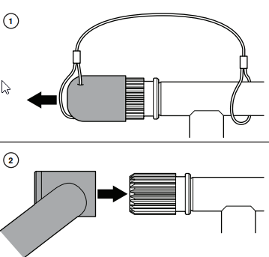
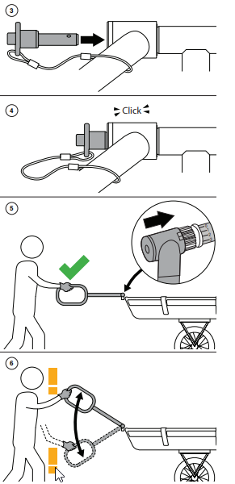
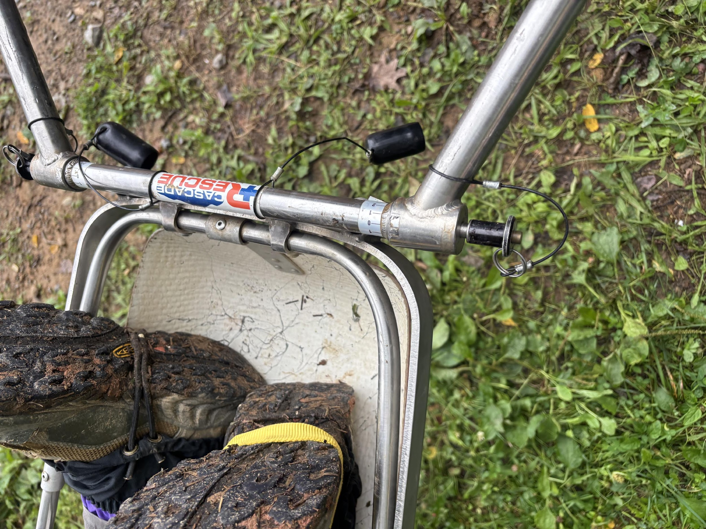
ASSEMBLY AND SETUP
ATTACHING THE EQUALIZER HANDLES TO RESCUE LITTER
Remove the Spline Cover from the Spline
Set handles to the proper height and insert them onto the spline
Insert Ball Lock Pin into the base of the handle
Push in the pin till you hear a click
Handles inserted at improper height will result in loss of control and injury

Slide 13
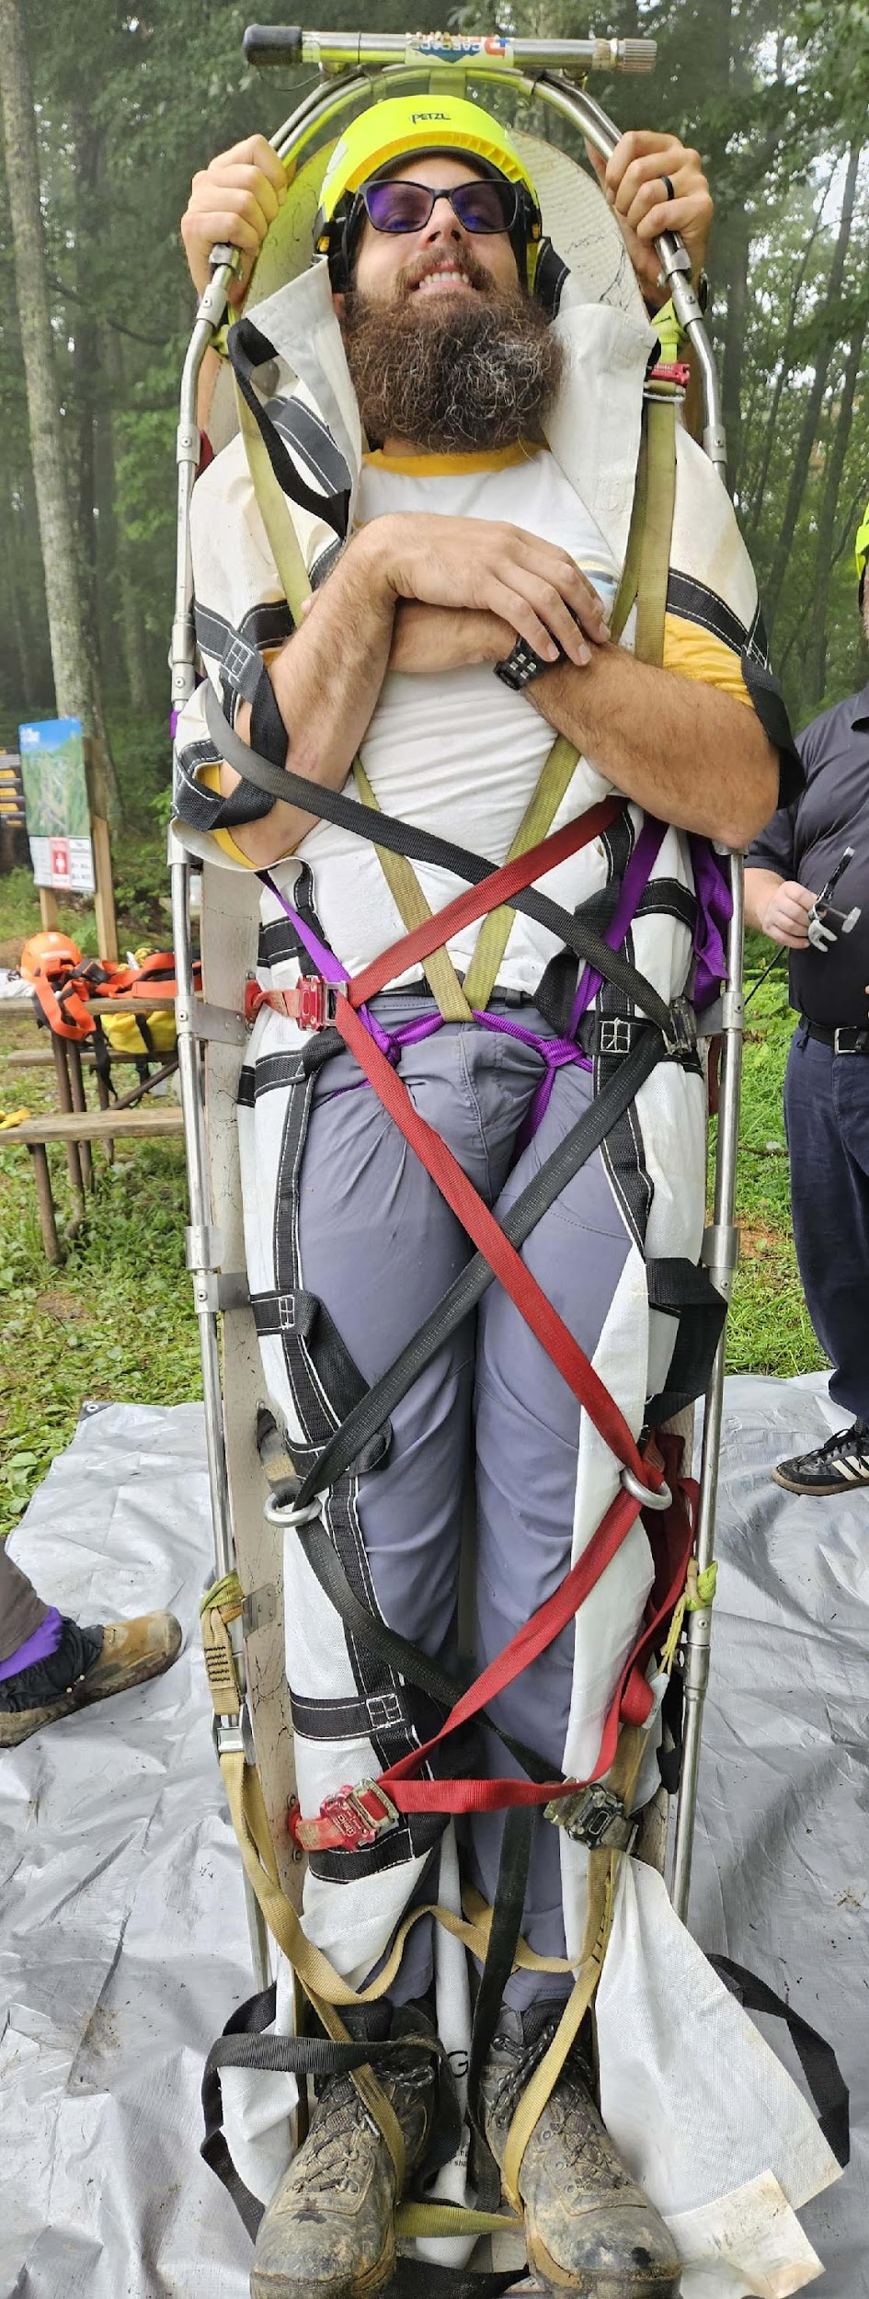
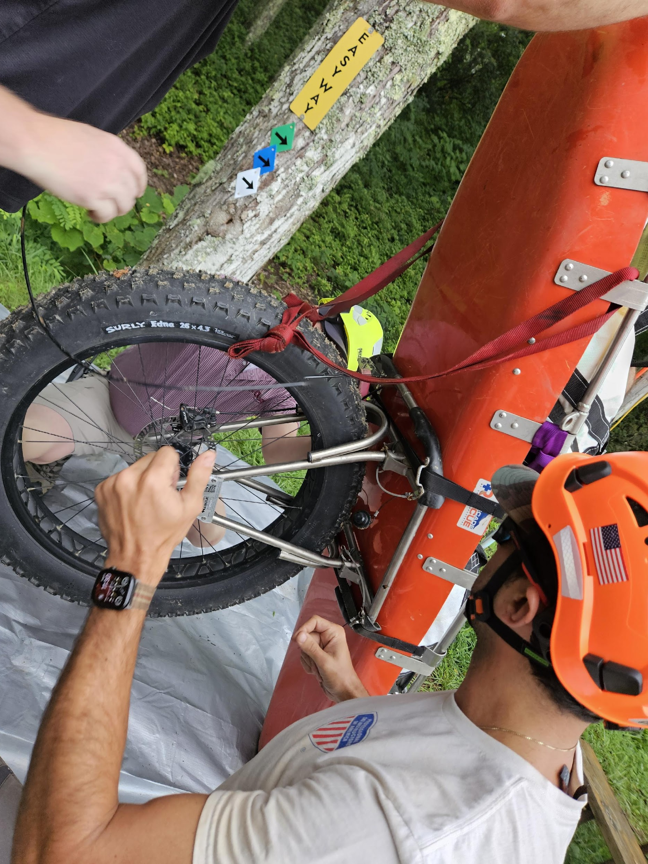
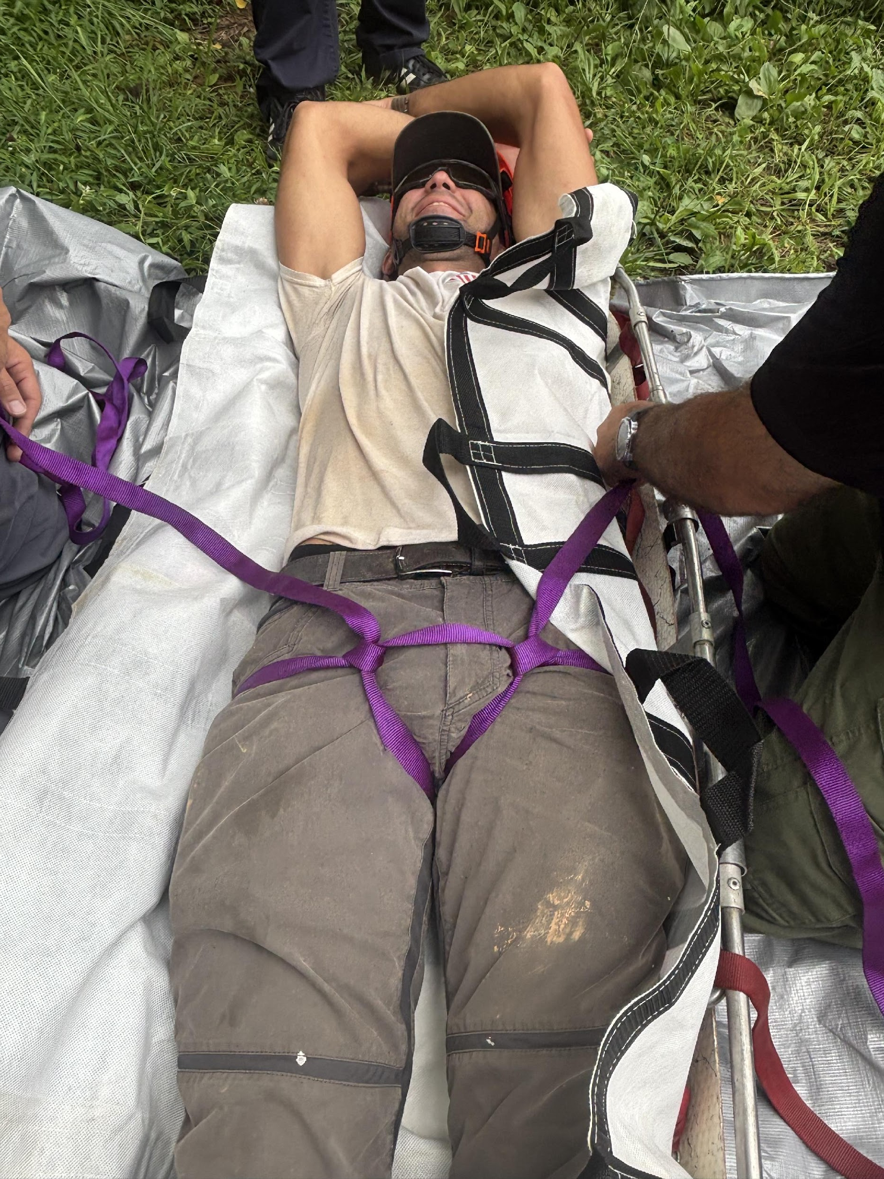
PROCEDURE
Patient should be assessed by medical staff and stabilized for transport.
The Terra Tamer saddle should be secured to the Stokes basket.
A Mega-Mover can be used to move the patient to the Stokes basket.
A seat harness is tied to the patient and secured as needed.
The foot adjustment strap is used to help the patient self-support.
The red and black straps should be adjusted and secured.
The stokes basket should be lifted and the wheel assembly attached. Make sure pins are in place, pointing inward.
Equalizer handles can be placed at a position of comfortable use. The brake should be attached to the head end of the Stokes basket on the equalizer handle.
Check and secure loose straps.
Notes:
THE TERRA TAMER RESCUE WHEEL
The Terra Tamer rescue wheel, which looks a lot like a unicycle, is a giant obstacle-crushing 26- Ã— 4.25-inch single wide tire within a fork and frame saddle assembly that attaches to the bottom of a rescue litter. Although it is designed specifically for the Cascade rescue litter, the Terra Tamer saddle can also be attached to most name-brand litters on the market as long as the top rail isn’t wrapped in plastic. The top rail tubing must be 1 inch in diameter or less and must be exposed so the hooks can grasp onto it. The sealed-hub wheel also features a disc brake system, with cable and handle, that clamps onto the top rail of the litter or the extended handles when Cascade’s Equalizer system is used. The brakes help control the descent of a patient-weighted litter on any terrain with a 35° slope or less.
The rescue wheel and fork and the saddle comprise a two-piece system that is assembled or disassembled with four easy-to-remove locking pins. This allows the Terra Tamer to be stored on the apparatus or carried in a transport pack. It also allows the rescue litter to be moved using other traditional transport methods without the rescue wheel being attached. For example, the rescue wheel would not be needed with aerial operations. Or, if the litter were needed as a sled, you wouldn’t want the saddle attached underneath the litter because it would not be able to slide over or against rocky, uneven surfaces.
In scenarios where the Terra Tamer is going to be used right off the bat, turn the litter upside down and attach the saddle bracket to the bottom of the litter. It is positioned at the center of gravity or where the patient’s lower torso mass will rest in the litter. Release the four straps and hook them to the top rail. The ratchets tighten the straps, locking the saddle in place. It is similar to attaching a luggage rack to the top of your car. Turn the litter right side up and lift it up horizontally to attach the fork and wheel. Insert the fork and wheel unit into the saddle’s four receiving posts and secure it by inserting the locking pins. The brake cable is always attached to the wheel, so the handle simply needs to be connected to the top rail closest to the head of the litter. That’s it. You can begin to move the patient. If the patient is already packaged in the litter before attaching the rescue wheel, simply put the feet side of the litter down on the ground and lift the head side up 45 to 60 degrees. This exposes the underside of the litter so the saddle and fork can be attached in the same manner. A well-trained crew of three can attach the Terra Tamer rescue wheel in less than a minute.
The rescue wheel, which serves as a fulcrum over the center of gravity, supports the weight of the litter. The load and effort are equally balanced on both sides of the fulcrum. The litter requires minimal lifting by rescuers tending the litter. Rescuers maneuver the system by pulling and pushing while tilting and shifting the weight. Litter bearers lift only enough to take the weight off the rescue wheel so it can roll over obstacles and rough terrain, such as over logs and boulders. Using the laws of physics to work smarter and not harder greatly reduces firefighter fatigue and injury during litter rescue operations in rough and steep terrain.
THE EQUALIZER ADJUSTABLE LITTER HANDLE SYSTEM
We are all familiar with normal litter-bearing operations. Rescuers need to grasp or clip onto the top rail. The bodies and legs of the rescuers are often too close to the litter. Hand positioning can be awkward, and short strides are often needed because the litter constantly bumps into rescuers’ legs. It is difficult to get a team of four or six litter bearers to walk and stride in unison, especially when climbing or descending steep terrain. It always seems like an awkward evolution, and all it takes is for one person to slip and fall to stall the operation.
The Equalizer comprises four precision adjustable handles specifically designed for Cascade rescue litters but that can also be attached to many other name-brand litters on the market. They are designed to work in conjunction with the Terra Tamer rescue wheel. They attach to the head and foot corners of the litter and extend horizontally approximately 32 inches. This provides litter bearers with much more room to work away from the edges of the litter, which allows better footing, balance, and maneuvering while still maintaining control of the patient. Since the weight of the litter is supported by the rescue wheel (and not the Equalizer handles), rescuers can use the handles to apply upward and downward pressure on the litter, which increases maneuverability while reducing rescuer effort. The handles also allow weight balance to easily shift back and forth, which allows for two-person carry-out patient removal with relative ease. The extended handles allow for better control on rocky descents and require less physical rescuer effort on difficult uphill slopes. It’s more a matter of pushing and pulling instead of lifting and carrying. When using the Equalizer system, the rescue wheel’s brake lever attaches to one of the head side handles to control the descent.
Quick-release locking pins allow the handles to be adjusted in 24 different positions. This is extremely beneficial to accommodate different size rescuers or to adjust for uneven rescuer height when ascending or descending steep slopes. The handles can even be adjusted straight down to a sawhorse position, supporting the entire weight of the litter off the ground just like an elevated bed. This would be beneficial when teams need to rest or switch out. It can also be useful to keep the patient level above water or snow while waiting at the landing zone for a helicopter to arrive.
https://www.fireapparatusmagazine.com/fire-apparatus/rescue-trucks/terra-tamer-rescue-wheel-and-the-equalizer-system/

Slide 14
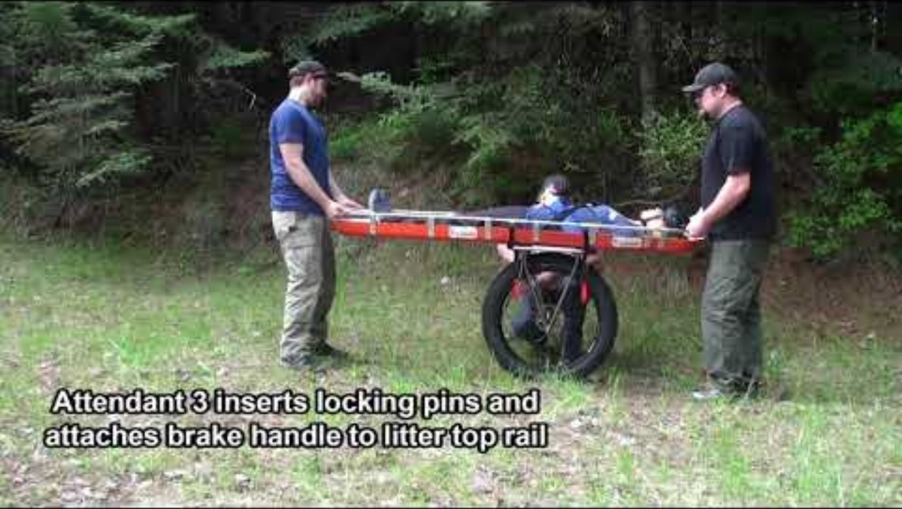
TERRA-TAMER IN ACTION

Slide 15
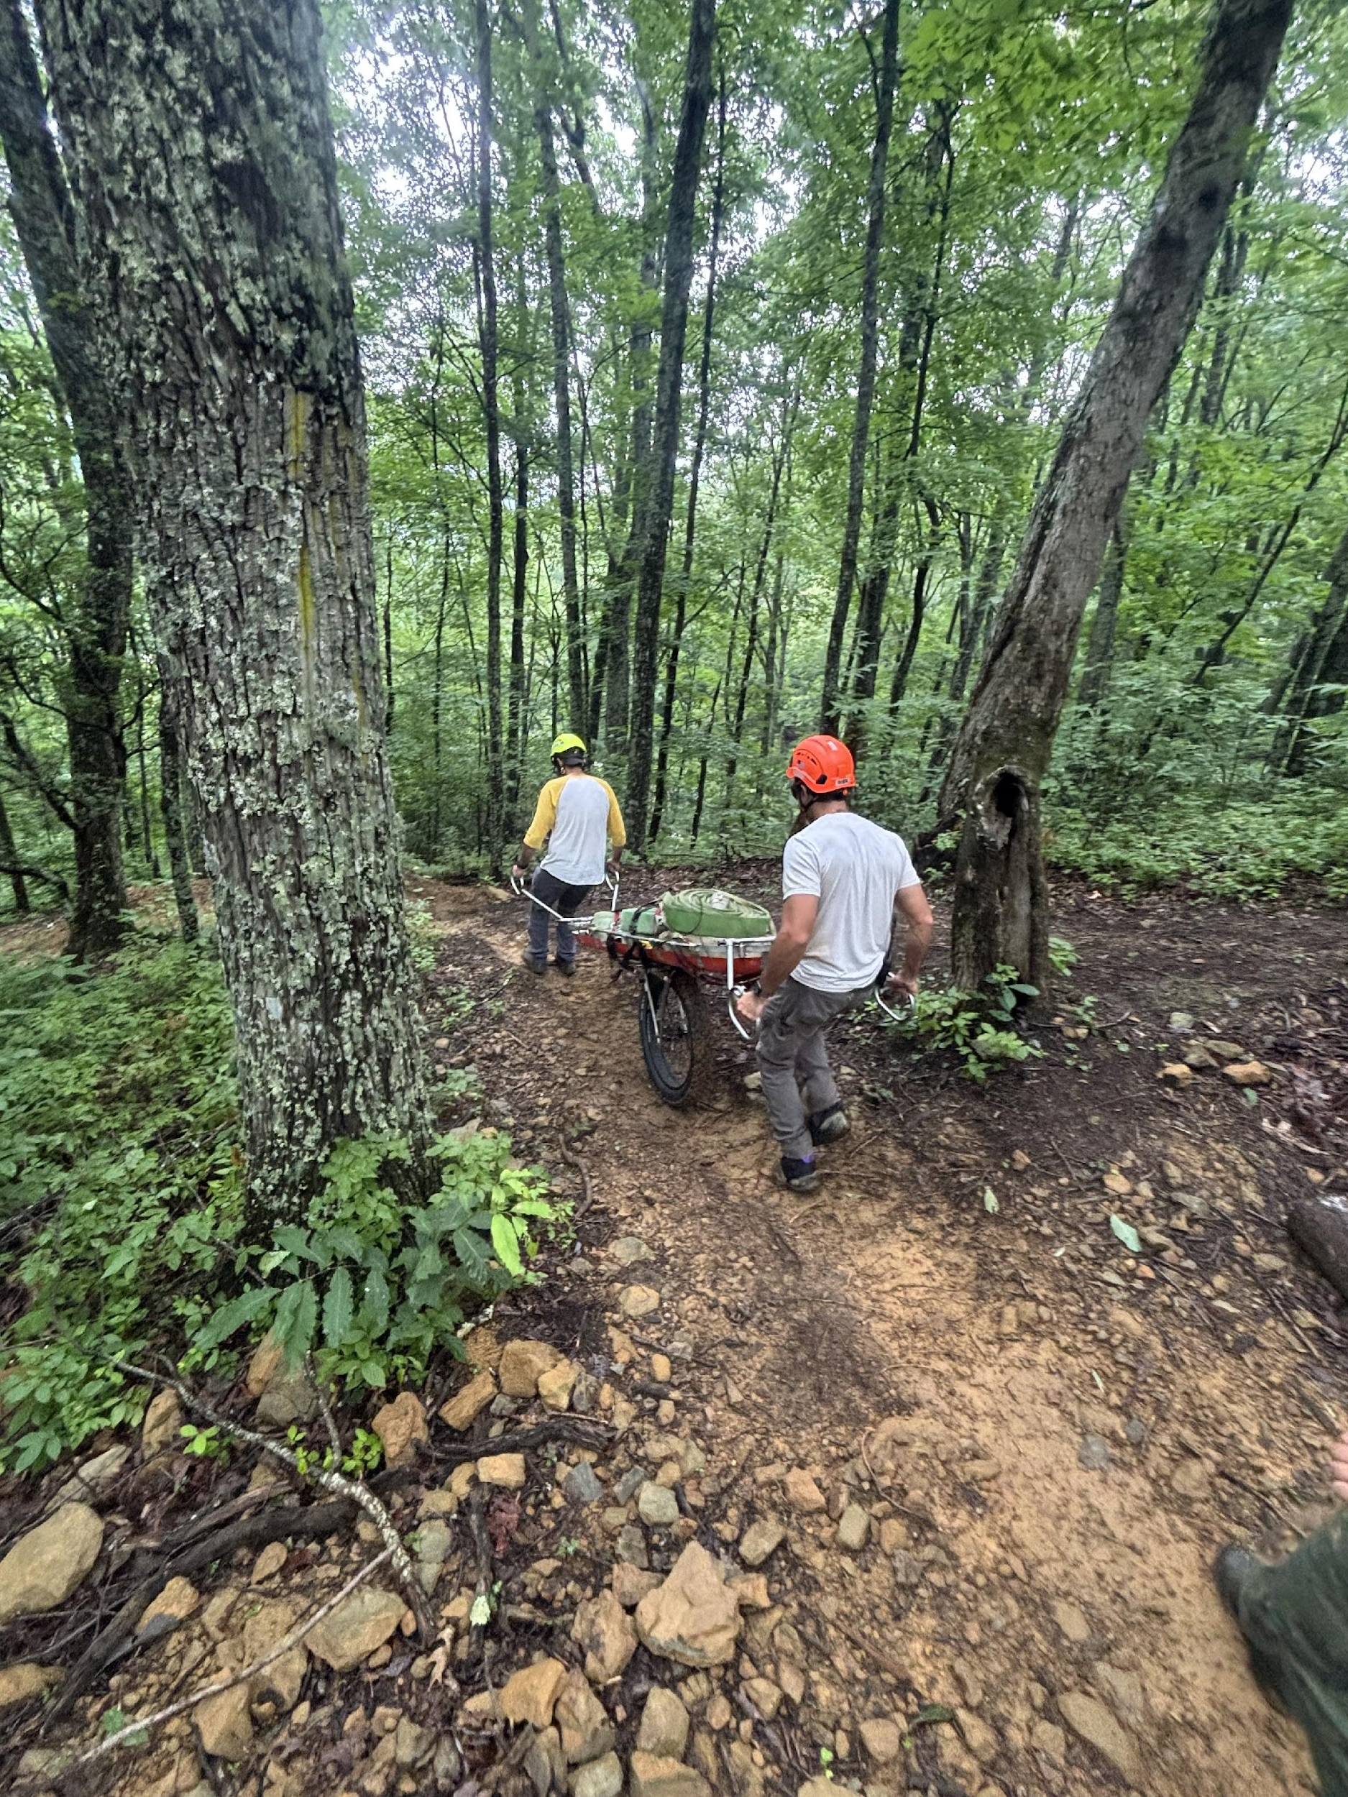
THANK YOU
Revision August 2025

