Slide 1

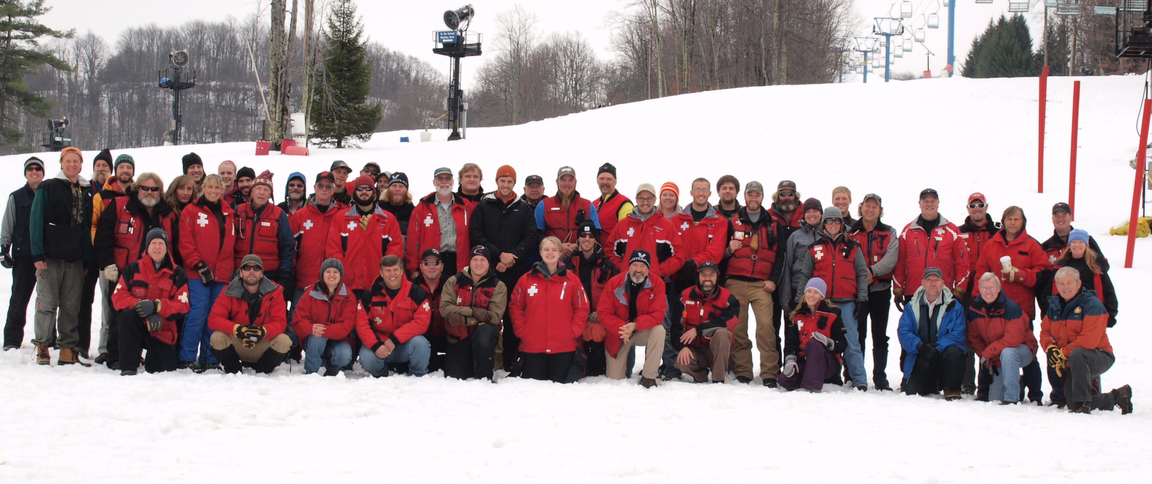
Leadership Development Overview
Notes:
Intro
Tom Wagner, Southern Division Leadership Coordinator. I have been a patroller for 37 years. Have served as a Patrol Representative, Assistant Patrol Director, Patrol Director, WV assistant and WV regional director, Senior program coordinator, and Resort Vice President.
At the Patrol Conference in 2023 Mary Lou Legg asked if I would be able to create a presentation on Leadership Development. I call this “Starting the Discussion”.

Slide 2
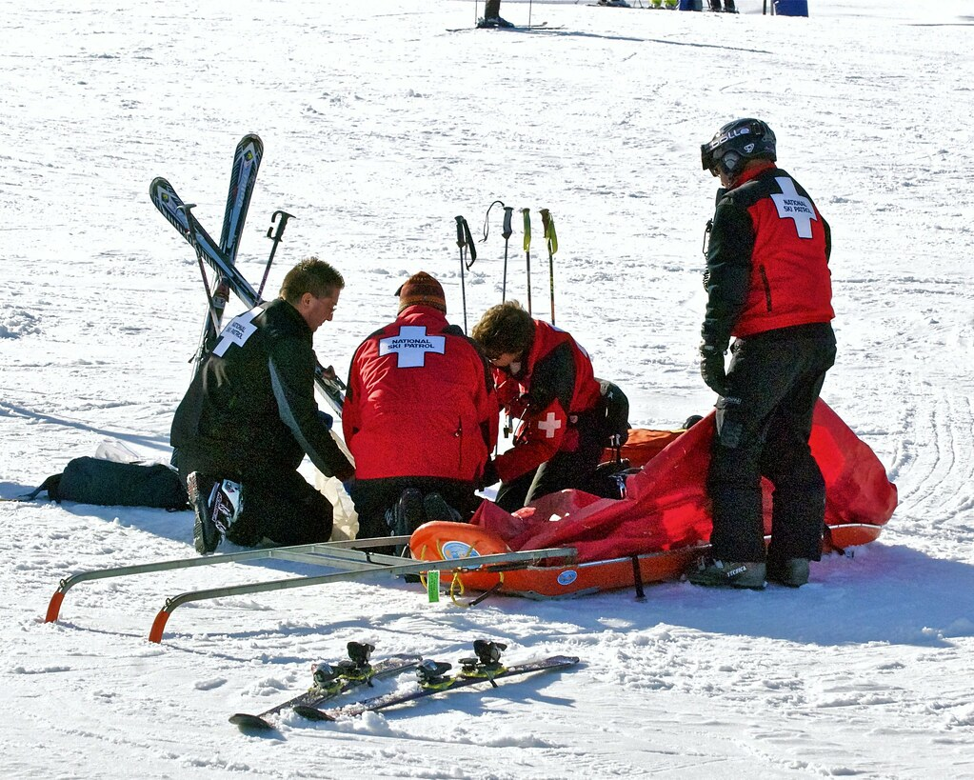
Starting the discussion:
Leadership Development
Southern Division Patrol Conference 2023
Low unemployment
59% of all ski resorts were short-staffed
Patrols challenged
Recruitment
Retention
Leadership Development
Notes:
At the time, nationally, the country had Low unemployment, and 59% of all ski resorts were short-staffed.
Patrols were challenged with Recruitment, Retention, and Leadership Development.
These are three topics that are discussed at every patrol and in every organization today.
From the 2023 presentation, 3 points came to the surface.

Slide 3
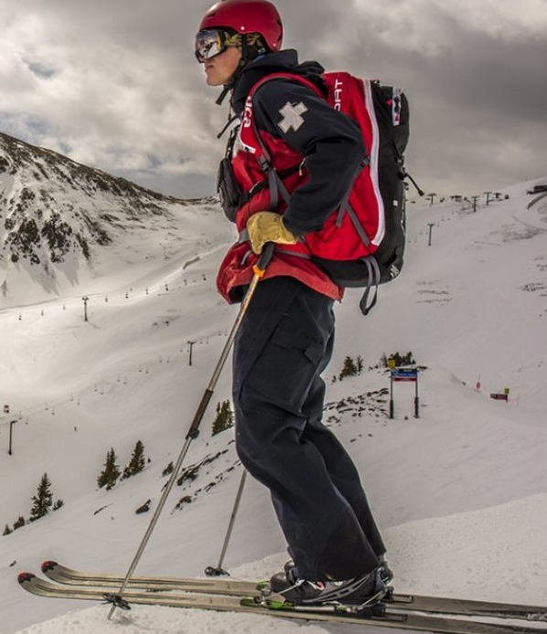
THREE take aways from 2023 leadership presentation
WE ALL NEED TO ASK OUR PATROLS AND OUR RESORTS “HOW CAN I HELP”
HELP PATROLLERS SET GOALS AND LEARN THE PATROL CULTURE ( be the coach)
START LOOKING FOR YOUR REPLACEMENT TODAY
Notes:
We are part of the solution – We need to ask our patrols and resorts “ How Can I Help?”
We need to help our patrollers set goals and learn the Patrol culture ( be the coach)
Start looking for our Replacement Today

Slide 4
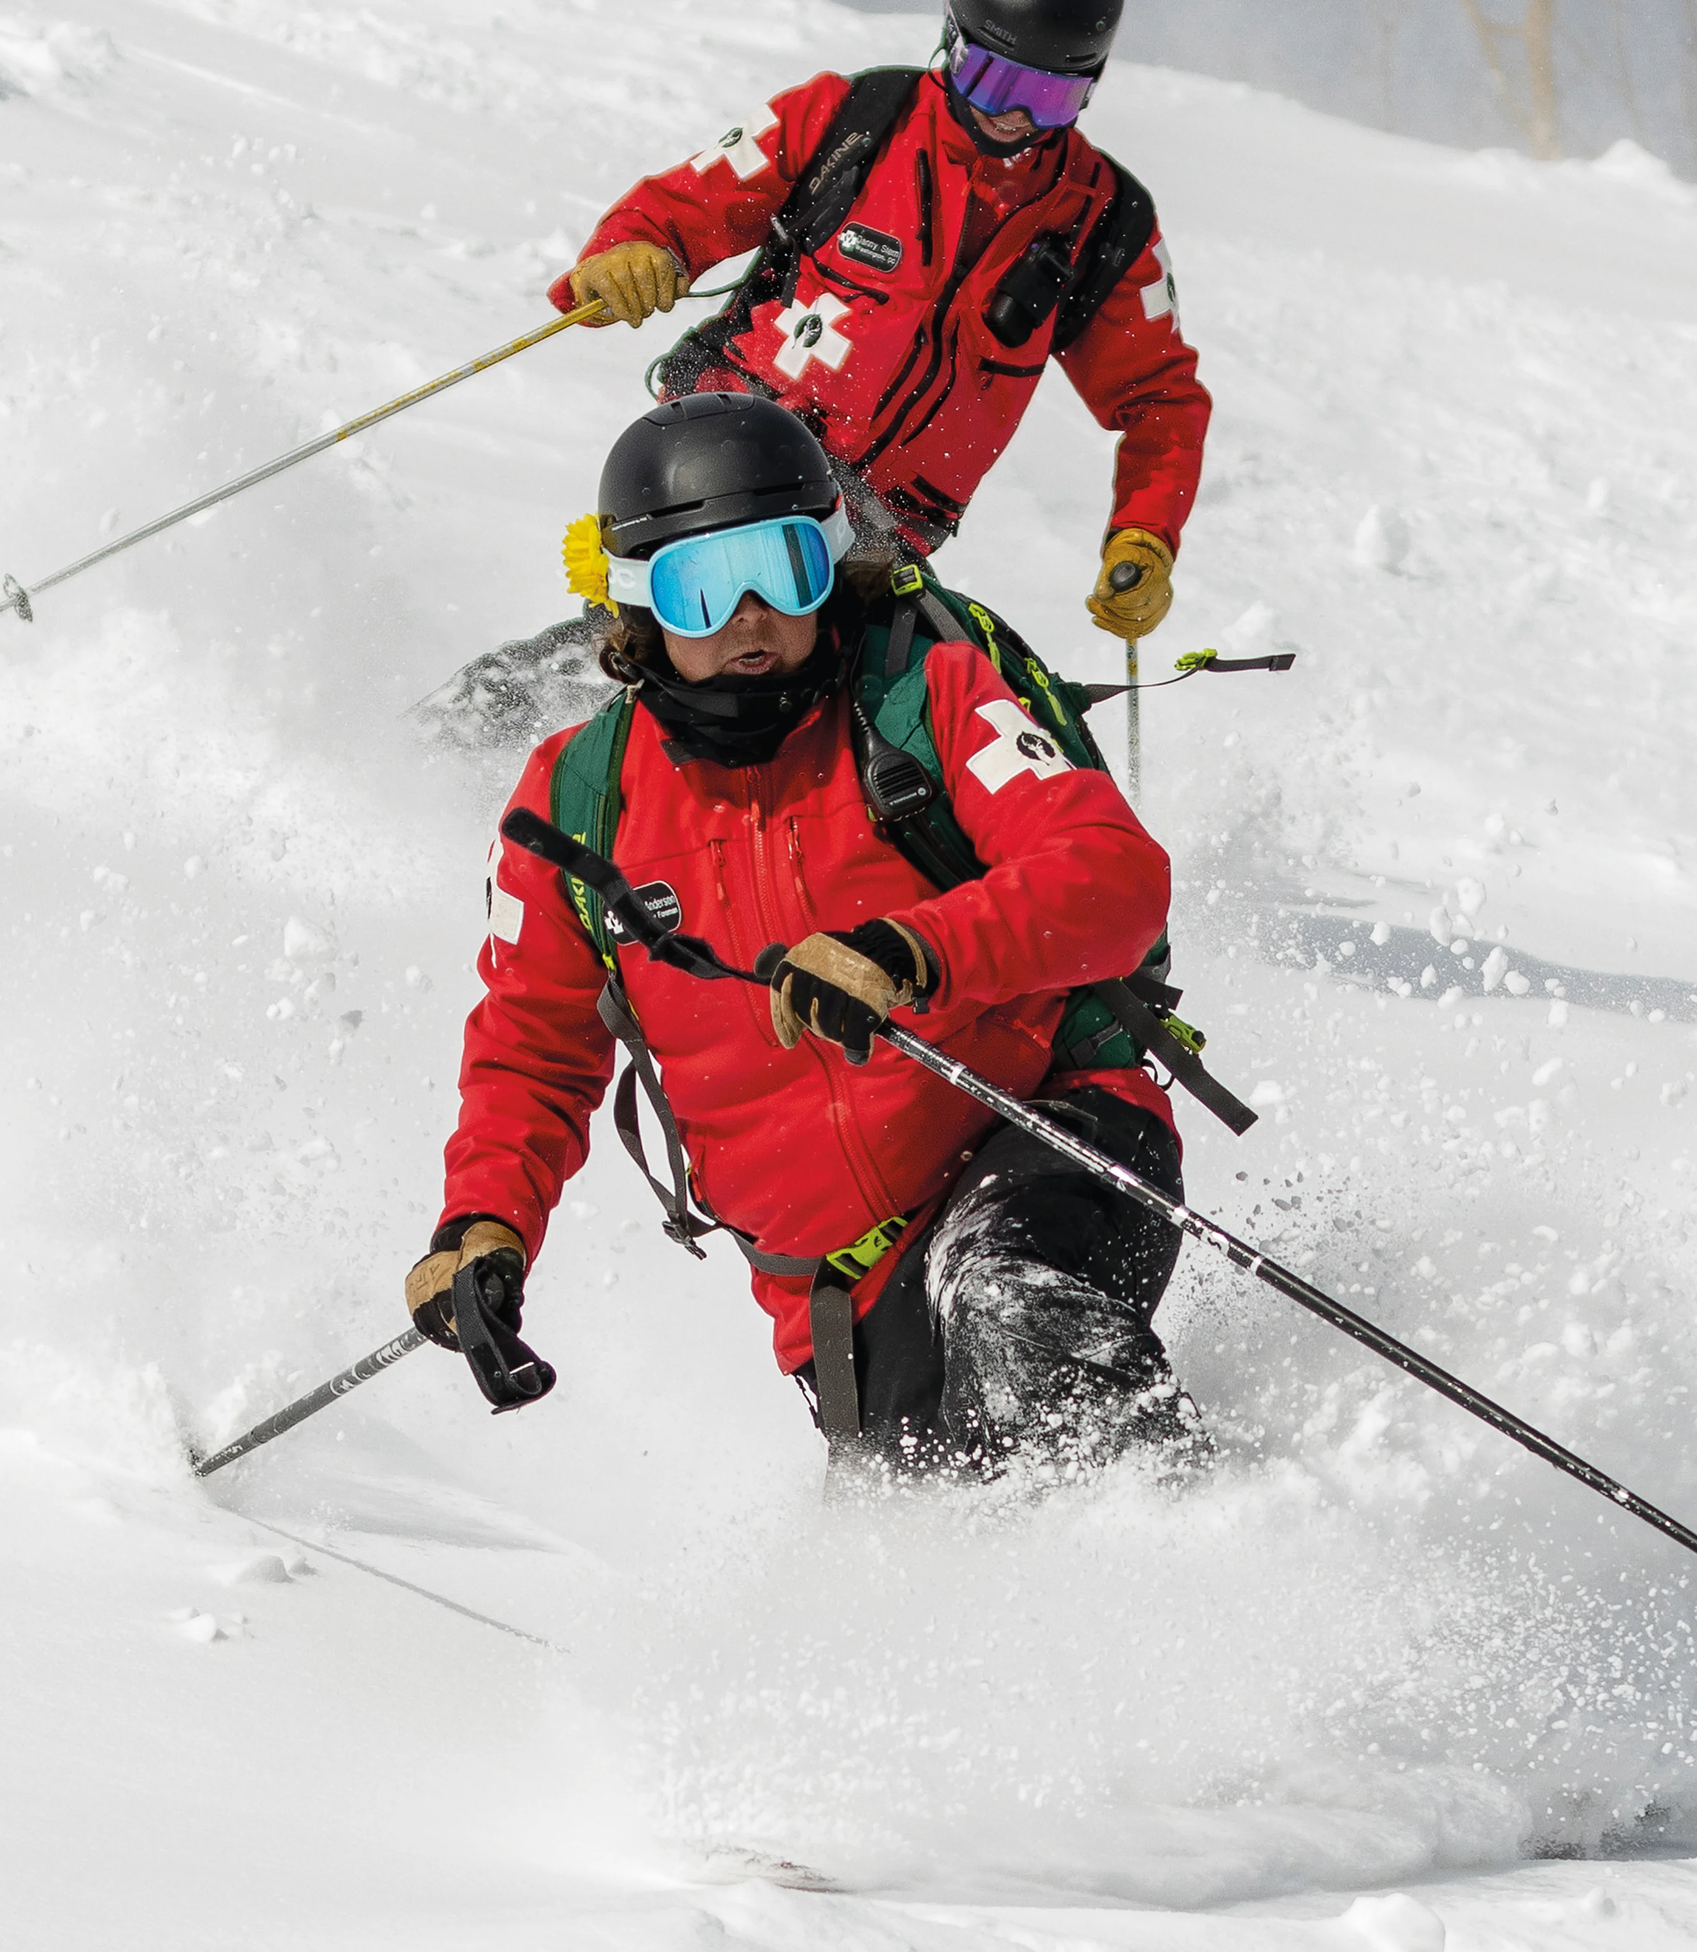
Nationally, NSP leadership identified the need to;
Prepare emerging leaders for increasing responsibility
Embed structured succession planning into NSP culture
Preserve institutional knowledge and convert to leadership acumen
Strengthen ethical and values-based leadership across all membership types
Ensure continuity across patrol, region, division, and national levels
Notes:
As mentioned, nationally resorts were facing labor shortages across all departments. Nationally, the NSP leadership recognized in more detail the need to;
Prepare emerging leaders for increasing responsibility
Embed structured succession planning into NSP culture
Preserve institutional knowledge and convert leadership acumen
Strengthen ethical and values-based leadership across all membership types
Ensure continuity across patrol, region, division and national levels

Slide 5
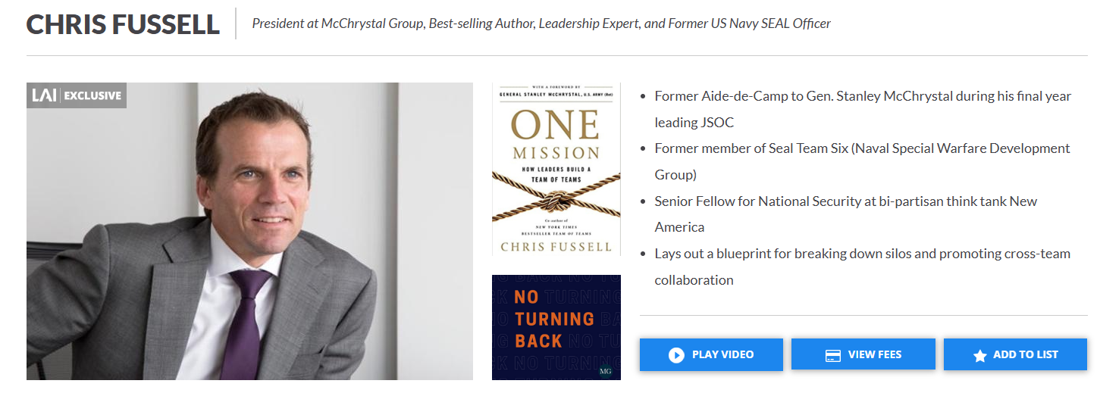
2024 Patrol Confrence
Notes:
In the 2024 Patrol conference we brought in Chris Fussell – President at the McChrystal Group / Best-selling Author / Leadership Expert and Former US Navy SEAL Officer.

Slide 6
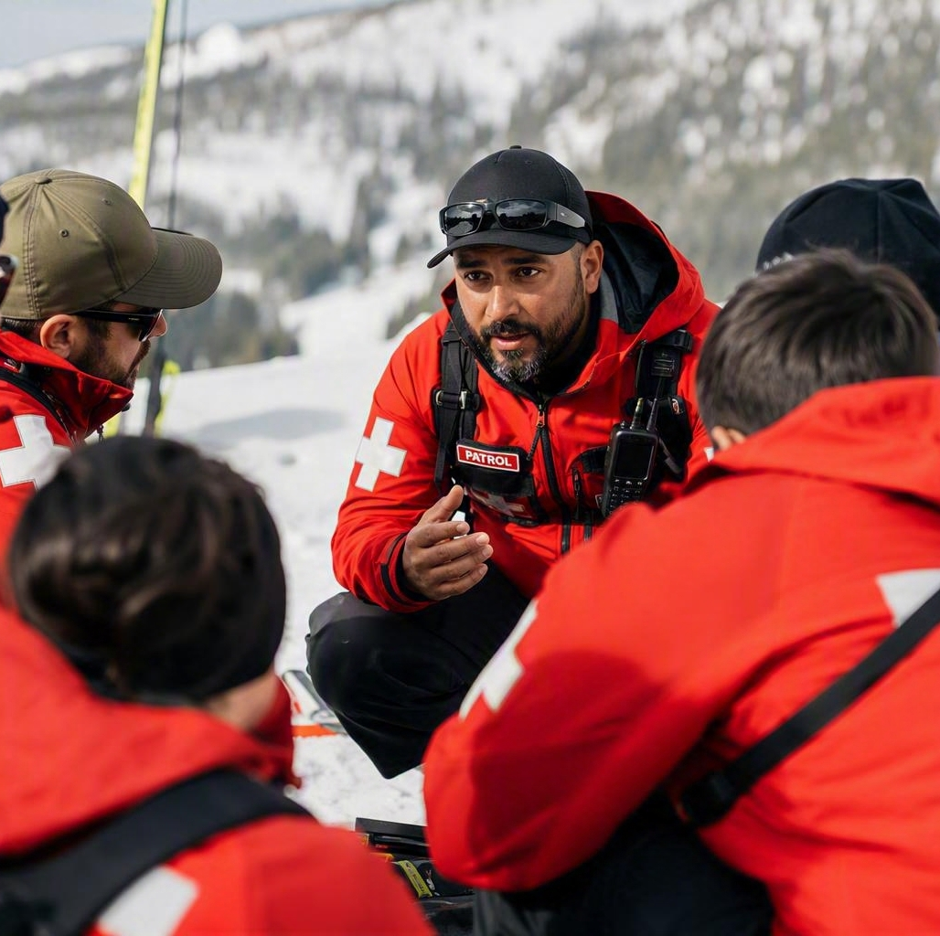
Servant Leadership
Leadership that prioritizes serving others, focusing on the growth and well-being of individuals and communities rather than on the accumulation of power and control.
Notes:
Chris introduced us to Servant Leadership.
Leadership that prioritizes serving others, focuses on the growth and well-being of individuals and communities rather than on the accumulation of power and control.

Slide 7
10 principles of Servant Leadership
Listening
Empathy
Self-awareness
Persuasion
Conceptualization
Foresight
Stewardship
Commitment to the growth of people
Building a community
Notes:
Including the 10 principles

Slide 8
2025
Course Content / 38 chapters
CHAPTER 1 Attributes of an Effective Leader
CHAPTER 2 Manager vs. Leader
CHAPTER 3 Leadership Theory
CHAPTER 4 Leadership Without Authority
CHAPTER 5 Lead by Example: The Power of Demonstrative Leadership
CHAPTER 6 Communication
CHAPTER 7 Relationship Management
CHAPTER 8 The Importance of Emotional Intelligence in Successful Leadership
CHAPTER 9 Ethics in Leadership
CHAPTER 10 Managing Change as a Leader
CHAPTER 11 Time Management
CHAPTER 12 Effective Delegation
CHAPTER 13 Accountability and Leadership
CHAPTER 14 Negotiation and Leadership
CHAPTER 15 Basic Project Management
CHAPTER 16 Continuous Improvement
CHAPTER 17 Technology Management and Tools for Leaders
CHAPTER 18 Succession Planning and Mentoring
CHAPTER 19 Organizational Culture and Politics
CHAPTER 20 Meeting Facilitation
CHAPTER 21 Creative Problem Solving
CHAPTER 22 SMART Goals
CHAPTER 23 Risk Management and Leadership
CHAPTER 24 Not-for-Profit Budgeting
CHAPTER 25 Social Media and Leadership
CHAPTER 26 Leadership in Volunteer Organizations
CHAPTER 27 Building and Leading a Team
CHAPTER 28 Leadership and Team Wellness
CHAPTER 29 Understanding Bias in Leadership: A Path to Fairness and Effectiveness
CHAPTER 30 Leading Multi-generational Teams
CHAPTER 31 Young Adult Leadership
CHAPTER 32 Women in Leadership
CHAPTER 33 Inclusive Leadership
CHAPTER 34 The Role of Mentoring in Leadership Development
CHAPTER 35 How to be a Strategic Leader
CHAPTER 36 Know Your Organization
CHAPTER 37 Code of Conduct
CHAPTER 38 Your Next Steps
Notes:
Last year, 2025, we were introduced to the NSP leadership course. This included 38 chapters covering topics such as attributes of an effective leader, Creative problem solving, and next steps, to name a few.

Slide 9

Module example
Chapter 22
SMART GOALS
Notes:
Last year we did a walkthrough of a Module Example (ch 22) on how to set SMART goals.

Slide 10
2026
Leadership Development Overview
A continuous journey of growth, practice, and real–world application
Notes:
Course Description: Leadership means different things to different people. Ask ten individuals to define it, and you’ll likely hear ten unique perspectives.

Slide 11
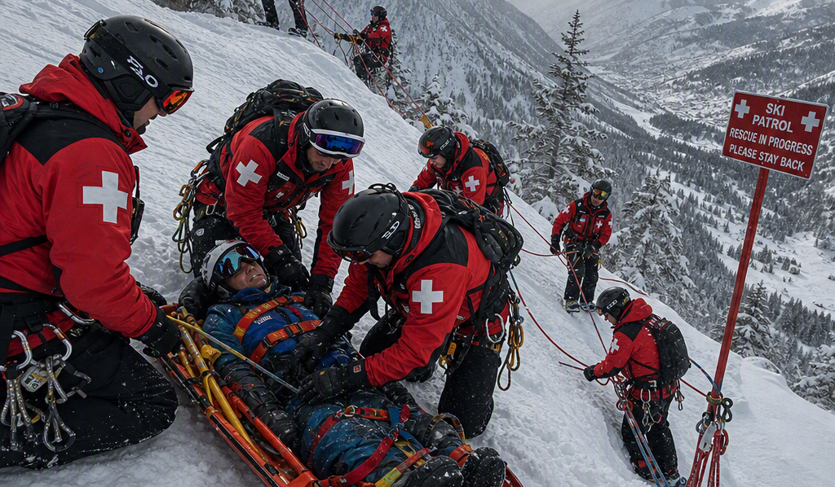

.
NSP LEADERSHIP DEVELOPMENT
“
Leadership is not a single skill or title — it is a set of behaviors, mindsets, and practices shaped by experience, context, and responsibility.
Effective leadership looks different across roles, environments, and moments in time.
Notes:
Leadership is not a single skill or title, it is a set of behaviors, mindsets, and practices shaped by experience, context, and responsibility. Effective leadership looks different across roles, environments, and moments in time.
Much like learning to ride a bike or manage a toboggan, leadership skills are refined through practice, reflection, and real-world application. Growth happens when ideas are tested, adjusted, and revisited over time. This course is designed to support that ongoing process.

Slide 12
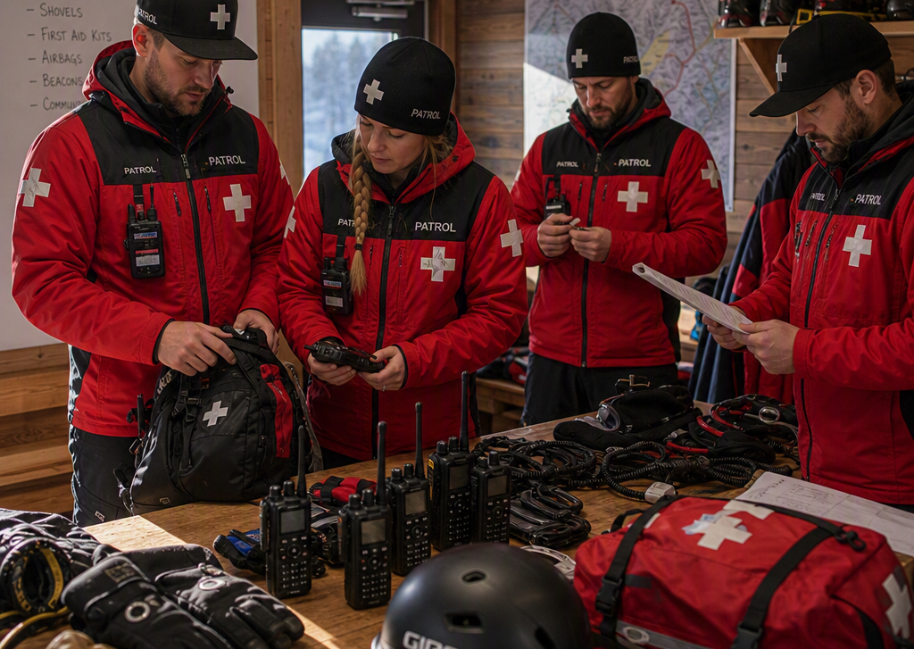
Course Overview
Framework not a formula, not a rigid, one-size-fits-all prescription.
Continuous journey: growth is ongoing, not a one-time event.
Designed for all levels, accessible to new and seasoned leaders alike.
Built for NSP but applicable beyond the NSP, relevant everywhere.
Intentional repetition. Inviting a deeper dive into the concept.
Notes:
The Leadership Development course provides a broad, high-level survey of leadership concepts drawn from the Leadership Development Manual. Rather than serving as a step-by-step “how to guide” the course offers:
A framework, not a formula; it's not a one-size-fits-all prescription
Provides for a continuous journey; growth is ongoing, it's not a one-time event.
Designed for all levels, accessible to new and seasoned leaders alike.
Applicable beyond NSP, built for the NSP but relevant everywhere.
Intentional repetition signals the topic's importance and invites a deeper dive into the concept.

Slide 13

Questions to ask when taking the course
How will you apply what you learn to improve your leadership skills?
Which track or units best support your current role and goals?
How will this course better support your continued leadership development?
Notes:
Questions you need to ask yourself before taking the course
How will you apply what you learn to improve your leadership skills?
Which track or units best support your current role and goals?
How will this course better support your continued leadership development?

Slide 14
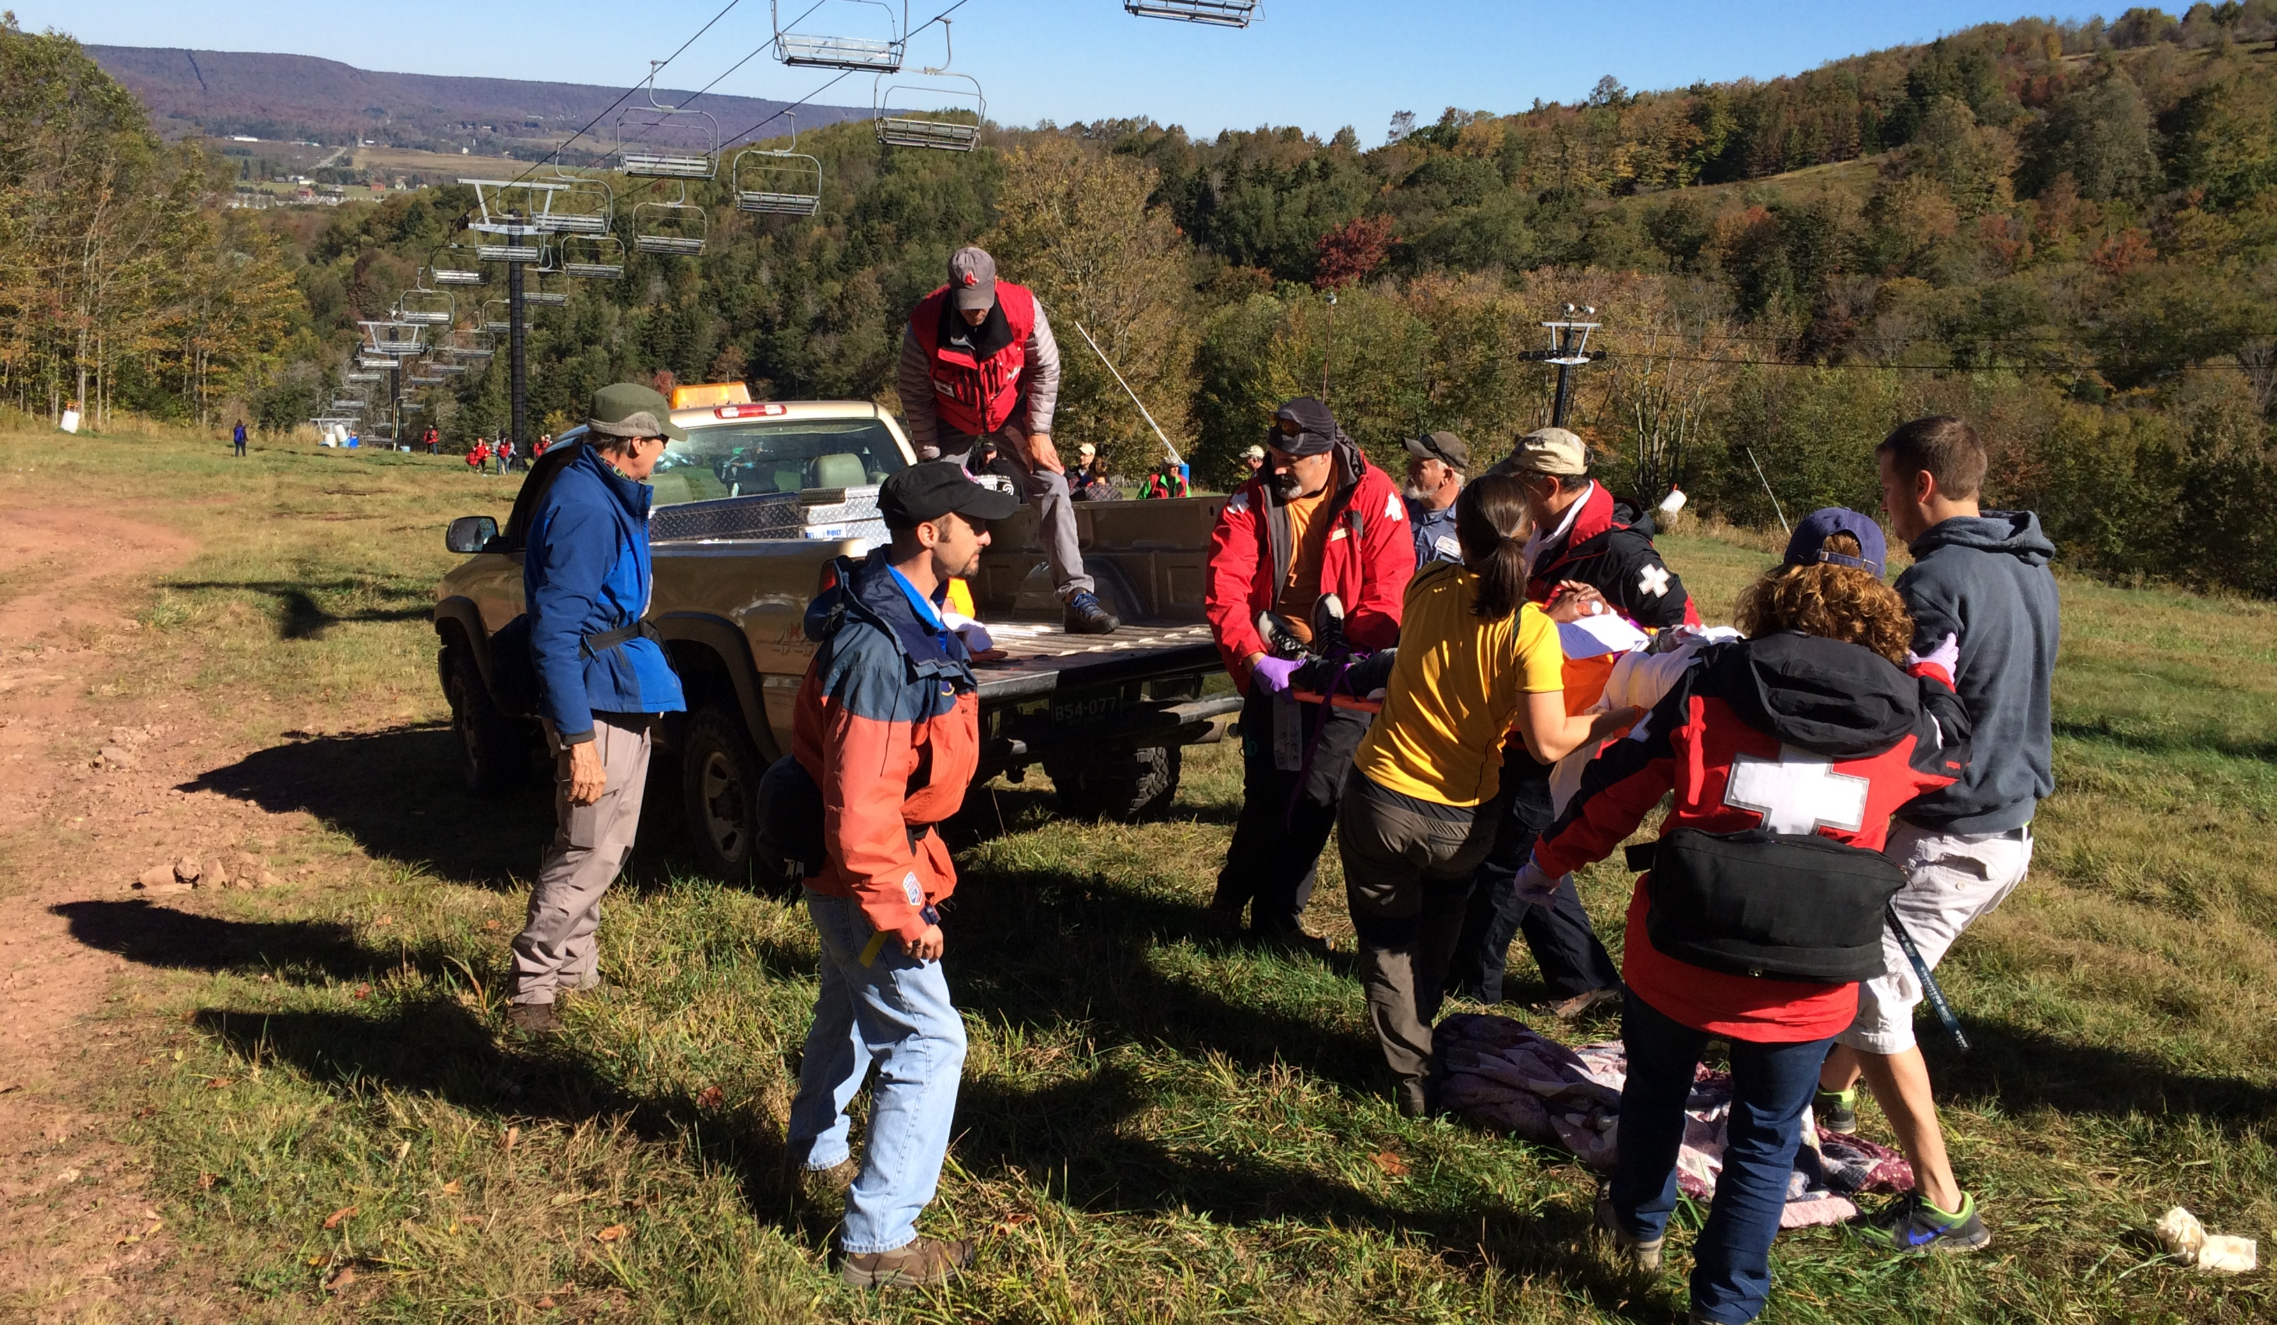
10 leadership tracks for your patrol journey
Intro to Leadership Foundations and Principles
Build a strong, shared foundation in leadership thinking and behavior
Communication Skills
Strengthen the communication behaviors that underpin effective leadership
Team Leadership
Lead People effectively in team–based environments
Strategic and Organizational Leadership
Think beyond immediate tasks to long-term alignment
Applied Leadership for Change
Apply leadership skills in dynamic, complex, and changing environments
Notes:
10 Leadership tracks for your patrol journey
Intro to Leadership Foundations and Principles
Build a strong, shared foundation in leadership thinking and behavior
This track is recommended as a starting point for all new leaders and as a refresher for experienced leaders seeking to reinforce fundamentals.
Communication Skills
Strengthening the communication behaviors that underpin effective leadership
Focus on core communication skills, active listening, giving and receiving feedback, managing difficult conversations, and facilitating productive discussions.
Tailor this track to focus on communication challenges most relevant to your role.
Team Leadership
Lead People effectively in team–based environments
Designed for leaders who work directly with teams and individuals.
This track is especially valuable for patrol leaders and others responsible for guiding volunteers or staff in operational settings.
Strategic and Organizational Leadership
Think beyond immediate tasks to long-term alignment
Strategic thinking, organizational awareness, decision-making, planning, and leadership at scale.
This track is particularly relevant for those working at regional, divisional, or organizational levels, or for those preparing to move into broader leadership roles.
Applied Leadership for Change
Apply leadership skills in dynamic, complex, and changing environments
Well-suited for leaders navigating transitions, growth, or evolving organizational demands and for those who want to strengthen their ability to lead effectively when conditions are not predictable.

Slide 15
10 leadership tracks for your patrol journey
  Administrative Roles: Regional Leadership, Division Directors
  Lead effectively across regions/divisions by aligning people, priorities, and operations
  Operational Roles: Patrol Directors/Reps
  Strengthen practical, day-to-day leadership for leading a patrol or unit
  NSP Directorial Leadership: BOD C-Suite Staff
  Provide governance-aligned leadership and strategic direction at the organizational level
  Instructional Leadership: Instructors, IORs, ITs, TEs
  Lead learning with credibility, consistency, and strong instructional influence
  Master Track
  Develop a comprehensive, well-rounded leadership skill set
Notes:
Administrative Roles: Regional Leadership, Division Directors
Lead effectively across regions/divisions by aligning people, priorities, and operations
This track is designed for leaders responsible for coordinating and leadership at the regional or division level.
Operational Roles: Patrol Directors/Reps
Strengthen practical, day-to-day leadership for leading a patrol or unit
This track is built to help patrol Directors/ Reps lead consistently, maintain strong relationships, and support performance in highly visible environments.
NSP Directorial Leadership: BOD C-Suite Staff
Provide governance-aligned leadership and strategic direction at the organizational level
Supports leaders who must set direction, steward resources and drive clarity and accountability across the organization.
Instructional Leadership: Instructors, IORs, ITs, TEs
Lead learning with credibility, consistency, and strong instructional influence
Ideal for instructional leaders who want to evaluate both their teaching effectiveness and their influence as role models within NSP.
Master Track
Develop a comprehensive, well-rounded leadership skill set
This track is ideal for learners seeking the most complete leadership development experience or those preparing for advanced or multi-level leadership responsibilities.

Slide 16
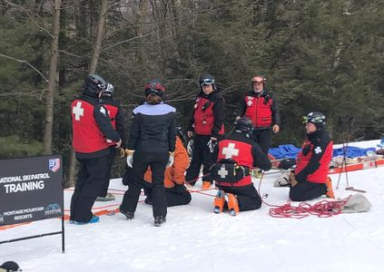
Every Module Delivers
Learning Objectives
Reflections Activities
Checklist of Definitions
Optional Deep Dives
Notes:
Every Module delivers
Learning Objectives
Refections Activities
Checklist of Definitions
Optional Deep Dive resources that invite you to learn more

Slide 17
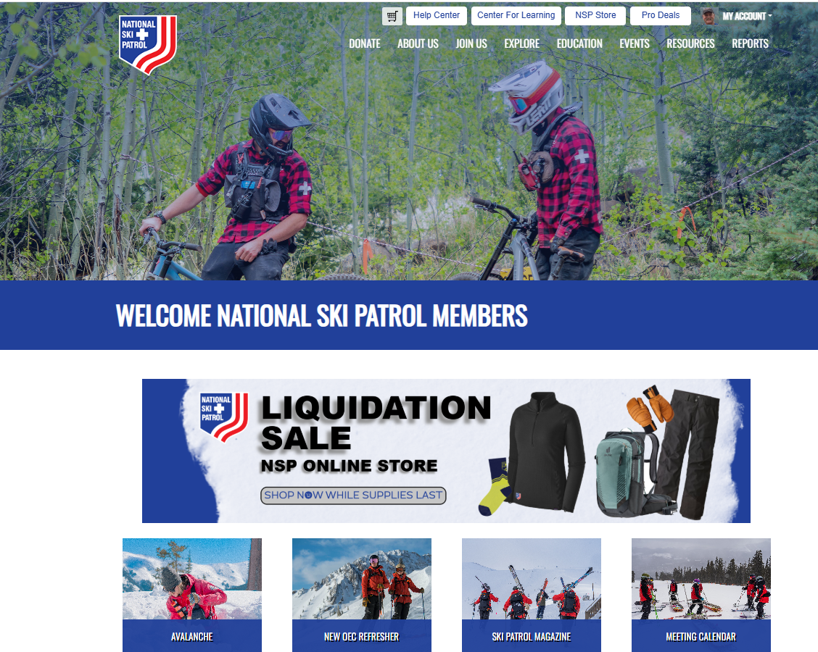
Where to find the course
Notes:
Where to find the course?
Sign on to the NSP website
Go to the Center for Learning

Slide 18
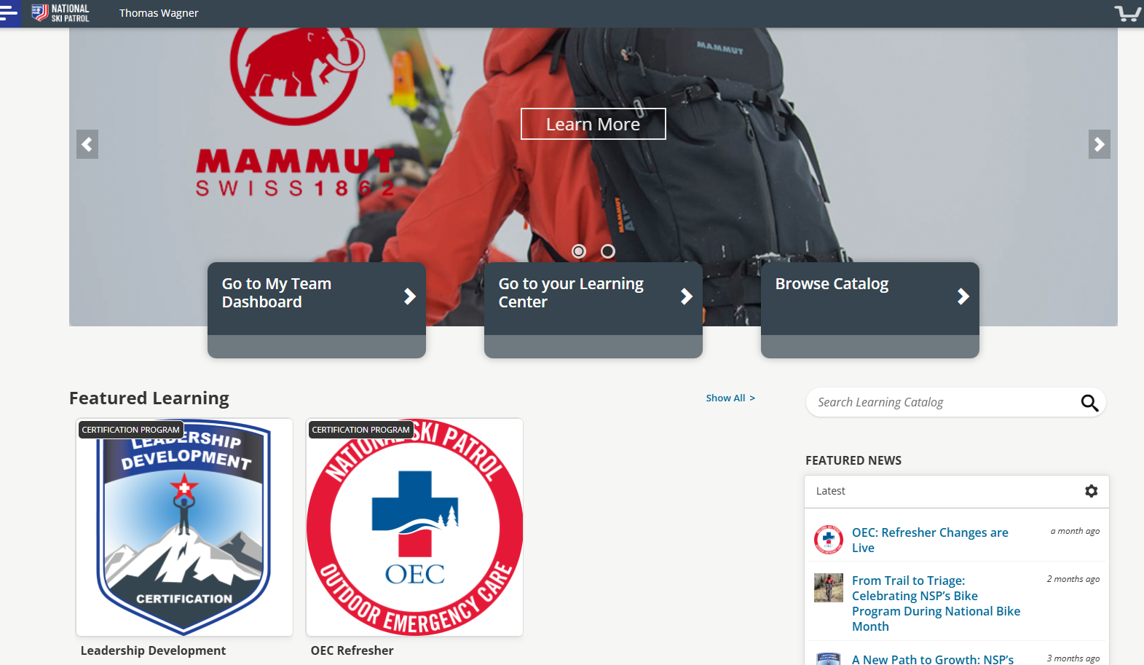
Notes:
Click on Leadership Development

Slide 19
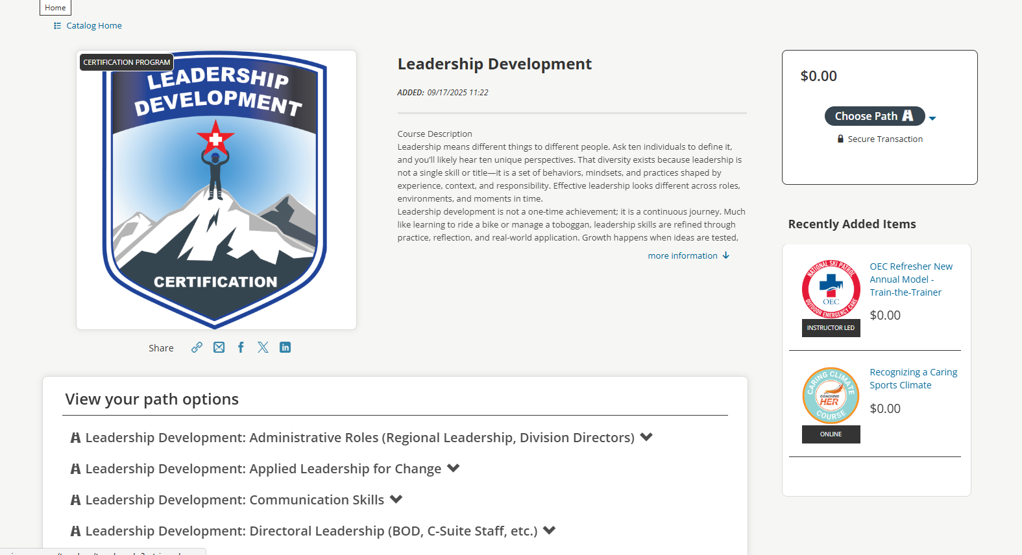
Notes:
Select the track you want to take

Slide 20
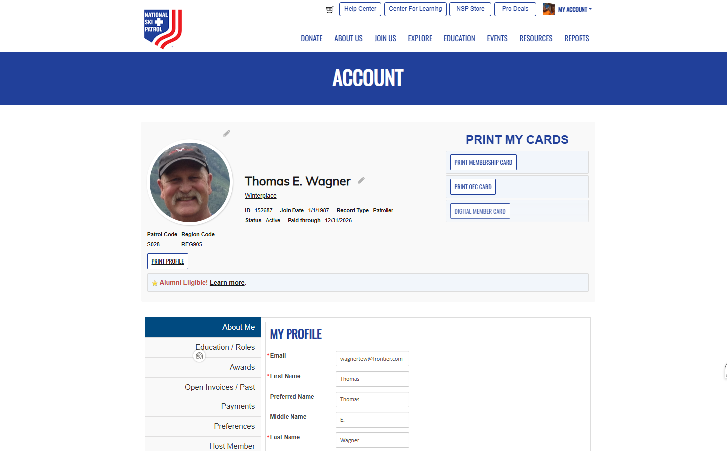
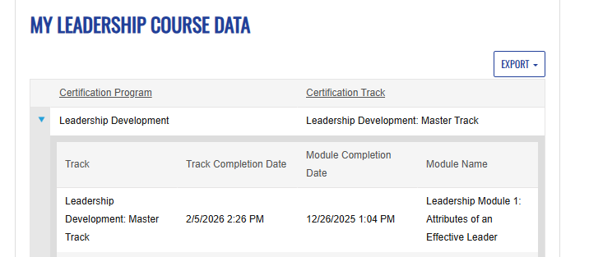
Completed courses become part of your record
Notes:
Select the track you want to take

Slide 21


LEADERSHIP DEVELOPMENT
Lead with Purpose.
Grow with Intention.
The NSP Leadership Development course is available now through the
NSP Learning Catalog at learning.nsp.org — free of charge for all members.
Self-paced & flexible
Role-based learning tracks
$0.00
— Free to all members
NATIONAL SKI PATROL · LEARNING.NSP.ORG
Notes:
Read the slide

